Slide 1
Roebling Museum Tour
Penn-Jersey Chapter ASSP
May 28, 2026
Roebling Museum tells the story of the origins and growth of Roebling, NJ, a company town built by John A. Roebling’s Sons Company. Some of the most important technological achievements of the industrial age, such as big bridges, telegraphs, telephones, electrification, deep mines, big ships, elevators, and airplanes, as well as everyday objects, were built in Roebling. For more information, go to: https://www.roeblinghistoricalsociety.org/roebling-history

Slide 2
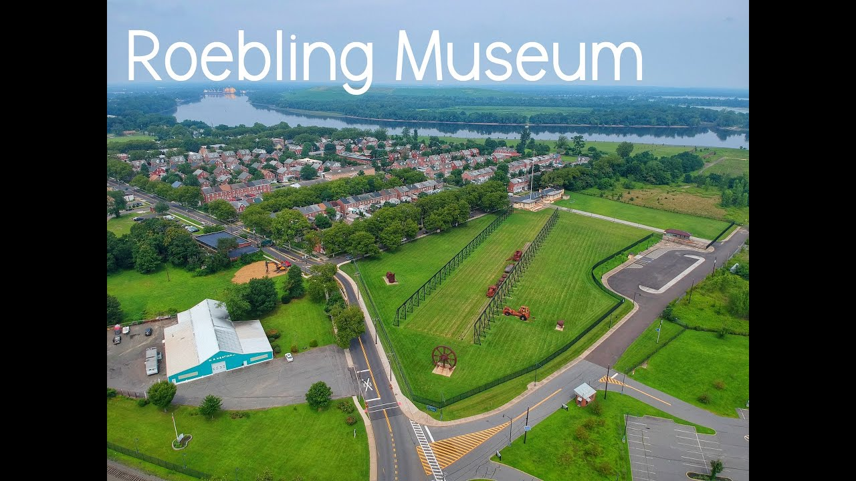

Slide 3

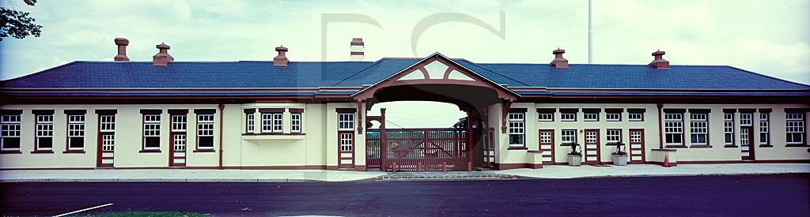
Roebling Museum
100 2nd Avenue, Roebling, NJ 08554
As a former gateway to a sprawling steel mill, the Roebling Museum building once served as the passage point for thousands of workers each day. Roebling Museum believes that the industrial development of the United States is best illustrated and understood through the experiences of the people who built our shared history.
Since opening our doors in 2010, Roebling Museum has offered a dynamic slate of programs, exhibits, and tours that emphasize and celebrate the experiences of those who lived in Roebling and worked for John A. Roebling’s Sons Company.
Notes:
Once visitors enter the museum, they are invited to watch an 18- minute video documentary of Roebling locals as they discuss life in Roebling and the Steel factory. Then, visitors walk through several exhibits about the Roebling family, workers of the factory, the creations of the factory, and life in the town. Various artifacts, including original cables from several bridges using Roebling wire, are on display. Afterward, learning about the Company and Town, visitors can walk around a small portion of the outside grounds to see some of the steel equipment. The Museum offers a unique history of New Jersey towns, which is worth exploring.

Slide 4
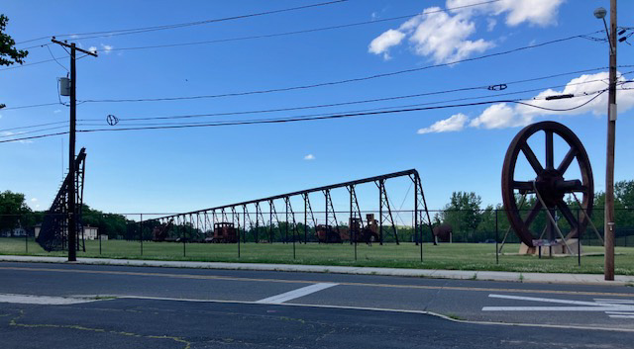
Remnants of the plant equipment in
Roebling NJ
In 1849, Roebling founded a steel wire manufacturing company in Trenton, New Jersey, on the western side of the Chambersburg area, chosen for its proximity to the Delaware and Raritan Canal, rail lines, and port connections.

Slide 5
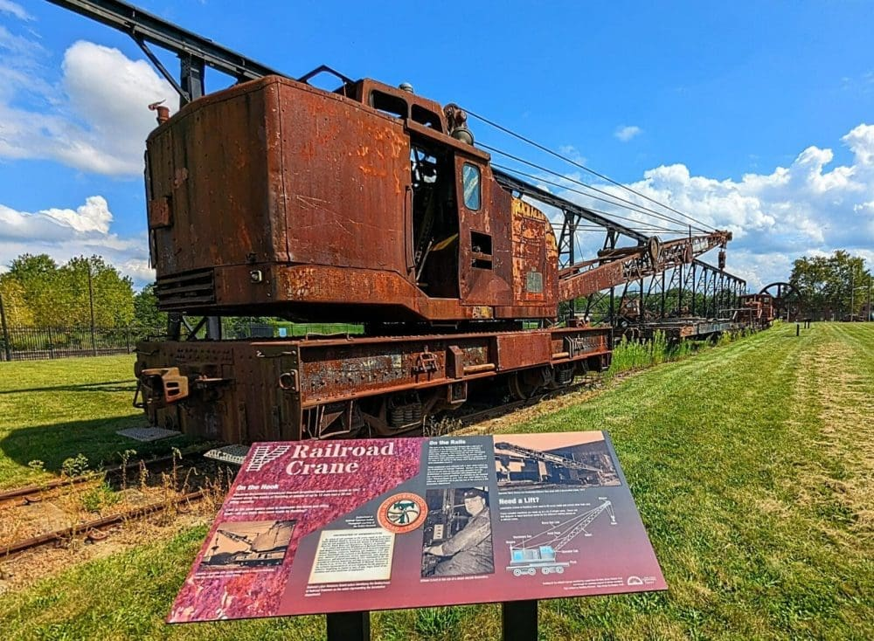
“The Railroad Crane outside the Roebling Museum”

Slide 6
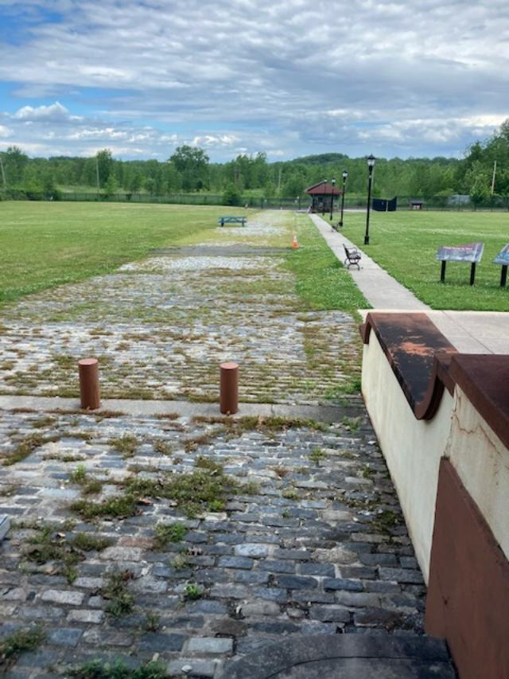
View from the museum to the location of the steel mill
Here, ideas and diverse cultures were exchanged through work, and the interactions of these communities changed the cultural and industrial landscape of New Jersey.
Roebling Steel Co is currently registered as an Active NPL superfund site by the EPA.
In 1904, when competition pushed them to start making their own steel, they bought farmland on the Delaware River and built the factory complex known as the Kinkora Works and the company town known as Roebling, NJ, for their workers.

Slide 7
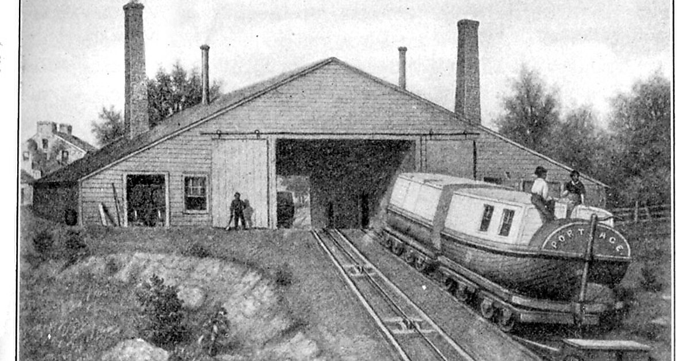
The first wire rope project of Roebling
Previously used 6” diameter hemp rope
that wore out quickly due to friction
The Allegheny Portage Railroad was the first railroad constructed through the Allegheny Mountains in central Pennsylvania, United States; it operated from 1834 to 1854 as the first transportation infrastructure through the gaps of the Allegheny that connected the Midwest to the eastern seaboard across the barrier range of the Allegheny. Approximately 36 miles long overall, both ends connected to the Pennsylvania Canal, and the system was primarily used as a portage railway, hauling river boats and barges over the divide between the Ohio and the Susquehanna Rivers.

Slide 8
Famous Bridges Built by the Roebling Company
The John A. Roebling Sons Company — founded by John A. Roebling and later expanded by his sons — was one of the most important engineering firms of the 19th and early 20th centuries, best known for its innovations in wire rope and suspension bridge construction. While the company did not “build” bridges directly, it supplied the cable systems and wire rope that made many of America’s most famous suspension bridges possible.
Key Bridges Using Roebling Wire Rope
John A. Roebling Suspension Bridge (Ohio River, 1867) – Spanning the Ohio River between Cincinnati, Ohio, and Covington, Kentucky, this was the longest suspension bridge in the world when it opened, with a 1,057-foot main span. It used Roebling’s patented “spun” wire rope cables, each containing thousands of individual wires.
Brooklyn Bridge (East River, 1883) – Designed by John A. Roebling and completed by his son Washington Roebling, this iconic suspension bridge connected Manhattan and Brooklyn. The Roebling Sons Company supplied the wire rope for its main suspension cables’
Other U.S. Suspension Bridges – Before 1950, Roebling wire rope was used in many major suspension bridges across the country, including the Brooklyn–Queens Bridge, Williamsburg Bridge, and others. The company’s manufacturing facilities in Trenton, NJ, and other locations produced the cables for these projects.
Roebling’s wire rope helped build San Francisco’s Golden Gate Bridge & George Washington Bridge

Slide 9
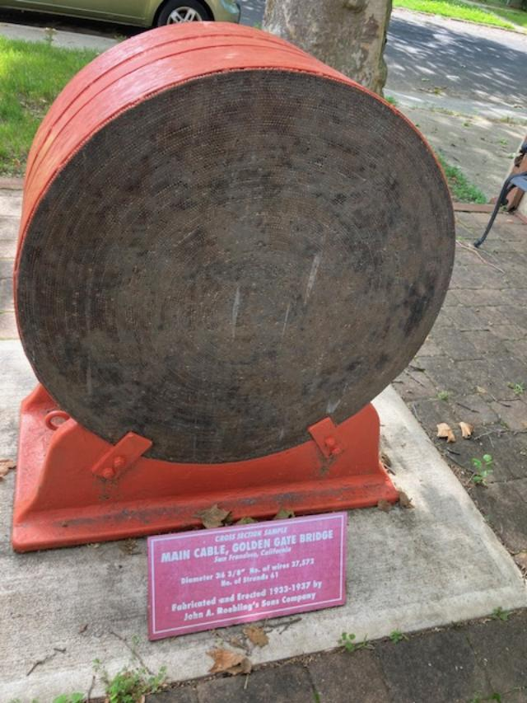
Golden Gate Bridge main cable cross-section
27,578 Individual wires

Slide 10
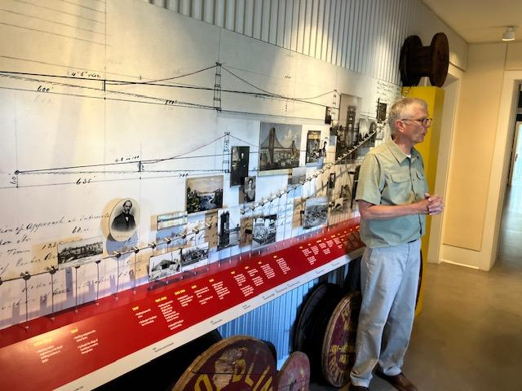
Great Docent explaining the timeline

Slide 11
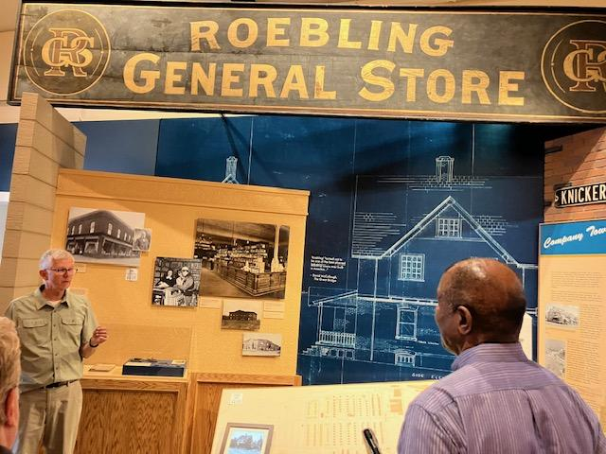
Sign from the original Roebling General Store
Having a great compassion for the welfare of the worker, despite the antipathy of some of his contemporaries, John’s son Charles created a model town along the lines of an English Tudor Village. It was a complete self-sustaining unit with brick houses for the workers, a hospital, schools, shops, a bank, & a theater to house a population of 4000. Completed in 1910, it contained every amenity known for the comfort, welfare, & recreation of the employee.
Notes:
The village of Roebling was conceived and executed by Charles G. Roebling, and it stands today as a very real and living monument to his engineering genius. John A. Roebling founded the Company. It had deep roots in Trenton, where it commenced operations in 1848, and John Roebling planned and made the wire rope for the Brooklyn Bridge, the first of a long line of majestic structures that included the latter-day Golden Gate and the George Washington.
In 1904, ground was broken for the mammoth steel plant that included a Steel Mill, a Blooming Mill, Rod Mills, Wire Mills, Cleaning Houses, Annealing and Tempering Shops and a woven wire Fabrics Factory.
Having a great compassion for the welfare of the worker, despite the antipathy of some of his contemporaries, John’s son Charles created a model town along the lines of an English Tudor Village. It was a complete self-sustaining unit with brick houses for the workers, hospital, schools, shops, bank and a theater to house a population of 4000. Completed in 1910, it contained every amenity known for the comfort, welfare, and recreation of the employee.
All the utilities were included: water, sewer, gas & later electric. The streets were lined with trees & the two main streets were boulevards with grass dividers that were filled with flowers that bloomed the colors of the rainbow from late spring to early fall. A riverfront park with a bandstand and benches was opened.
The new town soon had a station on the Pennsylvania Railroad and several stops for the trolley that ran from Trenton to Riverside.
Although it was a part of Florence Township, it was operated as an independent village with its own Mayor, Chief of Police & complete police force and fire department. A chain was connected once annually to concrete posts at each street entry to break off any claims of adverse use & to retain its identity as private property.
Charles Roebling loved his town, his factory and his people and got reciprocity from his workers who took pride in their homes, their streets & their lives. Charles loved green grass, flowers, trees, and shrubs and he would stop his carriage or car to pull a weed.
​The call was sounded for immigrants to work the mills and they came in droves from the Austro-Hungarian Empire, from Sweden, Germany and England to this village of opportunity. Other nationalities and blacks came later. They joined the cadre of Trentonians who started the mills.
Almost as soon as they got off the train from Ellis Island Charles Roebling made his presence-known and made them welcome.
Deeply religious, the newcomers needed a place of worship and space was provided until the congregations could provide their own. The Town Hall, above the drug store, was the meeting place for church groups and clubs. The company encouraged the immigrants to study English and become citizens. Tutors and instructor were provided to make certain that

Slide 12
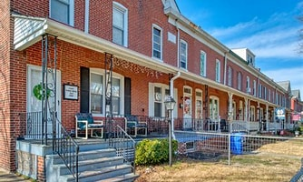
Some of the village houses in Roebling

Slide 13
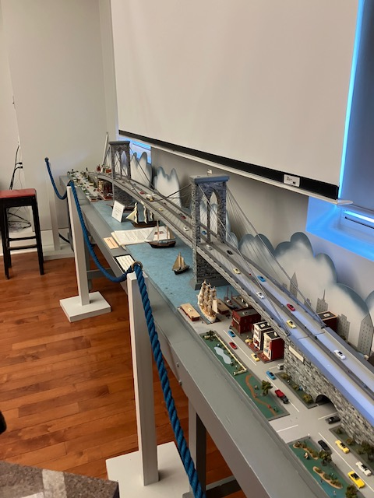
Auggie’s Brooklyn Bridge model
Long-time contributor to the museum, Auggie Pechinnie, built this educational scale model of the bridge and, for many years, took it to schools to describe the construction of the bridge. In 2016, he made a special evening presentation to our P-NJ ASSE chapter members here at the museum.

Slide 14
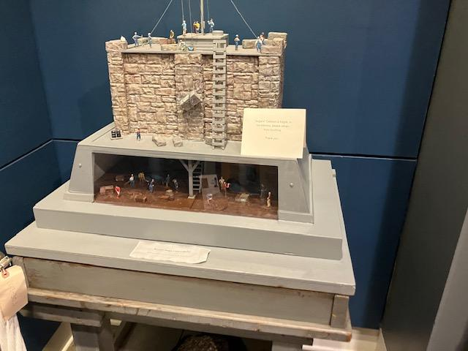
Auggie’s Caisson Model
A caisson is a box-like structure made of steel and reinforced concrete, designed to be sunk into the ground or underwater to serve as a foundation for bridges or piers. Its primary purpose is to transfer structural loads to deeper, more stable rock layers, while also keeping water out to allow safe and dry working conditions during construction.

Slide 15
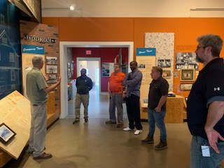
Fascinated by the docent’s stories
The innovations of John A Roebling’s Company were used to create advancements in telegraphs, telephones, ships, elevators, and airplanes.

Slide 16
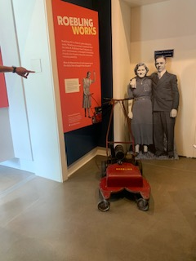
Roebling Company made Lawnmowers during hard times
Roebling lawn mowers are a rare and interesting footnote in the history of the Roebling family and their industrial legacy. The brand is tied to John A. Roebling’s Sons Company, a Trenton, New Jersey–based manufacturer of steel products and suspension bridges.
In the 1950s or early 1960s, the steel mill produced its own lawn mowers — a short-lived but notable foray into the lawn care market. These mowers were expensive at the time, reflecting the high-quality steel and engineering standards the Roeblings were known for. Production was limited to a few years, making them uncommon today.
318 and 322 models

Slide 17
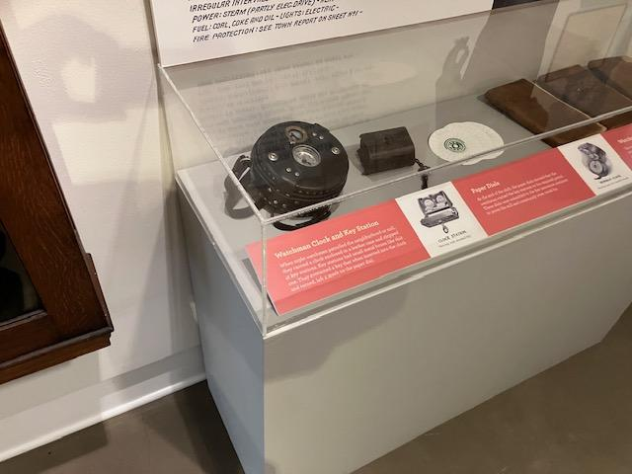
Security tour tools – internal police
Historical records indicate that security at the Roebling plant was a significant concern. Internal security at the Roebling plant was a critical concern during wartime, with documented sabotage incidents that prompted both physical and operational security measures to protect the facility and its workforce.
During World War I, the Roebling Company’s Trenton works were a major supplier of structural steel and wire for Allied war efforts, producing anti-submarine netting, artillery chains, and other armaments.

Slide 18
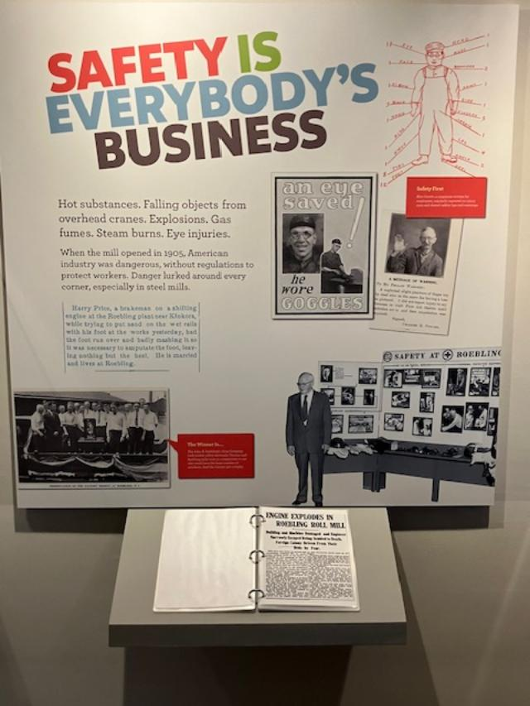
Roebling’s Safety Efforts

