Slide 1
OSHA Update
Danielle DiGironimo, CSP
Assistant Area Director – Marlton Office

Slide 2
ABOUT OSHA
Congress enacted the Occupational Safety and Health Act of 1970 (OSH Act).
OSHA's mission is to ensure safe and healthful working conditions.
Employees have rights and employers have responsibilities to protect them.
Most fatalities, injuries and illnesses can be prevented.
Even one preventable accident is one too many.
Notes:
Congress enacted the Occupational Safety and Health Act of 1970 (OSH Act), creating the Occupational Safety and Health Administration as a national public health agency dedicated to the basic proposition that employees should not have to risk their lives to earn a living.
When OSHA opened its doors, an estimated 14,000 fatal injuries occurred on the job – that’s an average of 38 lives lost on the job every day in America. Today, with a workforce almost twice as large, that rate has fallen to about 15 workplace fatalities every day.
Employees have rights and employers have responsibilities to protect them. OSHA's mission is to ensure safe and healthy working conditions by setting and enforcing standards, enforcing anti-retaliation provisions of the OSH Act and other federal whistleblower laws, and by providing training, outreach, education and assistance.
Most fatalities and injuries can be prevented with basic safety precautions such as a safety harness and line to prevent falls; shoring a trench to prevent a collapse; or using machine guards or covers to avoid amputations.
We all know that even one preventable accident is one too many. Workers and families should never have to worry about coming home safe and healthy at the end of the day.

Slide 3
AGENCY FOCUS
Working more with small businesses.
Listening to our stakeholders – We want to hear from you to know how we can be most effective for you.
Greater collaboration.
Increased use of compliance assistance.
Notes:
OSHA is committed to keeping workers safe and healthy by taking a balanced approach – valuing partnerships and compliance as important strategies alongside traditional enforcement. Improvements often come when employers are encouraged to lead the way and share their best practices.
OSHA’s focus during the transition:
Working more with small businesses.
Listening to our stakeholders – We want to hear from you to know how we can be most effective for you.
Greater collaboration.
Increased use of compliance assistance.

Slide 4
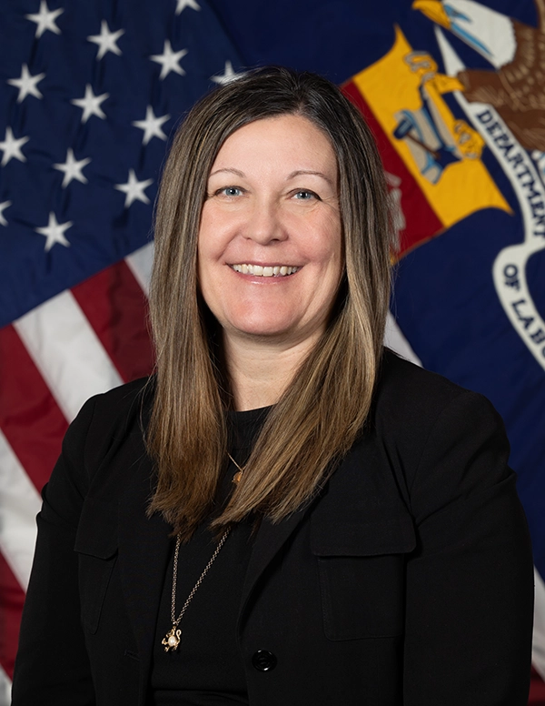
OSHA LEADERSHIP
Amanda Wood Laihow is the Acting Assistant Secretary.
White House nominated David Keeling as OSHA's next Assistant Secretary.
Continuing important work every day.
Notes:
OSHA Leadership
Amanda Wood Laihow is the Acting Assistant Secretary.
Before joining OSHA, Ms. Wood Laihow was a Senate confirmed Commissioner on the U.S. Occupational Safety and Health Review Commission from 2020–2023. She has served as the Deputy General Counsel for the U.S. Senate Homeland Security and Governmental Affairs Committee, Assistant General Counsel at the U.S. General Services Administration, as well as Director of Labor and Employment Policy at the National Association of Manufacturers.
The White House nominated David Keeling as OSHA's next Assistant Secretary. A nomination hearing was held on June 5, 2025, with the Senate Health, Education, Labor, and Pensions Committee.
We look forward to having an Assistant Secretary soon; until then we will continue to do important work every day by working more with small and medium-sized businesses, listening to our stakeholders and increasing collaboration and compliance assistance.

Slide 5
CURRENT INITIATIVES
Meeting employers where they are.
Collaboration through cooperative programs.
Engaging with workplaces at all stages.
Notes:
Current Initiatives
OSHA has been focusing its efforts on initiatives that meet employers where they are, whether they are just starting their safety journey or are longtime leaders in their industry.
A key part of the work we are doing is collaboratively through all the agency’s cooperative programs. OSHA is committed to these efforts that span from on-site consultation with small and medium-sized businesses, to helping employers start a program and recognizing exemplary safety and health programs through our Voluntary Protection Programs.
Whether a company is just beginning to develop a program or refining an existing one, we want to help those who are ready to improve by giving them a clear path to success.

Slide 6
LETTERS OF INTERPRETATION
Helping employers and workers.
Raising awareness and use of the agency’s Letters of Interpretation.
Help employers understand how to comply with federal requirements.
Search by keyword, standard number or date.
Notes:
Letters of Interpretation
At OSHA, we are committed to not only enforcing workplace health and safety standards – but also helping employers and workers understand how to meet them.
In June, OSHA announced an initiative to raise awareness and use of the agency’s Letters of Interpretation – our official responses to questions about how OSHA requirements apply to specific workplace situations or hazards.
These letters can help employers understand how to comply with Federal OSHA standards, regulations, and section 5(a)(1) of the OSH Act in specific workplace situations.
To make LOIs more accessible, we’ve updated the Letters of Interpretation webpage so you can now search by keyword, standard number or date – and see direct links between standards and related letters.

Slide 7
COMPLIANCE ASSISTANCE & COOPERATIVE PROGRAMS
Making real progress by working together.
Excellent ways to work with OSHA on meaningful safety and health initiatives.
Programs:
  On-Site Consultation Program
  Safety and Health Achievement Recognition Program (SHARP)
  Alliance Program
  Strategic Partnership Program
  Voluntary Protection Programs
  Safety Champions Program
Notes:
Compliance Assistance and Cooperative Programs
The purpose of OSHA’s Cooperative Programs is to build collaborative relationships that support employers in developing proactive safety and health practices that protect workers, prevent injuries, and reduce business disruptions.
We know that we can make real progress by working together.
Our cooperative programs are excellent ways for employers, employees, and associations to work with OSHA on meaningful safety and health initiatives.
These programs are about empowering employers to build strong safety cultures on their own terms.
These programs include:
On-Site Consultation Program
Safety and Health Achievement Recognition Program (SHARP)
Alliance Program
Strategic Partnership Program
Voluntary Protection Programs (VPP)
Safety Champions Program.
Ultimately, progress occurs when we all work together. OSHA is invested in providing compliance assistance, working with trusted intermediaries through our cooperative relationships to meet employers where they are, and move toward safer and healthier workplaces.

Slide 8
Voluntary Protection Programs
OSHA’s new Pathway to Safety and Health Success:
Increase outreach to more employers, especially small businesses;
Reimagine OSHA Challenge into Safety Champions Program;
Expand use of Special Government Employees (SGE);
Incorporate leading indicators;
Create VPP Elite level of distinction for VPP sites → 15+ years of VPP status;
Create VPP Emeritus designation for VPP sites → 25+ years of VPP status;
Expand VPP SHMS from four to seven elements.
Notes:
OSHA is meeting businesses where they are on their pathway to safety, helping them develop strong safety programs, lower injury rates, and prevent fatalities. Further, those in the Voluntary Protection Programs (VPP) work collaboratively with OSHA regional staff, incorporate regular self-evaluations into their process, and avoid programmed inspections.
VPP is OSHA’s premier safety and health recognition program, highlighting what is possible when employers, labor, and OSHA collaborate to create safer, healthier workplaces.
We are updating our recognition programs and building on the success of VPP to improve safety and health management programs in every workplace.
This commitment is not just about meeting safety standards, but also about investing in and fostering a culture of continuous improvement.
Through VPP and other recognition programs, OSHA is meeting employers where they are – whether they’re just starting their safety journey or are longtime leaders in their industry – we are providing tools, resources, and recognition for success at every step.
As techniques for managing workplace safety and health evolve, so must our approach. Building on our existing framework, we are developing a pathway that worksites can progress along as they improve their safety and health.
OSHA’s new Pathway to Safety and Health Success includes steps to increase and improve safety and health by:
Increasing our outreach to more employers, especially small businesses;
Reimagining OSHA Challenge into a new, more robust Safety Champions Program that connects employers with volunteer safety and health professionals​ for advice and support;
Expanding the use of Special Government Employees (SGE);
Incorporating leading indicators;
Creating VPP Elite level of distinction for VPP sites that have achieved 15 or more consecutive years of VPP status, and that meet other criteria;
Creating VPP Emeritus designation for VPP sites that have achieved 25 or more consecutive years of VPP status, and that meet other criteria; and
Expanding VPP Safety and Health Management Systems from four to seven elements​ – something that many of our VPP Star sites are already doing.

Slide 9
OSHA Safety Champions Program
A new program for employers to improve their safety and health programs.
Based on seven core elements of OSHA’s Recommended Practices for Safety and Health Programs.
Three steps: Introductory, Intermediate and Advanced
SGEs given tools to work with participants as they progress through program.
Participants will receive recognition letter upon completion of each step.
Notes:
Safety Champions Program is a new program for employers to improve their safety and health programs.
Safety and health professionals will be connected to employers to provide advice and support.
The Program is managed by the OSHA Safety Champions Program Coordinator in the Directorate of Cooperative and State Programs (DCSP).
The program is based on the seven core elements of OSHA’s Recommended Practices for Safety and Health Programs.
There are three steps – Introductory, Intermediate, and Advanced – each step is aligned to the core elements.
Special Government Employees (SGEs) will be available to assist with progression through the program.
SGEs will be given the necessary tools to work with participants as they progress through the program.
OSHA will send a recognition letter to participants upon completion of each step.

Slide 10
ON-SITE CONSULTATION PROGRAM &
COMPLIANCE ASSISTANCE SPECIALISTS
Offers small businesses confidential occupational safety and health services.
    Separate from enforcement.
CASs work with employers to:
  find and fix workplace hazards,
  give advise for complying with OSHA standards,
  help establish and improve safety and health programs, and
  train employees.
Find a CAS near you; https://www.osha.gov/complianceassistance/cas.
Notes:
On-Site Consultation Program and Compliance Assistance Specialists
We are also increasing our efforts to support compliance through the On-Site Consultation Program, which offers no-cost and confidential safety and health services to small and medium-sized businesses.
OSHA’s On-Site Consultation Program offers confidential occupational safety and health services to small- and medium-sized businesses in all 50 states, the District of Columbia, and several U.S. territories, with priority given to high-hazards worksites.
On-Site Consultants work with employers to find and fix workplace hazards, give advice for complying with OSHA standards, help establish and improve safety and health programs, and train employees.
On-Site Consultation Program visits do not result in citations or penalties. Instead, they are meant to help identify hazards, strengthen protections, and improve workplace productivity – proving that safety pays.
To request a no-cost consultation, visit https://www.osha.gov/consultation/directory-text.
OSHA also has Compliance Assistance Specialists (CASs) in federal OSHA regional and area offices across the country who are an excellent resource for employers and employees.
CASs conduct outreach to a variety of stakeholders, from small businesses and other employers to trade and professional associations, to union locals and worker centers, to community and faith-based groups.
CASs can provide general information about complying with OSHA’s standards and understanding employer responsibilities and employee rights.
They also promote and help implement OSHA’s cooperative programs, such as the Voluntary Protection Programs, the Strategic Partnership Program, and the Alliance Program. They also play a critical role in raising awareness around OSHA’s initiatives, including the annual Fall Stand-Down and Safe + Sound Week event.
To find a Compliance Assistance Specialist nearest you, visit https://www.osha.gov/complianceassistance/cas.

Slide 11
Safe + Sound Week 2025
Safe + Sound: Year-round campaign promoting workplace safety and health programs.
Safe + Sound Week was held August 11-17, 2025, celebrating workplace safety successes.
Offered resources and activities for emergency preparedness at work and home.
Notes:
Safe + Sound is a year-round campaign to encourage every workplace to have a safety and health program.
Safe + Sound Week was August 11-17, 2025, and we recognized the successes of workplace safety and health programs and offers information and ideas on how to keep America’s workers safe.
We provided resources and activities for businesses on emergency preparedness and response that can be done at work or at home.

Slide 12
ENFORCEMENT
Set enforcement policy and targeted inspection programs.
Respond to fatalities, catastrophes and complaints.
Emphasis Programs at the national, regional and local levels.
  National Emphasis Programs;
    Heat
    Amputations
    Falls
Notes:
Enforcement
OSHA sets enforcement policy and targeted inspection programs, and responds to fatalities, catastrophes and complaints.
OSHA conducts two inspection types: programmed and unprogrammed.
Unprogrammed inspections are initiated for reasons such as imminent danger situations, fatalities and catastrophes, complaints, and referrals.
Programmed inspections are oriented towards high-hazard workplaces and recalcitrant business owners and employers.
Approximately 60% of OSHA inspections are of the unprogrammed type.
Achieving abatement of hazards is a primary objective for the agency.
OSHA also implements emphasis programs at the national, regional, and local levels. These are temporary programs that focus OSHA’s resources on particular hazards and high-hazard industries before incidents occur. We have national emphasis programs that address hazards for heat stress and amputations.

Slide 13
National Emphasis Programs
Amputations
Falls
Heat
Notes:
National Emphasis Programs
NEP on Amputations in Manufacturing Industries
OSHA renewed its NEP on Amputations in Manufacturing Industries that focuses on finding and reducing dangers that could lead to amputations and other injuries in manufacturing workplaces.
Under the renewed program, OSHA will conduct inspections of manufacturing facilities to ensure compliance with safety practices while operating, servicing, or maintaining machines. This includes controlling dangerous energy sources and making sure machines are properly guarded to prevent amputations.
The program was renewed on June 27, 2025, and will remain in effect for five years.
Falls
Falls continue to be the leading cause of fatal incidents in the construction industry.
Our NEP allows us to continue our enforcement focus on the industry, and we’ve uncovered and worked to ensure correction of approximately 4,500 violations this fiscal year through March 31.
Six of the top 10 violations are related to working from heights.
Enforcement is not our only approach; our outreach activity also makes a heavy impact.
This combination of outreach and enforcement is an enduring effort to decrease fatal falls in an industry with ever-changing worksites and work force.
Heat
The NEP was implemented in 2022.
Preliminary data from heat NEP inspections found that most employers (95% or more) have available water and access to shade for their workers.
However, we also found that there is room for improvement on training on the signs and symptoms of heat stress or providing first aid measures when needed.
The Heat NEP has been extended through April 2026 and will continue while OSHA revises it.
Working in extreme weather conditions is a workplace hazard that can be deadly if proper precautions aren’t taken.
No one should risk their health or life for simply going to work.
We will continue to perform compliance assistance visits as part of the NEP.

Slide 14
INSPECTIONS
Focus inspection resources on the most hazardous workplaces.
  Imminent danger situations
  Severe injuries and illnesses
  Complaints
  Referrals
  Targeted inspections
  Follow-up inspections
Notes:
Inspections
OSHA focuses its inspection resources on the most hazardous workplaces in order of priority:
1. Imminent danger situations—hazards that could cause death or serious physical harm receive top priority. Compliance officers will ask employers to correct these hazards immediately or remove endangered employees.
2. Severe injuries and illnesses — employers must report all work-related fatalities within 8 hours and all work-related inpatient hospitalizations, amputations, or losses of an eye within 24 hours.
3. Complaints—allegations of hazards or violations also receive a high priority. Employees may request anonymity when they file complaints.
4. Referrals of hazards from other federal, state or local agencies, individuals, organizations or the media receive consideration for inspection.
5. Targeted inspections—inspections aimed at specific high-hazard industries or individual workplaces that have experienced high rates of injuries and illnesses also receive priority.
6. Follow-up inspections—checks for abatement of violations cited during previous inspections are also conducted by the agency in certain circumstances.

Slide 15
INSPECTION PROCESS
Four phases:
  Presentation of credentials
  Opening Conference
  Walkaround
  Closing Conference
Notes:
A typical OSHA inspection has four phases:
Presentation of credentials - The on-site inspection begins with the presentation of the compliance officer’s credentials, which include both a photograph and a serial number.
Opening Conference—The compliance officer will explain why OSHA selected the workplace for inspection and describe the scope of the inspection, walkaround procedures, employee representation and employee interviews.
Walkaround—Following the opening conference, the compliance officer and the representatives will walk through the portions of the workplace covered by the inspection, inspecting for hazards that could lead to employee injury or illness. The compliance officer will also review worksite injury and illness records and the posting of the official OSHA poster.
Closing Conference—After the walkaround, the compliance officer holds a closing conference with the employer and the employee representatives to discuss the findings.
Results – When an inspector finds violations of OSHA standards or serious hazards, OSHA may issue citations and fines.
Appeals – When OSHA issues a citation, it offers the employer an opportunity for an informal conference with the Area Director to discuss citations, penalties, abatement dates, or any other information pertinent to the inspection.

Slide 16
CIVIL PENALTY ADJUSTMENTS
Federal Civil Penalties Inflation Adjustment Act Improvements Act (2015).
Annual adjustments for inflation no later than January 15.
2025 adjustments:
  Maximum penalties:
    For serious and other-than-serious violations from $16,550 per violation.
    For willful or repeated violations from $165,514 per violation.
Notes:
In 2015, Congress passed the Federal Civil Penalties Inflation Adjustment Act Improvements Act to advance the effectiveness of civil monetary penalties and to maintain their deterrent effect.
Under the Act, agencies are required to adjust the level of civil monetary penalties and make subsequent annual adjustments for inflation no later than January 15 of each year.
Civil penalty amounts were adjusted based on inflation for 2025 and became effective January 15, 2025.
OSHA’s maximum penalties for serious and other-than-serious violations increased from $16,131 per violation in 2024 to $16,550 per violation in 2025. The maximum penalty for willful or repeated violations increased from $161,323 per violation to $165,514 per violation.

Slide 17
PENALTY REDUCTIONS
Updated procedures intends to minimize burden on small businesses and increase prompt hazard abatement.
Employers can benefit if they:
  Immediately address or correct hazard,
  Have never been inspected by federal/state OSHA,
  No history of serious, repeat or failure-to-abate violations, or
  Were inspected in previous five years but had no serious, willful or failure-to-abate violations.
Effective July 14, 2025.
Notes:
OSHA updated its guidance on penalty and debt collection procedures with the intent to minimize the burden on small businesses and increase prompt hazard abatement.
The new policy increases penalty reductions for small employers, making it easier for them to invest resources in compliance and hazard abatement.
For example, under the previous policy, a penalty reduction level of 70% was applicable only to businesses with 10 or fewer employees. Under the revised policy, the 70% penalty reduction level will be expanded to include businesses that employ up to 25 employees.
Employers can benefit from expanded penalty reductions if they:
Immediately take steps to address or correct a hazard,
Have never been inspected by federal or state OSHA,
Do not have a history of serious, repeat or failure-to-abate violations, or
Have been inspected in the previous five years but had no serious, willful or failure-to-abate violations.
New policies are effective July 14, 2025.

Slide 18
Heat
  Well-known hazard for indoor/outdoor workers that can cause to serious or fatal illness.
  Workers should have adequate water, rest breaks, and shaded areas.
  Train employees on heat illness prevention, signs of heat illness and how to respond to a coworker showing signs of heat-related illness.
  New/returning workers should acclimate to heat gradually.
Notes:
Hazards
Heat is a well-known occupational hazard for outdoor and indoor workers that can cause serious or fatal illness if they don’t have the necessary protection and training.
Workers should have adequate water, rest breaks, and shade or a cool rest area.
It's important for employees to be trained on heat illness prevention, signs of heat illness, and how to act if they or another employee appears to be suffering from a heat-related illness.
Training managers can help them identify and prevent heat illness themselves.
New or returning employees at a high-heat workplace may need time to gradually get used to working in hot temperatures.

Slide 19
Heat Rule
Public hearing began on June 16, 2025.
Archived recordings of the hearing on OSHA’s rulemaking page at https://www.osha.gov/heat-exposure/rulemaking.
Notes:
OSHA recently concluded public hearings on the Heat Injury and Illness Prevention in Outdoor and Indoor Work Settings proposed rule as part of the ongoing rulemaking process.
Once the record on the hearing closes, the Department will take everything into consideration and make a decision on how to proceed.
You can find links to archived recordings of the hearing on OSHA’s rulemaking page.

Slide 20
WHISTLEBLOWER PROTECTIONS
OSHA enforces more than 20 whistleblower statutes.
Statutes protect workers from adverse actions.
Ways to file a complaint:
  Online
  Fax/Email/Mail
  Telephone
  In person
  Complaints are accepted in all languages
  Visit www.whistleblowers.gov
Notes:
OSHA’s Whistleblower Protection Program enforces the whistleblower provisions for 25 whistleblower statutes.
These statues are meant to protect workers if an adverse action is taken against employees for engaging in activities protected by OSHA’s whistleblower laws.
Ways to file a complaint:
Online - Use the Online Whistleblower Complaint Form to submit your complaint to OSHA. Complaints from employees in States with OSHA-approved Plans will be forwarded to the appropriate State Plan for response.
Fax/Mail/Email – Fax, mail, or email a letter describing your complaint, or a printed copy of your completed Online Whistleblower Complaint Form to your local OSHA Regional or Area Office.
Telephone - Call your local OSHA Regional or Area Office. OSHA staff can discuss your complaint with you and respond to any questions you may have.
In person – Visit your local OSHA Regional or Area Office. OSHA staff can accept your verbal or written complaint and provide information as needed.
OSHA accepts complaints in any language. If you need assistance, such as a foreign language interpreter, please contact your local OSHA Regional or Area Office.
Visit www.whistleblowers.gov to learn more about OSHA’s Whistleblower Protection Program and how employers can develop or improve their program.

Slide 21
TRACKING WORKPLACE INJURIES AND ILLNESSES
Helps understand industry hazards, where to implement protections, and prevent future incidents.
Establishments that meet size and industry criteria must submit data from OSHA Form 300A, 300, and 301 (or equivalent forms) annually.
OSHA publishes data collected on its website after taking steps to detect and remove certain personally identifiable information (PII).
Severe Injury Report – online tool to search the database, view trends, and prevent injuries.
Notes:
Recording and reporting work-related injuries and illnesses helps to understand hazards by industry and occupation. This information can be used to determine where to implement protections to reduce and eliminate hazards and prevent future work-related injuries and illnesses.
Establishments that meet certain size and industry criteria are required to electronically submit injury and illness data that they are already required to keep from their OSHA Form 300A, 300, and 301 (or equivalent forms) once per year to OSHA through the Injury Tracking Application (ITA).
OSHA publishes data collected on its website after taking steps to detect and remove information that could reasonably be expected to identify individuals directly.
All employers, regardless of size or industry, are required to notify OSHA when an employee suffers a work-related hospitalization, amputation, or loss of an eye, within 24 hours. OSHA defines these types of incidents as severe injuries.
Our Severe Injury Report (SIR) dashboard is an online tool where users can search the severe injury report database and view trends related to work-related hospitalizations, amputations, and eye losses reported in states covered by federal OSHA.
The SIR dashboard can be used to learn how severe injuries happen in industries and use the agency's available resources to help prevent severe work-related injuries and illnesses.

Slide 22
EMPLOYEE RIGHTS
Federal law entitles every employee the rights to:
A safe and healthful workplace
Speak up about safety and health concerns without fear of retaliation
Be trained in the language they understand
Required safety equipment, such as gloves or a harness and lifeline for falls, and
Report an injury or illness, request an OSHA inspection, and speak to the inspector.
Visit osha.gov/workers
Notes:
Federal law entitles every employee to a safe workplace; and
The right to speak up about safety and health concerns without fear of retaliation,
The right to be trained in the language they understand,
The right to required safety equipment, such as gloves or a harness and lifeline for falls, and
The right to report an injury or illness, request an OSHA inspection, and speak to the inspector.

Slide 23
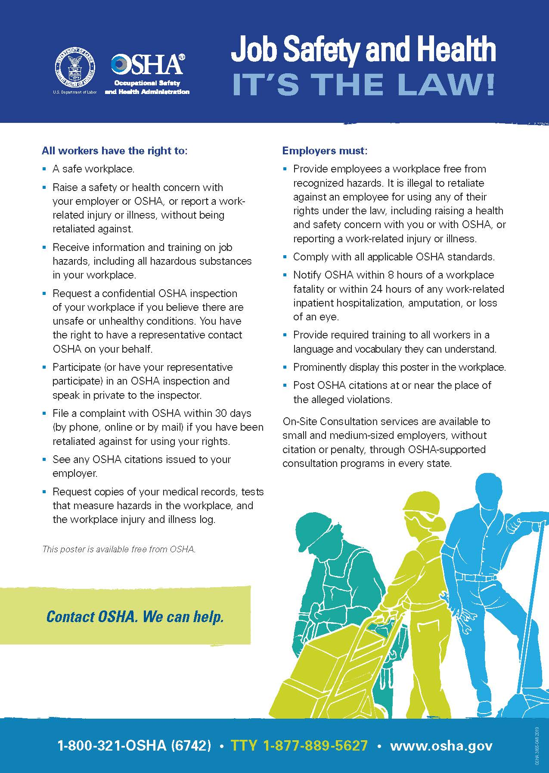
EMPLOYER RESPONSIBILITIES
Provide a workplace that is free of known safety and health hazards.
Display OSHA poster "Job Safety and Health: It's the Law" in the workplace.
Many employers with more than 10 employees must keep a record of serious work-related injuries and illnesses.
Certain low-risk industries are exempt.
Visit www.osha.gov/employers
Notes:
Employers are required to provide a workplace that is free of known safety and health hazards.
All covered workplaces are required to display the OSHA poster, “Job Safety and Health: It’s the Law,” in their workplaces. The poster must be prominently displayed where employees can see it. The poster is available for free from OSHA.
Many employers with more than 10 employees are required to keep a record of serious work-related injuries and illnesses. Certain low-risk industries are exempted.
Visit www.osha.gov/employers for more information on employer responsibilities as well as compliance assistance, education, and training.

Slide 24
TRAINING
Often referred to as 10-and 30-hour training.
Program is not a certification or license, does not meet requirements of OSHA standards.
Provides assistance and tools to develop effective safety and health programs.
OSHA Training Institute (OTI) Education Centers are a national network of non-profit organizations authorized by OSHA to offer OSHA courses.
OTI Education Centers offer more than 50 courses in construction, maritime, and general industries.
Visit www.osha.gov/otiec.
Notes:
The Outreach Training Program, often referred to as 10- and 30-hour training, is a voluntary program on recognizing, controlling, and preventing workplace hazards.
The Outreach Training Program trains more than one million employees each year. The program is not a certification or license and does not meet the training requirements in any OSHA standard.
Training provides businesses with assistance and tools they need to develop effective safety and health management programs and to help save lives.
The OSHA Training Institute (OTI) Education Centers are a national network of non-profit organizations authorized by OSHA to offer OSHA courses geared toward the private sector.
OTI Education Centers offer more than 50 courses in construction, maritime, and general industries. More than 52,000 people annually are taught through more than 4,400 courses each year.
Visit www.osha.gov/otiec for more information about the OTI Education Centers.

Slide 25
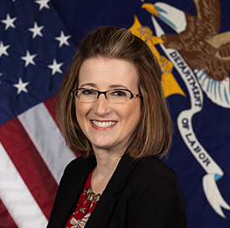
NATIONAL FAMILY LIAISON
Tonya Ford, OSHA's National Family Liaison, supports and assists families who lost a loved-one in a workplace incident.
Can be reached at a time convenient to families via email (ford.tonya.e@dol.gov) or phone at (531)893-3409.
Workers Memorial Tribute Wall.
  Family members can share their loved one’s photograph/written testimony at remembrance@dol.gov
Workers Memorial Day (April 28), events to honor and recognize fallen workers, and offer support to their families.
Notes:
OSHA now has a National Family Liaison to support and assist family members in their time of need after losing a loved one in a fatal workplace incident.
Family members and loved ones are encouraged to contact the National Family Liaison if they need any assistance or guidance after their injury/loss.
Our National Family Liaison can be reached at a time convenient to you via email (ford.tonya.e@dol.gov) or phone at (531) 893-3409.
OSHA has created a Workers Memorial Wall in honor and recognition of those who lost their lives while on the job.
If you have lost a loved one due to a work-related incident, we invite you to share his/her photograph and a written testimony with OSHA at remembrance@dol.gov as we will recognize him/her on our virtual Workers Memorial Wall.
In preparation for Workers Memorial Day (April 28), the National Family Liaison organizes events to honor and recognize our fallen workers, providing support to their families. Throughout the week leading up to the observance, a series of virtual and in-person events are held to highlight the importance of workplace safety, featuring educational webinars and other events.

Slide 26
QUICK TAKES/INFORMACIÓN RÁPIDA/DID YOU KNOW?
Keep up-to date with OSHA
Monthly newsletter QuickTakes (English)
Monthly Spanish-language sister newsletter Información Rápida
Focused and timely messages Did You Know? (Bilingual)
Notes:
QuickTakes/ Información Rápida /Did You Know?
Get the latest updates from OSHA by subscribing to our monthly newsletters.
Monthly newsletter QuickTakes (English) (https://www.osha.gov/quicktakes)
Monthly Spanish-language sister newsletter Información Rápida
Focused and timely messages Did You Know? (Bilingual) (https://www.osha.gov/quicktakes)

Slide 27
SOCIAL MEDIA
Follow OSHA on:
Instagram: @OSHA_DOL
LinkedIn: @OccupationalSafetyandHealthAdministration
X:@OSHA_DOL
Facebook: @OccupationalSafetyandHealthAdministration
Notes:
Social Media
You can follow OSHA on our social media platforms: Instagram, Facebook, LinkedIn, and X.
Instagram: @OSHA_DOL
LinkedIn: @OccupationalSafetyandHealthAdministration
X: @OSHA_DOL
Facebook: @OccupationalSafetyandHealthAdministration

Slide 28

OSHA Contact Information
www.osha.gov
800-321-OSHA (6742)

