Slide 1

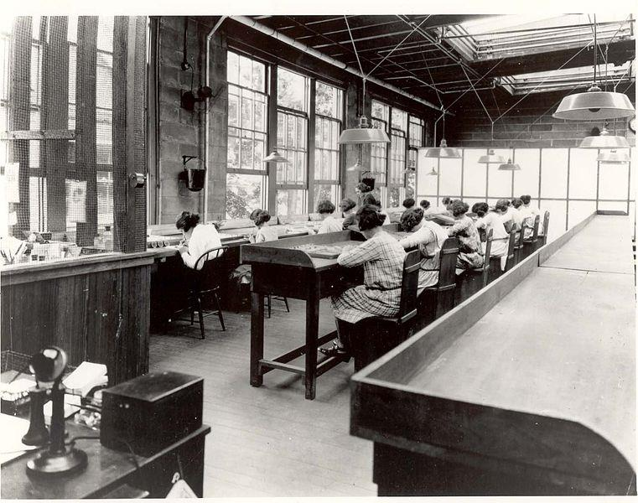
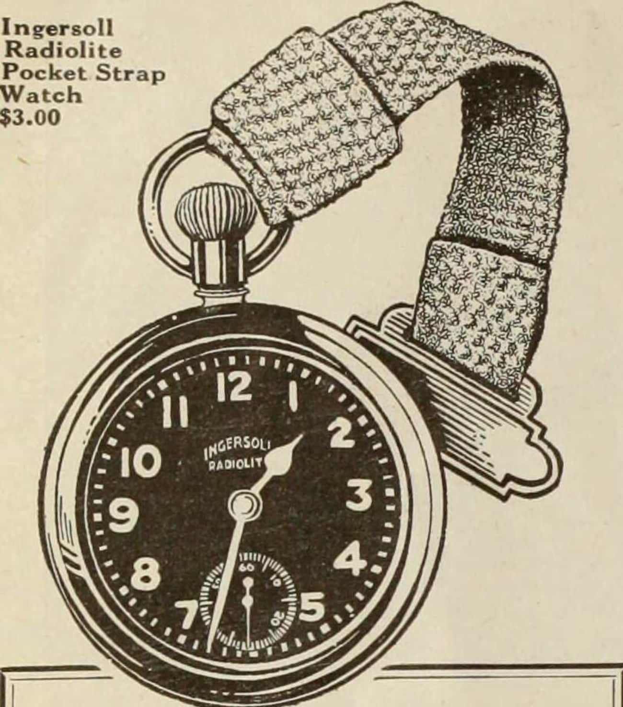
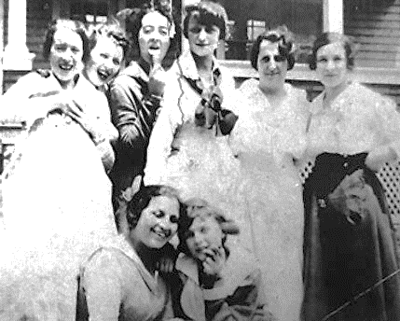

The Preventable Tragedy of The “Radium Girls”
The Women Who Fought for Their Lives in a Killer Workplace
This is not a figment of Science Fiction imagination but unchangeable history.
Newspapers dubbed them The Legion of the Doomed, THE Living Dead & the Ghost Girls.
The victims, villains & heroes in this spellbinding story of courage and resilience
$3.00
Blissfully unaware that they were slowly killing themselves.
A typical self-luminous watch that uses radium paint contains around 1 microgram of radium. Radium watches would continue to be manufactured until 1968, although the safety regulations were drastically improved. By the 1970's there were estimated to be over 10 million watches & clocks in the USA with luminous Ra-226 dials
The women in each facility were told that the paint was harmless, but they ingested deadly amounts of radium. The powder got everywhere. The factory was filled with it, so much so that the very air itself glowed. People had died of radium poisoning before the first dial painter ever picked up her brush.
Notes:
When Marie and Piere Curie discovered radium in 1898, it was soon viewed as a wondrous and powerful element: a cure for cancer, and a source of beauty and vitality. The radium girls, as the newspapers called them, were still in their 20s; some as young as 11 & 13 many were newlyweds with young children.
Some earned >3 times the salary of the average factory-floor worker. Some earned more than their fathers. They were ranked in the top 5% of female wage earners & on average took home $20 ($370) a week. Girls lucky enough to be employed felt blessed—proud to be one of the “shining girls.”

Slide 2

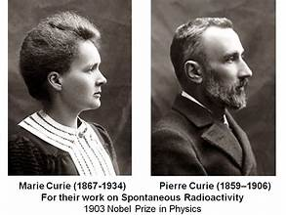
What is Radium?
Discovery date | December 21, 1898
Discovered by | Pierre & Marie Curie
Origin of the name | Derived from the Latin 'radius', meaning ray.
Radium is a radioactive material & is classified as a DOT Hazard Class 7
Radium was the first radioactive element to be discovered. Radium is a radioactive chemical element with the symbol Ra & atomic number 88. It is the sixth element in group 2 of the periodic table, also known as the alkaline earth metals. Radium is a decay product of uranium found in all uranium-bearing ores. Pure radium is silvery-white, but it readily reacts with nitrogen upon exposure to air, forming a black surface layer of radium nitride. Radium has no smell or taste thus the hazards are not evident. ²²⁶Ra) emits mostly alpha particles, but other steps in its decay chain emit alpha or beta particles, & almost all particle emissions are accompanied by gamma rays.
Thirty-four isotopes of radioactive radium are known; their half-lives, except for Radium-226 (1,600 years) & radium-228 (5.75 years), are less than a few weeks.
Its compounds display a faint bluish glow in the dark due to their emitted alpha-particles exciting electrons in the other elements in the compound & the electrons release their energy as light when de-excited.
Notes:
Though it was Henri Becquerel who discovered radioactivity, it was Marie Curie who coined the term. It was taken from the French radioactivité, coined in 1898 by the Curies. Occasionally, miners digging for silver would hit a snag: a vein of precious metal would give way to a blackish ore they dubbed pitchblende, or “bad luck rock,” since it usually meant the end of silver in that vein.
Four naturally occurring isotopes of radium are known. They are radium-223, radium-224, radium-226, and radium-228 Radium & its compounds have relatively few uses.. Radium was the first radioactive element to be discovered.
One curie (Ci) is the approximate number of radioactive decays in one gram of radium per second – approximately 3.7 x 10¹⁰ decays per second.
Normally, alpha radiation is harmless in small doses. Countless natural sources of this radiation can be found in the average kitchen or bathroom. Even nature is full of it as the low-energy particles have difficulty penetrating even one layer of skin. Outside the body, it’s virtually safe.
American inventor William J. Hammer went to Paris & obtained a sample of radium salt crystals from the Curies. Hammer discovered that he could make glow-in-the-dark paint by mixing the radium with glue & zinc sulfide.
Marie & Pierre Curie themselves suffered extreme burns from handling the element, & her prolonged exposure to its radiation ultimately killed her in 1934. One gram of radium-226 undergoes 3.7E10 disintegrations per second. This unit was coined the Curie. Pierre Curie was struck by a horse-drawn wagon with a load of military uniforms, weighing some six tons while crossing a street in Paris and died instantly on April 19, 1906.

Slide 3

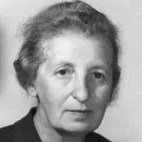

The Faulty Paradigm of Scientific Discovery
In the early 20Th century
There is a common narrative in early science of the tragic genius who suffers for a great reward, & the tale of Curie, who died from exposure to radiation as a result of her work, is one of the most famous.
  Curious fact: When Curie died, her body was so radioactive that she had to be laid to rest in a coffin that had a 2.5 mm lead-lining. However, no one knew this until 1995 when her coffin was exhumed.
In the Curie lab, dedication to science was demonstrated by a willingness to poison yourself. It was inconceivable to her that the benefits of the research would not outweigh the risks to themselves & their employees.
Irène Joliot-Curie, (Curie’s daughter) “had a penchant for asserting that anyone who worried
about radiation hazards was not a dedicated scientist.” She died in 1956 of leukemia.
Elizabeth Rona, a chemist in Curie’s lab, wrote of a lab assistant, Catherine Chamie.
Rona records a litany of radioactivity researchers who followed Camie’s indifference to
one’s safety: their lungs, hands, & bones falling apart. The thumbs, forefingers, & ring fingers
of their left hands were especially prone to damage because they were exposed to the radioactive substances they poured from flask to flask without gloves.
Fortunately, today such cavalier people represent a small number of those who dedicate their lives to science. We should celebrate scientists not solely for their accomplishments but also for their courage & the tenacity required to discover anything. They are brave because of the intense emotional risks of trying to do something, no one has done before, by following their own lead. They can succeed primarily because now Safety has become an important component of scientific exploration.

Slide 4
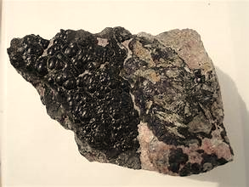
Why is Radium valuable?
There is about 1 g of radium in 7 tons of pitchblende. (280 cubic feet)
  Pitchblende is a highly complex mineral, made of combinations of up to 30 different elements
  It took over 3 years to isolate one-tenth of a gram of pure radium chloride
When radium decays, it emits ionizing radiation as a by-product, which can excite
fluorescent chemicals & cause radioluminescence.
  In the 1920s, a gram of radium cost more than $100,000, $2 million by today’s standards.
²²⁶Ra is the most stable isotope of radium with a half-life of over a millennium, it makes up almost all-natural radium. In World War I, fewer than 30 grams were used worldwide.
  Curious Fact: Marie Curie’s notebooks, which contain information about radium, are still radioactive & can only be accessed using protective gear (stored in a lead-lined box at France’s Bibliothèque National).
All other 27 known radium isotopes have half-lives under 2 hours, & most are under a minute.
Pure radium is a volatile silvery-white metal, although its lighter congeners calcium, strontium, & barium have a slight yellow tint. This tint rapidly vanishes on exposure to air, yielding a black layer.
From 1917-1926, U.S. Radium Corporation, originally called the Radium Luminous Material Corp., was engaged in the extraction & purification of radium from carnotite ore to produce luminous paints, marketed under the brand name "Undark". The ore was mined from the Paradox Valley in Colorado.
  The man who originally invented Undark⁠—Dr. Sabin Arnold von Sochocky⁠—himself died of poisoning by radium dial paint in November 1928, becoming the 16th known victim.
Pitchblende
Notes:
Being able to access and view watches in the dark trenches, ahead of timed and coordinated pushes over-the-top, was vital. This led to a key innovation: luminous dials and hands.
It took the Curies four years to prepare one gram of the element. To do so, they had to sift through more than seven metric tons of pitchblende!
The high toxicity and radioactivity of radium mean that its uses are severely limited today. Most of its historical applications have been discontinued or replaced with safer materials, and any remaining uses are highly specialized and regulated.
>190 g of radium was used by the US for luminous dials during World War II compared with <30 g used worldwide in World War I.
By 1926, Memorial Sloan Kettering had more radium than anywhere else in the world — about 9 grams — earning it the nickname “Radium Hospital.”

Slide 5
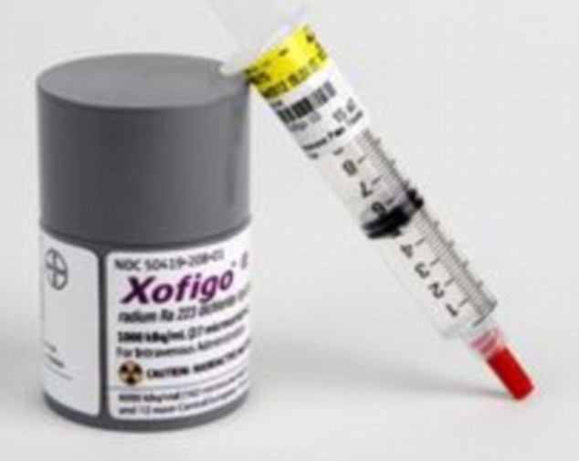
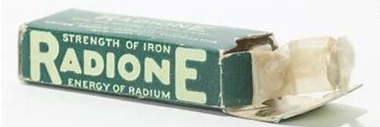
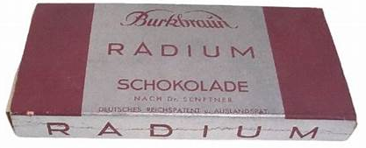
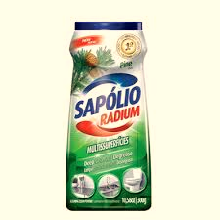
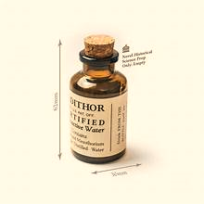
Discouraged or Obsolete Uses
“A Cure for the Living Dead” & “Perpetual Sunshine,”
Medical Treatments
In the early 1900s, radium found a place in medical treatments, especially for cancer.
Called "radium therapy," the technique involved placing small "seeds" of radium near
or into tumors. Initially, the results seemed promising.
Everyday Products
During the 1920s, radium was somewhat of a fad element. It was used in everyday products, from toothpaste to cosmetics & even food items, touted as a miracle substance that could rejuvenate & energize.
Quack Medicines
"Radium tonics" & similar products were once marketed as health supplements.
These tonics were thought to cure anything from arthritis to impotence.
Radium is a potent example of scientific discovery, public fascination, & the subsequent realization of the dangers of radioactivity. Its significant health risks overshadowed its initial promise for transformative applications in medicine & industry. Nonetheless, radium’s discovery was instrumental in broadening our understanding of radioactive elements & their potential effects—both beneficial & hazardous — on human life.
Notes:
Manufacturers started putting the “miracle” substance into:
Food – the Radium Schokolade chocolate bar manufactured by Burk & Braun, & Radium Bread made with radium water & manufactured by the Hippman-Black bakers.
Water – the Revigator was a radium-laced container that stored a gallon of water; drinking the water supposedly cured arthritis, impotence, & wrinkles.
Toys – the Radiumscope was sold until 1942, and it was marketed as a “wonderful” nightlight since it “glows with a weird light in a dark room.”
Toothpaste – a toothpaste containing both radium and thorium was sold by Dr. Alfred Curie, who was no relation to either Marie or Pierre Curie.
Cosmetics – the same Dr. Curie also marketed cosmetics under the Tho-Radia brand, which promised to brighten and rejuvenate your skin.
Impotence Treatments – the Radioendocrinator was a booklet that contained cards coated in radium and meant to be worn inside undergarments at night.
There was even a town in Claremore Oklahoma named Radium Town. Several hotels with bathhouses started up at various locations and afflicted individuals started arriving by the thousands. Stomach problems, skin diseases, rheumatism or eczema, it didn’t matter. Claremore’s magic springs could cure almost any health matter.
What turned the tide against radium water and its sellers was the jarring death of wealthy steel mogul Eben M. Byers. The industrialist, advised by a doctor in response to his nagging arm injury, had been a daily drinker of the radium beverage Radithor for two years. Byers, at 51, was found to have “necrosis in both jaws, anemia & a brain abscess, all symptomatic of radium poisoning,” the Tribune reported a few days after he died in late March 1932.
The Food and Drug Administration banned most radiation-based patent medicines in 1932.

Slide 6
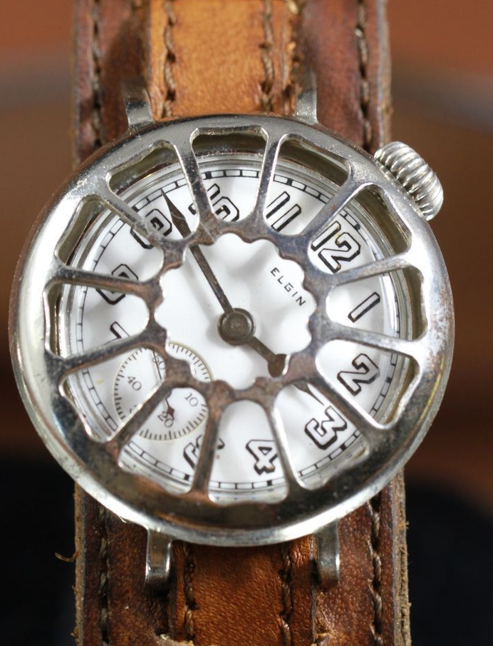
The Creation of the Wristwatch
In 1900, Men carried pocket watches, the idea of a watch on the wrist was considered feminine.
Soldiers enduring the horrors of the trenches of WWI started jerry-rigging their standard-issue pocket watches to straps around their wrists, giving them a much quicker way of assessing the time than having to dig them out of their tunics, open the case, & then replace them.
The men’s wristwatch movements were usually taken directly from women’s so-called
‘pendant’ watches. The men’s watches were called “Trench Watches.”
These men’s models generally measured between 27mm to 30mm in diameter.
In 1917 the wristwatch was deemed so essential to the soldier that the British War
Dept. began issuing wristwatches to all combatants. By the end of 1918,
one in six soldiers owned a luminescent watch, most with shrapnel shields.
Gaining usefulness & enjoying wide acceptance initiated the success of wristwatches post-war.
The last wristwatches to employ radium luminescent paint were produced in the U.S. in 1968.
To see information about the exposure from wearing a radium dial watch: https://watchrepairtutorials.com/the-actual-risks-of-vintage-radium-dial-watches-a-guide
Notes:
Before the United States entered the war, many American men had pocket watches. When World War One began the wristwatch became a necessary kit for servicemen worldwide. It was trench warfare that made the wristwatch such an essential tool. As soldiers held guns, whistles, and other kit in their hands there was simply no room for a pocket watch. So, a glance at the wrist became the norm. As the Army’s “technology” department, the Signal Corps oversaw testing timepieces and purchasing wristwatches for soldiers, Those wristwatch models that passed the necessary tests would then be distributed by the U.S. Army Quartermaster Corps. The Army announced the standards for all purchased wristwatches as early as October 1916. The wristwatch specifications would change two or three more times in the following two years as technology improved.

Slide 7
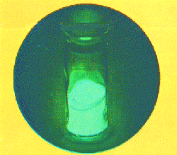
Radium’s Primary Use
In Luminous Paints
One of the earliest & most iconic uses of radium was in luminous paints. During the early 20th century, radium's phosphorescent properties made it ideal for use in clock & watch dials, aircraft switches, gun sites & fishing lures. The emitted light is due to radium's radioactive decay, which excites the electrons in the doping agents. Copper-doped zinc sulfide is the most common
phosphor used & yields blue-green light. Copper & magnesium-doped zinc sulfide yields
yellow-orange light. Zinc sulfide undergoes degradation of its crystal lattice, leading to a
gradual loss of brightness after about 2 years. But, still highly radioactive!
At the onset of World War I, several factories were established across the US to produce watches & military dials painted with a mixture containing radium. Corporations in the U.S. & Canada hired an estimated 4,000 workers to paint watch faces with radium.
  The watch dial painters at RLMC were all women, who were recent immigrants. Most had minimal education. The workers were not unionized.
  While some girls were as young as 11, most were 14, 15, 16, & 19-year-olds.
  The FLSA which prohibits such young workers was not passed until 1938.
The rate of pay was about a penny & a half per dial (equivalent to $0.36 in 2023), earning the girls $3.75 (equivalent to $89.18 in 2023) for painting 250 dials per shift.
  At peak, production at USRC was nearly 55,200 dials per year, per dial painter.
  By the end of WWI, the US was producing over 4 million watches a year.
Notes:
When the U.S. entered WWI in 1917, soldiers on the front could not see their watch dials at night, which made coordinating night attacks more difficult. Wristwatches were developed as an improvement over pocket watches & called “Trench Watches.” By the end of WWI, the US was producing over 4 million watches a year
Being a dial painter in this era was an elite position for a woman. Hundreds of women were employees in a watch factory in Orange, New Jersey. The company hired women because it believed they were smaller & able to paint the finer details of a watch face. As a result, the paint constantly glowed, day & night. There was no need for sunlight to trigger the reaction. Very old watches from around the First World War have relatively large amounts of radioactive material in their paint & give off much stronger radiation than later luminous watches.
The workers were required to make their own paint at the factory. Paint is made of two materials: a pigment & a binder. The pigment provides the color while the binder holds everything together, allowing it to adhere to a surface. Radium is the pigment, used to create a paint that went by the names Undark, Luna, and Marvelite. They would do this by combining the radium pigment with water & adhesive. The luminous paint used on WWI watch dials was made with a mixture of radium & zinc sulfide phosphor. This was doped with an activator, typically copper. The zinc sulfide phosphor glowed brightly when hit by radiation from the radium. Because the radium pigment was produced as a powder, the factory was filled with it, so much so that the very air itself glowed.
The powder got everywhere. There was radium dust all over the studio. Little puffs of it hovered in the air before settling on the hair of the dial painters. It made the girls themselves glow. Other companies around the US did the same. They worked in unvented rooms; if they wore smocks they laundered them at home.
At the time, the wristwatch market was dominated by companies such as Elgin, Waltham, Illinois, Hamilton, and Depollier & Son. All their timepieces were categorized as “trench watches,

Slide 8
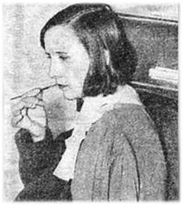
The Painting Process Explained
To apply its paints the 3 companies manufacturing radium dials, established several dial painting studios, They needed hundreds of workers to fulfill their lucrative contracts & found young women to be ideally suited for the intense concentration & nimble handwork that dial painting required. Radium dust to which they were exposed daily made their clothes, hair, & skin glow.
These "shining girls" were the luckiest alive — until they began to fall mysteriously ill.
The process involved mixing the paint, provided to the workers as a powder, & using a tool to paint each number & arm in the dial. The luminous paint contained a mixture of zinc sulfide activated with silver, & powdered ²²⁸Radium or later mesothorium, (²²⁶Ra) a product that Radium Dial Company named Luma. (More on the difference later)
Paint in the UK was a combination of ²²⁶ radium salts & a phosphor, both powders, in a binder of clear varnish to paint metal dials. People in the UK used a glass rod to apply the paint, with NO lip-pointing! Women in the U.S. painting paper watch dials used precise camelhair brushes to apply the water-based paint.
To keep a fine point on the brush the painters used a technique known as lip pointing, placing the brush between their lips, & as a result, ingested a minute quantity of radium with each dial. The smallest pocket watch they painted measured only 3.5 cm across its face, meaning the tiniest element for painting was a single millimeter in width
Most of the women pointed about six times to every watch dial. (1,500 lip pointing exposures per day!)
A worker could ingest 125 mg-1.75g of paint daily. This would contain 3 - 43 micrograms of radioactive radium.
Until 1920, the dial painters were allowed to eat at their workstations without washing their hands. During wartime, the girls often worked overtime & 7 days a week.
"lip, dip, paint"
Charlotte Purcell
The girls used slim camel hair brushes with narrow wooden handles. Each brush had approximately 30 hairs.
Notes:
The materials and methods of application were dependent on the type of dial being painted. While dial painters that worked on metal dials used styluses to apply an oil-based mixture, the Radium Girls were painting paper dials, so used camelhair brushes to apply water-based paint. dial painting was done in Europe where dial paint had been used for over a decade. Different countries had different techniques. But in none was lip-pointing used, probably because brushes weren't used either: in Switzerland, there were solid glass rods; in France, small sticks with cotton wadding on the ends; and elsewhere in Europe, a sharpened wooden stylus or metal needles. The dial paint usually contained long-lived radium-226 and shorter-lived radium-228. A toxicity ratio has been developed for these isotopes; it has been estimated that radium-228 is about 2.5 times as effective, per μCi, in inducing bone sarcomas as radium-226 (Lloyd et al. 1986; ). For various other effects, estimates of the effectiveness of radium-228 relative to radium-226 have ranged from zero to six
To paint the intricate numerals on watch faces, the dial painters were encouraged to use the lip-pointing technique, pressing the brush between their lips to form a fine point before they dipped it in the paint. Every time this was done, a small amount of radium was ingested. The luminous paint, which worked by converting the radiation into light through a fluorescent chemical, was one of the most successful radium-based products.
By putting the brushes in their mouths, the Radium Girls were especially at risk – so why did they do it? “Because it was the easiest way to get a fine point on the brush, to paint on numbers as small as a single millimeter in width,” Estimates of the total number of women employed in the industry between 1917 and 1935 vary, but a number approaching 10,000 is not unreasonable.

Slide 9
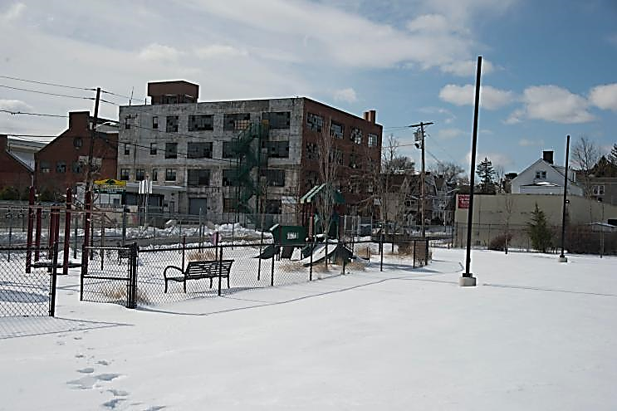
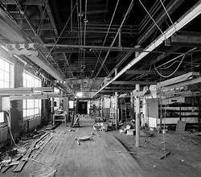

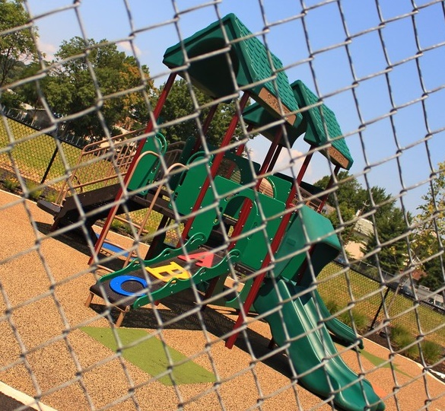
The place where it all began
The original site of the Radium Luminous Materials Corporation in Orange, NJ
Radium Luminous Materials Corp., opened in this neighborhood of Newark around 1917.
  The US government became one of the company’s biggest clients.
In the 1920s, workers’ rights were nonexistent. The US DOL was tipped off to the “ghost girls’ ’’ plight, but it barely registered with the agency. The Department of Labor was pro-business.
  Under NJ law, DOL had no authority to stop an industrial process, even if it was harmful. After a brief investigation, government officials gave the plant a “clean bill of health.”
USRC finally closed in 1941, bankrupt & with no way out, given that it couldn’t find anyone willing to work in its studios.
Today, around the former factory site in Orange, it is hard to find anyone who has heard of its disturbing past. Once told of the story, residents are sympathetic to its doomed workers’ plight — but then wonder in the same breath if the old site is safe for them & their kids. The contaminated soil & building material removal was completed in September 2005
Quietly tucked into a tree-lined residential neighborhood, it has been renamed High & Alden St. Park
& features a playground —a fitting tribute to the paradox of the lives lost.
Notes:
The buildings were plain, concrete-block structures with simple rectangular floor plans. Both were built in 1917 in a neighborhood of late 19th-century worker housing and hat factories. Both were used commercially until the 1980s. Additions, removal of original equipment and most original fixtures had heavily altered both.
In 1979, the US Environmental Protection Agency (EPA) found that the former USRC site in Orange had levels of radioactivity 20 times higher than was safe.
The former U.S. Radium manufacturing plant was a Superfund Site. In 1980, the NJ Department of Environmental Protection found radon levels at the site of up to 50 microcuries per liter vs. the normal background level of 0.3 microcuries per liter. In addition, surface testing revealed “highly contaminated soil with 200-300 picocuries per gram, with high nodes of up to 5000 picocuries per gram.” The contaminated soil and building material portion of the remedy was completed after 9 years in September 2005
The US Radium Corporation site in Orange, NJ was determined significant and eligible for listing in the National Register of Historic Places in 1997.

Slide 10
Other Companies Painting Dials
There were three companies in the U.S.: United States Radium, (USRC) in Orange, New Jersey, which began around 1917, the Radium Dial Corporation in Ottawa, Illinois, which started in 1922, & the Waterbury Clock Company in Waterbury, Massachusetts.
The Radium Dial Company was established in Ottawa, Illinois in the town’s former high school. Like the United States Radium Corporation, the studio in Ottawa painted dials for clocks, their largest client being Westclox’s Corporation in Peru, Illinois.
  At the highest point in production (around 1925), the Radium Dial Company employed around 1,000 young women who turned out around 4,300 dials per day.
Radium Dial closed in 1937, but another company, Luminous Processes, Inc., (LPI),
opened the same year under the same management, five blocks from the original site. LPI closed in
1978, leaving behind its abandoned building & radium contamination.
  Federal regulators found radiation levels up to 1,666 times higher than the allowable amount at the facility.
Dials painted in Ottawa appeared on Westclox's popular Big Ben, Baby Ben, & travel clocks; & like the United States Radium Corporation, Radium Dial hired young women to paint the dials, using the same "lip, dip, paint" approach as the women in NJ & by another unaffiliated plant in Waterbury, Connecticut, that supplied the Waterbury Clock Company.
Notes:
Few companies at that time were willing to employ women, and the pay was much higher than most alternatives, so the company had little trouble finding employees to occupy the rows & rows of desks. Though US Radium was not the only radium-painting business in the US, they were arguably the most evil.
In September 1922, 800 miles from Orange, New Jersey, a radium dial-painting plant was started in Ottawa, Illinois, a town of 10,816 people located 85 miles southwest of Chicago.
LPI operated until 1976 when federal regulators found radiation levels up to 1,666 times higher than the allowable amount at the facility. The Superfund site was ultimately cleaned up and is now a parking lot.
Many leading radium scientists had investments in radium companies, but they were disinclined to disclose the dangerous side effects. Scientists have known since 1914 that radium could cause anemia & skin burns. It would later be revealed during the litigation that the UNRC scientists & management had taken considerable precautions to protect themselves from the effects of radiation but did nothing to protect their dial painters.

Slide 11
Why is Radium Harmful?
Radium emits alpha, beta, & gamma radiation. The low-energy alpha & beta particles have difficulty penetrating even one layer of skin. Outside the body, it’s virtually safe. For months after exposure, minimal amounts will leave the body every day through urine & waste matter. If radium is swallowed in water or food, it quickly leaves the body as waste.
However, exposure to radium over a period of many years may result in an increased risk of some types of cancer, particularly lung & bone cancer. Higher doses of radium have been shown to cause effects on the blood (anemia), eyes (cataracts), teeth (broken teeth), & bones (reduced bone growth).
Radium can be absorbed through inhalation, ingestion, or skin contact, & once it enters the body, it acts similarly to calcium & concentrates in the teeth & bones.
Inside the body, it wreaks havoc on the body’s tissues. That warming glow radium puts out is caused by the element’s atoms acting like tiny batteries.
When radium is placed next to human cells or in the bloodstream, like when it crosses a mucous membrane such as the gums, it becomes a lodged in the body’s tissues. The
radium fires off particle after particle at very close range, eventually mutating & killing the cells around it.
At some hazardous waste sites even being near radium at those high levels may be dangerous to your health, There are 116 Superfund sites in NJ, the most in the nation, many with radium. In the 1930s soil tainted with radioactive tailings from the USRC factory had been used to fill in low-lying areas of Essex County -- a total of 210 acres in Glen Ridge, Montclair, & West Orange.
The granular, sand-like tailings were also sold as sand for school playgrounds, burning the kids' hands!
microscopic machine gun
Notes:
While calcium strengthens, radium eats away, leaving the bones under attack from alpha radiation from the inside. This condition would later become known as “radium jaw.” By 1924, 50 women who worked at the Orange factory had reported illness, & 12 had died.
Every one of the workers from the Waterbury Clock Company died terrible and protracted deaths from rare forms of cancer and bone sarcomas. Some had softball-sized growths on their chins or knees. All of them suffered tremendous pain
The residue from radium extraction looked like seaside sand, and the company had offloaded this industrial waste by selling it to schools and playgrounds to use in their children’s sandboxes;
If radium is swallowed in water or with food, most (about 80 percent) will promptly leave the body in the feces. The other 20 percent will enter the bloodstream and be carried to all body parts. Some of this radium will then be excreted in the feces and urine daily; however, a portion will remain in the bones throughout the person’s lifetime.

Slide 12
How Radiation Exposure Occurs
U.S. Radium Corporation (USRC) hired women to perform various tasks including handling radium, while the owners & the scientists familiar with the effects of radium carefully avoided any exposure to it themselves. Chemists in the lab used lead screens, lead-lined aprons, tongs, & masks.
  They knew Undark’s key ingredient was approximately one million times more active than uranium.
  Despite this knowledge, several similar deaths had occurred by 1925, including USRC’s chief chemist, Dr. Edwin E. Leman, (The 1^{st.} recorded Male death from Radium) who discounted hazards & flaunted the use of precautions
For several years, working at the radium plant was fun & well-paid, so many employees encouraged their sisters, nieces, & sisters-in-law to apply.
  By 1920, several large families were working at USRC, totaling 300 radium girls at the peak of operations
USRC distributed literature to the medical community describing radium’s “injurious effects” around 1917.
The girls’ hair, faces, hands, arms, necks, dresses, underclothes, & even the corsets of the dial painters were luminous. One of the girls showed luminous spots on her legs & thighs.
Marie Curie said, “There is no means of destroying radium once it enters the human body.”
  The dial painters ingested anywhere from a few hundred to a few thousand microcuries of radium per year.
  One-tenth of a microcurie is now considered to be the maximum safe exposure.
There is no medical test that can tell you how much Radium you were exposed to or predict whether you will develop harmful health effects. Urinalysis & bone biopsy tests are sometimes used to determine if individuals have ingested radium. Radon, a decay product of radium, can also be measured in exhaled air.
Today, 100 years later, the young women’s bodies still glow in their graves.
Notes:
The radioactive material used in the NJ plant contained predominantly mesothelium with smaller amounts of radium. Mesothelium, an isotope of radium, has a faster rate of atomic decay, and therefore, emits greater amounts of radiation in the first few years following its ingestion
Harvard physiologist Cecil Drinker, who later investigated the factories, reported, “Dust samples collected in the workroom from various locations and from chairs not used by the workers were all luminous in the dark room. Their hair, faces, hands, arms, necks, dresses, underclothes, even the corsets of the dial painters were luminous. One of the girls showed luminous spots on her legs and thighs. The back of another was luminous almost to the waist.”
The radium ingested by the dial-painters became embedded in their bones and accumulated over time, becoming a source of ionizing radiation within the body. This internal source of radiation gradually killed healthy cells and eventually destroyed their bone marrow and blood cells, culminating in the horrific symptoms the dial painters were experiencing.
There is a significant correlation was found between radium ingestion level and reaction times. Residents with higher levels of ingestion of ²²⁶Ra had longer reaction times.
one difference between facilities that had an impact on radium intake was the type of adhesive used. Compared to an oil-varnish adhesive, paint applied with a water-based adhesive usually resulted in more frequent lip-pointing as water tends to separate brush hairs and was also less objectionable to put in the mouth. Also, paint was easier to apply with a stylus of some kind (e.g. glass rod or metal pen) with oil-varnish adhesive, which is likely why European dial painters did not exhibit the same effects as early American dial painters.
The last wristwatches to employ radium-containing radio luminescent paint were produced in the U.S. in 1968. Estimates of the average dose to the gonads for someone wearing such a watch ranged from 0.5 to 3 mrem per year.

Slide 13
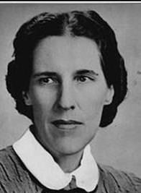


Investigations into the Hazards of Radium
U.S. Radium Corporation, President attempted to halt the growing concern around 1923. USRC conducted a covert internal investigation, he hired a married couple, Cecil &
Katherine Drinker researcher at the Harvard School of Public Health. Drinker is a
recognized expert & published 250 articles, textbooks, & reports during his career.
  The Drinker’s June 1924 report recommended changes in procedures to protect the workers, but Arthur Roeder, resisted the suggestions.
  Their report concluded that the total lack of safety precautions was putting the dial painters in danger,"
  However, USRC submitted a falsified version of the report to NJ officials & suppressed the Drinker’s findings, continuing to refute the idea that its radium dial paint was making anyone sick.
In July 1925, Columbia University specialist Frederick Flynn examined Grace Fryer.
  He said, the exam showed that her health was good.
  A consultant colleague who happened to be present emphatically agreed.
  Fryer later discovered that Flynn’s examination was part of a campaign of misinformation started by USRC. The Columbia specialist was not licensed to practice medicine — he was an industrial toxicologist on contract with her former employer.
  The colleague had no medical training either — he was a vice president of U.S. Radium.
In April 1925, Alice Hamilton wrote to Katherine Drinker, in the letter, “Mr. Roeder is not giving you & Dr. Drinker a square deal. He tells everyone he is safe because he has a report from you exonerating him from any possible responsibility in the illness of the girls.
Later in 1925, Katherine Wiley of the NJ Consumers’ League was informed by Dr. Hamilton that she would arrange to get Katherine appointed by the U.S. Bureau of Labor Statistics to come & investigate the cases in Orange, N.J.
Notes:
U.S. Radium Corporation,(USRC), President Arthur Roeder attempted to halt the growing concern around 1923. He hired Cecil & Katherine Drinker, researchers at the Harvard School of Public Health. (Drinker was a pioneer in industrial medicine &
established industrial hygiene & applied physiology as disciplines in preventive medicine and public Health). In the Drinker’s June 1924 report recommended changes in procedures to protect the workers, but Arthur Roeder, president of U.S. Radium, resisted. Many of the authors of pro-radium research had a ﬁnancial interest in the radium corporations.
In April 1925, Alice Hamilton wrote to Katherine R. Drinker, in the letter, “ Mr. Roeder is not giving you & Dr. Drinker a square deal. He tells everyone he is safe because he has a report from you exonerating him from any possible responsibility in the illness of the girls.
After Hamilton’s letter, Cecil Drinker realized why Roeder had been stalling him and trying to keep his report from being published. Drinker then sent his original report to the Department of Labor and published it in the Journal of Industrial Hygiene in August 1925, despite U.S. Radium’s threats. Meanwhile, a Consumer League consultant trumped the Drinkers by reading a radium necrosis paper at the American Medical Association conference. Drinker finally published the paper later that year
Columbia University specialist Frederick Flynn, who said he was referred by friends, asked to examine Grace Fryer in July 1925. The results, he said, showed that her health was as good as his. A consultant collogue who happened to be present emphatically agreed. Later, Fryer found out that this examination was part of a campaign of misinformation started by the U.S. Radium Corporation. The Columbia specialist was not licensed to practice medicine — he was an industrial toxicologist on contract with her former employer. The colleague had no medical training either — he was a vice president of U.S. Radium.
The League in its fight over the radium issue did not primarily attempt to mobilize unions and workers to take up the women workers’ health issues, but turned to middle-class allies concerned about the workplace, hoping to achieve structural reforms in the area of industrial hygiene and workers’ compensation.

Slide 14
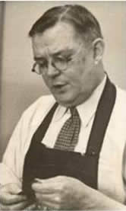
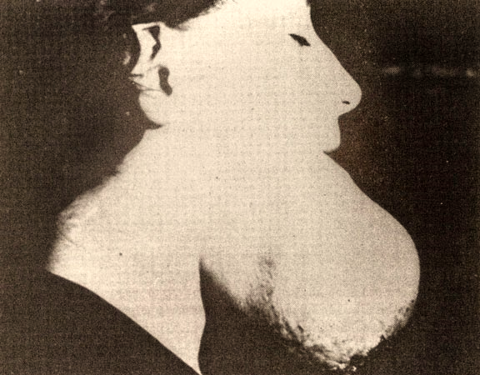
Radiation Poisoning Discovered
Dentists were among the first to see numerous problems among dial painters. Dental pain, loose teeth, lesions, ulcers, & the failure of tooth extractions to heal were some of these conditions. There was a black ooze with a strong garlic odor.
Radium is commonly referred to as a bone seeker. The women later began to develop anemia, bone fractures, & necrosis (From the Greek, necrosis (making dead)) of the jaw. The women also experienced suppression of menstruation & sterility.
In 1923, the first dial painter died, & before her death, her jaw fell away from her skull. By 1924, 50 women who had worked at the NJ plant were ill, & a dozen had died.
  Local physicians were bribed, by the company, to attribute worker deaths to Syphilis, a notorious sexually transmitted
  infection, which was cited in attempts to smear the reputations of the women.
The radiation-induced disease was first defined by pathologist Dr. H.S. Martland in 1924 to be symptomatic of radium
paint ingestion after many female workers from various radium paint companies reported similar dental &
mandibular pain. He devised a method to measure the amount of radioactivity stored in the bones of the radium paint workers. He was
also able to measure the breath of the workers to record radiation levels & correlate this with their disease. He described the cases of
18 dial painters who died of cancer at ages 20 to 54 years old. Causes of death were listed as anemia, necrosis of the jaw, &
osteogenic sarcoma. The typical period of exposure was about two years.
The first written reference to the disease was by dentist, Dr. Theodor Blum, in 1924, who described an unusual mandibular osteomyelitis in a dial painter, naming it "Radium Jaw.“
If pregnant, the women were prone to stillbirths, or “terminations” of pregnancy as the doctors
“would not permit development” of the fetus, because there were extreme deformities in the body
structure, fractures, & shortening of limbs. (Yes, Radium is a Teratogen)
There was no treatment & no cure. Radiation poisoning was a death sentence.
The last Radium dial worker died in 1988.
Sometimes, the moment a woman realized she had radium poisoning was when she caught sight of herself in a mirror in the middle of the
night — for a ghost girl was reflected there, shining with an unnatural luminosity that sealed her fate.
Notes:
The human body mistakes radium for calcium, so it filled their bones as calcium would, irradiating them from within. The victims had their bones break, teeth fall out, and spines collapse, The deaths of Helen Quinlan, 21, & Irene Rudolph, 22, came the following year. They had worked as dial-painters for 20 months and 2 ½ years.
It was only when the first male employee of the radium firm died that experts finally took up the charge. Martland discovered that when radium was used internally, even in tiny amounts, the damage was many thousands of times greater. A recent examination of data on whole-body radium retention in humans revealed that the excretion rate diminished with increasing body burden.
The effects of radiation exposure on a fetus depend on the level of exposure and the stage of fetal development. Radiation effects can appear immediately and result in cell death, embryonic death, or teratogenesis. The Radium business soon collapsed in New Jersey with the Orange Plant raised in 1933. Katherine Schaub and Grace died on the 18th of February and 27th of October respectively. In December 1936 Radium Dial upped stick to New York only being found via the paper’s help. Aiming to stop any litigation the new president Ganley had Peg Looney’s autopsy evidence destroyed.
Some realized they weren’t long for this world when they looked into the mirror at night. There they saw the bones of their skull glowing faintly underneath their skin.
Peg Looney and Catherine Donohue, were buried in lead-lined coffins.

Slide 15

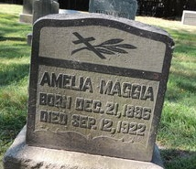
What is it like to have Radium poisoning?
The following is very gruesome, so do not visualize the revulsion of this woman’s story
    19-year-old Mollie Maggia started at Radium Luminous Materials Corp. in Orange, NJ, in 1917
    In January of 1922, she got a toothache. Her dentist Joseph P. Knef told her the molar needed to come out.
    A few weeks later, she was back to have the tooth next to that one pulled. Neither wound healed, but they grew together & seeped blood & pus into Mollie’s mouth.
By May, her dentist thought Mollie needed surgery to remove a fast-growing abscess he’d found on her jaw. When he got the gum open, the bone didn’t look right as it was ashy & gray, so he gently prodded it with his finger. To his shock, the whole bone crumbled under his fingertip.
Instead of removing a tumor, he wound up digging Mollie’s entire left jaw out with his fingers. Unbeknownst to him, the radium had perforated the bone cells & stripped them of calcium. It had, shredded the collagen inside & left it as little more than a pile of splinters. It was boring holes inside her jaw while she was alive.
On September 12, 1922, eight months after her first toothache, Mollie Maggia was dead! The tumors had cut into her jugular vein & flooded her throat with blood, choking her to death in bed.
She died at the age of 24 after only 5 years of employment at RLM, she
is buried in Orange's Rosedale Cemetery.
Notes:
Mollie wasn’t the only one of the radium girls that this happened to. Radium passes easily through the gums and into the blood, so around the time Maggie got sick, all sorts of odd symptoms were cropping up among the shop girls. Next came co-worker Helen Quinlan. Then Irene Rudolph. Then Catherine O’Donnell. Then Hazel Kuser.
One suffered a total collapse of her vertebrae, as the radiation did to her spine what it had done to Maggie’s jaw. Others developed skin cancer, cataracts, throat cancer, and other symptoms of long-term radiation exposure, such as loose teeth and hair loss.
At the time, though radium was known to be acutely dangerous, nobody had any experience with radiation sickness.

Slide 16
Occupational Disease Labor Law
It was a system of non-compensation because of the legal doctrines that impeded recovery & other barriers that reflected the "resources & power" of defendants
The Consumers League of New Jersey successfully campaigned to have radium necrosis recognized as an occupational disease by the NJ State Workmen’s Compensation Board in 1926. Until then, radium poisoning was not compensable, Only the 9 on the list. Only Radium necrosis was added as a compensable disease & had a 2-year statute of limitations. However, it was too late to benefit any radium girls because the federal two-year statute of limitations had run out! And the new law wasn’t retroactive.
In 1929, the US Department of Labor identified 23 fatalities attributed to radium poisoning.
In 1941, New Jersey passed a bill making all industrial diseases compensable.
  Less than a dozen “Radium Girls” were compensated for their injuries.
In 1949, the US Congress passed a law that gave workers the right to receive compensation for occupational illnesses.
Today, the OSHA PEL-TWA for radium is 0.2 mg/m³. The EPA has set a drinking water limit of 5 picocuries per liter (5 pCi/L) for radium-226 & radium-228 (combined).
The EPA & the National Academy of Sciences, Committee on Biological Effects of Ionizing Radiation, have stated that radium is a known human carcinogen.
The Radium Girls saga holds an important place in the history of both the field of health physics & the labor rights movement. The right of individual workers to sue for damages from corporations due to labor abuse was established because of the Radium Girls' case. In the wake of the case, industrial safety standards were demonstrably enhanced for many decades.
Notes:
In the United States, there does not seem to have ever been prohibitory legislation banning radium use in clocks & watches. It was only with the passage of the Energy Policy Act of 2005 that the US Nuclear Regulatory Commission (NRC) was given oversight of the use of radium.^{[9]} Before that date, "the federal government had a limited role in ensuring the safe use of radium,“
The Radium Girls of the 1920s changed the course of occupational disease labor law. These glowing young women brought about the first case in which an employer was held responsible for the health of its employees. In 1926 three suits against the corporation were settled for $9,000, $3,000, and $1,000, but the attorney who brought these suits took no more cases. In 1926, radium necrosis was added as a compensable disease under Workman’s Compensation. But it only covered jaw necrosis, not anemia, not locked hips, broken thighs, sarcomas, or any of the other diseases the girls suffered or were doomed to die from. And the law wasn’t retroactive. None of the victims of radiation poisoning in the New Jersey cases won a favorable verdict from a court.
It was determined that the company's scientists and management had taken considerable precautions to protect themselves from the effects of radiation, but it did not seem to protect their employees. Additionally, for several years the companies had attempted to cover up the effects and avoid liability by insisting that the Radium Girls were instead suffering from syphilis. This complete disregard for employee welfare significantly impacted occupational disease labor law formulation. Radium Dial appealed over and over, taking the case to the Supreme Court, and on October 23, 1939, the court decided not to hear the appeal, and the lower ruling was upheld
In Ottawa, Illinois, the Radium Dial Corporation had medical reports from their doctors showing that the girls were suffering from radium poisoning but took out full-page ads in the local newspaper stating that radium was completely safe. The Radium Dial building was torn down in 1968 with no regard to potential radioactive danger, resulting in radioactive debris left all over the town.
Radium has been found in at least 18 of the 1,177 National Priorities List sites identified by the Environmental Protection Agency (EPA). As of December 2023, NJ had 115 Superfund sites on the Environmental Protection Agency's National Priorities List.

Slide 17
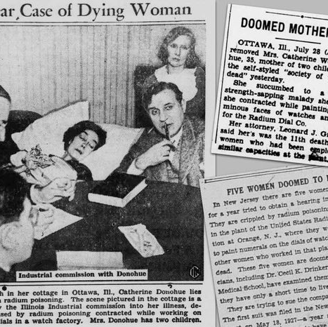
The Role of the Press
The Radium Girls brought out the best & worst of the press in its raw & erratic form.
The news media suddenly found the story irresistible. Headlines included: “Woman Awaiting Death Tells How Radium Poison Slowly, Painfully Kills”.
Despite the sensationalism, a moment arrived in the case when the “Radium Girls” needed a champion. Their physical condition was deteriorating & their financial situation was pitiful. Time was running out!
Alice Hamilton’s long-time friend was World editor Walter Lippmann, who editorialized: “The whole thing becomes a legal nightmare when to obtain justice, 5 women go to court & prove that they are dying. … This is a case which calls not for fine-spun litigation but for simple, quick, direct justice.”
With Lippmann & the newspapers outraged & public opinion building in favor of the victims, pressure to settle the case built on U.S. Radium.

Slide 18
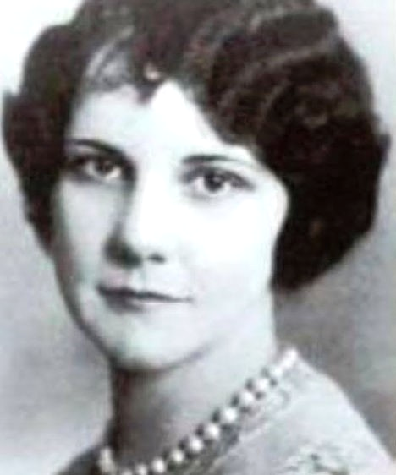
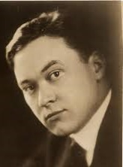
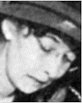
Litigation - Naming, Blaming, & Claiming
Under NJ law, employees had 2 years to file an injury claim, from their end of employment, against their employer. However,
many of these women didn’t have symptoms of radiation poisoning until much later.
In 1925, Harrison Martland studied the issue for himself & reopened the case of Mollie Maggia.
  Mollie had died in 1922. Mollie’s body was exhumed on October 16, 1927.
  The autopsy confirmed that her bones were highly radioactive.
It took U.S. Radium dial painter Grace Fryer 2 years to find a lawyer. On May 18, 1927, Raymond Berry, a young Newark
was willing to take her case. She was joined by 4 others: Edna Hussman, Katherine Schaub, & sisters Quinta McDonald & Albina Larice.
  The women were unable to claim relief under the Workers’ Compensation statute. Eight other states, including NJ, had a provision containing an exclusive listing of 9 compensable occupational diseases such as anthrax, & lead, mercury, phosphorus, & wood alcohol poisoning. Radiation poisoning, a relatively new & rare malady, was not included on the list of compensable diseases.
  Berry alleged that U.S. Radium’s misrepresentation of scientific opinion & campaign of misinformation was the reason
  that the women were not informed & did not take legal action within the statute of limitations
  In NJ the Statue of Limitation clock started at the end of employment, NOT inception of Disease
They sought $250,000 each in damages. It took eight appeals before the former radium girls finally had a victory, in October 1939.
Berry, hired physicist Elizabeth Hughes, from the National Bureau of Standards who used an electroscope to measure radioactivity in the
breath of the 5 dial painters. Hughes testified that all 5 women had ingested enough radium that their breath was toxic.
U.S. District Court Judge William Clark, (a USRC stockholder), mediated an out-of-court settlement, in 1928, in which the 5 young women settled with the company, which admitted no wrongdoing. They were given $10,000 each & $600 a year for each year they lived, plus have their medical & legal expenses paid. They all died by 1932.
It wasn’t until 1938 when a dying radium worker named Catherine Wolfe Donohue successfully sued the Radium Dial Co. in
Ottawa over her illness. As Catherine testified, she appeared ancient & emancipated at only 71 pounds. The company only had
to pay $10,000 to the women, collectively. RDI’s actions to hush up the scandal went as far as interfering in the girls’ autopsies
when the Illinois workers began to die. Company officials stole their radium-riddled bones in their callous cover-up.
It is estimated that radium was responsible for the deaths of 112 young women.
  Strange Fact: The distance between West Orange & Greenwich Village is 17 miles, yet the union movement started in 1911 at the Triangle Shirtwaist factory never reached Orange, NJ, so the Radium Girls never received support in their struggles from a union.
Grace Fryer
Notes:
U.S. Radium was well defended by a team of lawyers and held a prominent position as a government contractor. In 1925 Harrison Martland studied the issue for himself. First, Martland reopened the case of Mollie Maggia. At that time, cause of death was established by a coroner’s jury, which was made up of laymen & acted like the jury in a court case. This is as dysfunctional in pathology as it is in criminal justice, so Martland, as Medical Officer of Essex County, abolished the jury system & hired competent medical examiners.
USRC’s chief chemist, Dr. Ed Lehman, was in the habit of handling radium without gloves, & suffered from lesions on his hands. He refused the Drinkers’ suggestions for protective equipment & died soon after.
Cecil & Katherine Drinker concluded that much of the USRC workforce, especially the dial painters, had ingested harmful & potentially fatal amounts of radioactive material. They sent Roeder a report of their findings with suggestions for improvement. Roeder was outraged at the idea, & threatened to sue if the report was ever published. The Drinkers acquiesced. Roeder forged his copy of the report wherein he claimed that the dial painters were found to be in excellent health. He forwarded that version to the NJ DoL
Alice Hamilton, who had carefully laid out a strategy in the previous months with the editor of one of the nation’s most powerful newspapers of the time, the New York World. An avowedly liberal newspaper founded by Joseph Pulitzer, the World championed public health causes as part of its mission to “never lack sympathy with the poor [&] always remain devoted to the public welfare. Walter Lippmann’s editorials, Berry’s maneuverings, the behind-the-scenes public relations work of Hamilton & others, & the accumulating outrage as represented in headlines convinced the NJ court system, & a trial was rescheduled for early June 1928. In 1936, the U.S. District Court for the District of NJ ruled against Vincent LaPorte, by that time widower of former dial painter Irene LaPorte, finding that the USRC had not fraudulently concealed the dangers of radium dial painting. Radium Dial appealed over & over, taking the case to the Supreme Court, & on October 23, 1939, the court decided not to hear the appeal, & the lower ruling was upheld. Tom, Catherine’s grieving & bankrupted widower, received $5,700, a fraction of the amount that had been spent on his suffering wife’s medical bills.

Slide 19
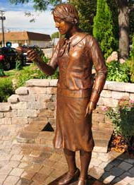
Statue to the Victims
In 2006. An 8th-grade student in Ottawa, IL, Madeline Piller, learned what had happened in her hometown & was amazed that no one else seemed to know about it. She lobbied her elected officials to erect a Radium Girl Memorial
Local unions were asked to provide funds & gentle political pressure. The town eventually commissioned Madeline's father, sculptor William Piller, to create a life-size bronze statue of a Radium Girl, which was unveiled Sept. 2, 2011 & is known as Radium Dial Painter Day
The statue is of a young 1920s woman with paintbrushes in one hand & a tulip in the other. Her long-sleeved blouse makes it impossible to tell if she's wearing a wristwatch of doom. But the tulip bulb she holds is limp, suggesting -- at least to us -- a canary-in-a-coal-mine situation; she's knocked the life out of it with her radioactive breath.
Marker is at the intersection of Clinton Street & West Jefferson Street in Ottawa
Notes:
The advent of "radium dials" was not only a supremely bad idea at the time, it is one of the more tragic legacies that stems from nuclear technology in the civilian sector.
In 1954, the total worldwide supply of purified radium amounted to about 5 pounds (2.3 kg) and it is still in this range in 2015. Radium’s current annual production — by extraction of spent nuclear fuel rods — is less than 100 grams.
While radium use had fallen, in the 1990s terrorism prompted new security concerns about radioactive sources of all types. Experts worried that untracked or stolen radioactive sources, including radium, could be used in "dirty bombs."

Slide 20
9 Health & Safety Knowledge Discrepancies
In retrospect, most modern EHS professionals could recognize these & act
Radium was used without an adequate Risk Assessment.
Its Hazards were not well researched, documented, or shared!
Economic incentives outweighed developing prudent safety precautions.
The medical community lacked sufficient knowledge of the dangers.
Privileged Stakeholders were valued & protected – procedures & PPE.
Precautions were not shared with the dial painter workers.
Working procedures were instituted that enhanced the exposure – Lip pointing
Treatments & cures were unavailable – victims suffered horribly!
Criminal efforts were employed to cloud or dismiss the hazards.
Imminent victim deaths were hoped to dispel interest!

Slide 21
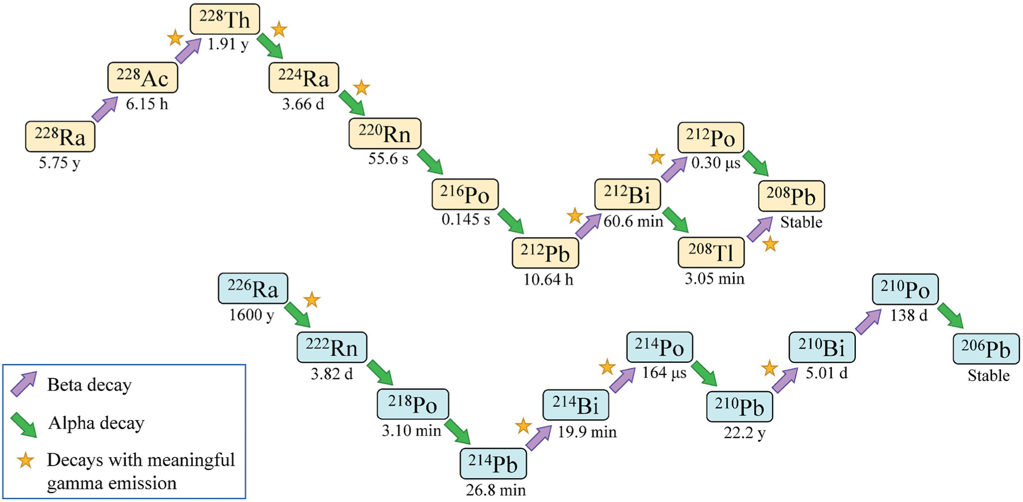
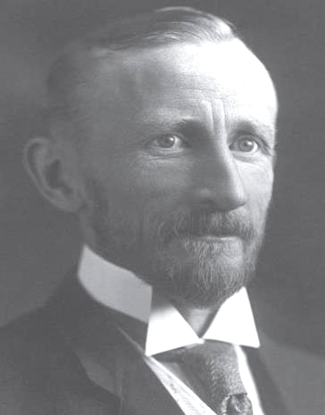
National Center of Human Radiobiology
In 1969, the three major human studies of radium were centralized at Argonne National Laboratory.
The radiation decay timeline for radium
It has been estimated that radium-228 is about 2.5 times as effective, per μCi, in inducing bone sarcomas as radium-226
This Center is a unique resource for retrospective analyses & distribution studies of plutonium, uranium, americium, radium, & barium in the whole human body, as well as in specific tissues & organs,
The study of radium dial workers is part of the Million Person Study of low-dose health effects that is designed to evaluate radiation risks among healthy American workers & veterans. The mortality experience of 3,276 radium dial painters & handlers employed between 1913 & 1949 was studied through 2019.
The last epidemiologic follow-up was 30 years prior when most of these workers were still alive. Nearly 65% were born before 1920, 37.5% were teenagers when first hired, & almost 50% were hired before 1930.
Dr. Frederick Hoffman, a statistician by education, published independent observations in 1925, concluding that
detrimental effects observed in dial painters were most likely due to direct contact with radium in the paint via lip pointing.
Notes:
Robley Evans, a physicist at California Institute of Technology investigated the safety of radium & to attain expertise in radium safety. Evans was commissioned by the U.S. Army to conduct the first of a series of epidemiological follow-up experiments on the long-term effects of radioactivity in human beings using the women dial painters as his subjects at the Radioactivity Center at the Massachusetts Institute of Technology (MIT) (1934-1950).
The second phase of experiments (1950-1970) were conducted on behalf of the Atomic Energy Committee (AEC) which studied the health risks of atomic tests. The research involved measuring the amount of radium in the women’s bodies.
The third phase of research which began after 1970, focused on research by the center for Human Radiobiology at the Argonne National Laboratory (ANL) and the University of Chicago. Eventually, all of the radium case studies were centralized at Argonne.
By the time the final radium study was terminated in 1993, 3,161 radium dial painters had been identified and 1,575 had been seen and studied. A total of 6,675 people containing radium had been identified and 2,403 of them had been located and measured.”

Slide 22
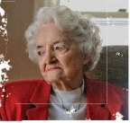
Legal, Moral & Memorial Legacy
Fighting against behemoths of business & capitalism who saw the importance of the working-class girls’ lives as equally minuscule to the trace amounts of radium killing them, these women united.
The bravery of these “Radium Girls” paved the way for workers to be safe at work by holding employers accountable for their actions. Employers have a legal duty to ensure the safety of their workers & to be open & transparent. Almost everything we know about radiation inside the human body, we owe to them.
As one official from the Atomic Energy Commission would later note, “If it hadn’t been for those dial-painters, the [Manhattan] project’s management could have reasonably rejected the extreme precautions that were urged on it & thousands of workers might well have been, & might still be, in great danger”.
  Since Radium has a half-life of about 1,600 years, their remains glow in the dark for quite a while in their graves.
Although their profession is long since obsolete, we have the radium girls & their unwilling sacrifice to thank for our right to compensation for illnesses contracted in the workplace.
  To see a list of those who died, go to: https://www.theradiumgirls.com/the-girls
On March 1, 2014, the last of the radium girls, Mae Keane, died at her home in
Middlebury, Connecticut at the age of 107. Luckily for her, her bosses weren’t
satisfied with her work as a dial painter, & she was quickly fired.
“As foul fumes along the New Jersey Turnpike assaulted my young nose, Toxic Tales
mixing in my youth, a story about radioactive paint seemed just another part of NJ life.”
Mae Kean, 2013
Notes:
The media attention paid to the 1928 case, & the cases of dial painters in Ottawa & Waterbury in the 1930s led to public awareness of the dangers of radium. Legislation was introduced to crack down on commercial radium products and to recognize radium poisoning as a compensable occupational disease.
“Bad chemistry enveloped me, as foul fumes along the New Jersey Turnpike assaulted my young nose, particularly on journeys to my grandmother’s house. With such toxic tales & noxious odors mixing in my chemical youth, a story about radioactive paint seemed just another part of New Jersey life. When I left the Garden State, my memories of the Radium Girls quickly faded away.”
Author Ainissa Ramirez On an April afternoon in 2013, I drove to a large home tucked away behind a pond where George Washington once camped. I found myself sitting with a very friendly group. Everyone had something to share with me about radium. About 20 minutes later, Mae joined us walking up from her downstairs bedroom, full of life and energy. I examined this little woman intently: the transparency of her skin, the depletion of color in her hair, and the effervescence of her smile. At 107 years of age, she looked magnificent. I sat there dumbstruck listening to Mae retell stories about her time in the radium painting studio.
By 1948, Argonne National Laboratories. Part of this entailed contacting former dial workers. Within 20 years, 205 volunteers were tested for body burden radioactivity., It became the most expensive medical study of a group of workers ever done in America. 80% had radium-caused cancers. 50% died by the time the study ended. When the project ended in 1993, detailed information on 2,403 cases had been collected.
Manhattan Project safety regulations were also based on those of the radium dial factories, which were much improved by this time.

Slide 23
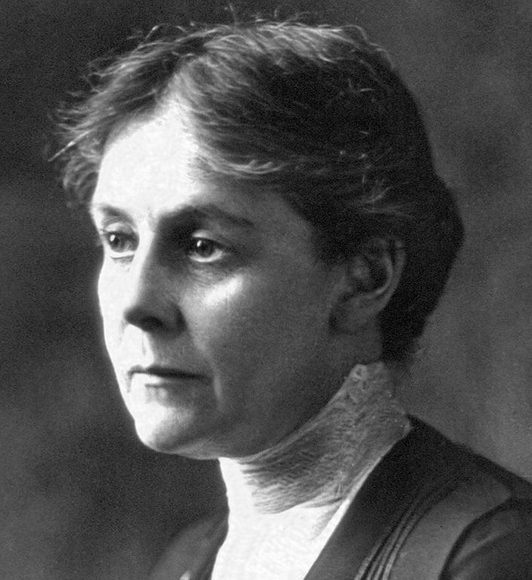
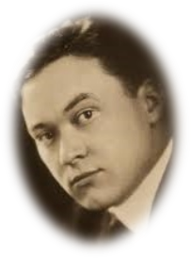
The Sequence of Workplace Disasters learned from this & other Incidents
The struggle to enact safeguards for hazardous working conditions is often led by women & girls, who are disproportionately harmed by job hazards or toxic chemicals. All too often, companies are most aggressive in marketing these toxic products to Black/Brown women or immigrants or hiring them to produce ordinary products in unsafe factories, to eke out a subsistence living. But: Powerful women always lead the fight!
Technology advances while protection lags, due to poor or non-existent Risk Assessment
The Hazard is unrecognized, or the damage is falsely attributed to other causes & is not shared
Marginalized workers are targeted, underrated, are the first to suffer, & then receive character attacks
Financial stakeholders resist investigation, refuse accountability, hide facts & may resort to criminal acts
Multiple miss-diagnosed illnesses & deaths finally expose the problem – Quack cures/causes are offered
Litigation is initiated, but defeated because of lack of resources, rich stakeholders temporarily win
Powerful influencers become aware & intervene
The press finally takes notice & reports the disaster - the public is outraged
Legislatures act; laws change & protection is mandated
New precautions enhance the progress of technology but, at the expense of the first victims!
In conclusion: in my opinion, we EHS professionals must move beyond excellent Risk Assessment, to the societal impact
Notes:
The struggle to enact safeguards on toxic chemicals is often led by women & girls, who are disproportionately harmed by toxic forever chemicals, Time and again we find deadly ingredients like asbestos, mercury & formaldehyde in personal care products. All too often, companies are most aggressive in marketing these toxic products to Black and brown women.
Over the last more than two decades, the Environmental Protection Agency removed or contained radium in more than a dozen sites. But one remains. The state of Illinois owns the area, 17 acres on the east side of the Fox River
President Donald Trump has proposed slashing federal money for the Superfund program, which allows the EPA to decontaminate hazardous sites. Ottawa has been a part of the program since 1988

Slide 24
Resources used to prepare this presentation
Moore, Kate (2017). The Radium Girls, The Dark Story of America's Shining Women. ISBN 978-1492649366.
Claudia Clark, Radium Girls: Women and Industrial Health Reform, 1910-1935 (Chapel Hill, NC: University of North Carolina Press, 1997).
Ross Mullner, Deadly Glow: The Radium Dial Worker Tragedy (Wash., DC: American Public Health Association, 1999).
https://en.wikipedia.org/wiki/Radium_Girls
https://environmentalhistory.org/people/radiumgirls/
https://www.britannica.com/story/radium-girls-the-women-who-fought-for-their-lives-in-a-killer-workplace
https://www.nist.gov/blogs/taking-measure/new-jerseys-radium-girls-and-nist-trained-scientist-who-came-their-aid
https://www.damninteresting.com/undark-and-the-radium-girls/
https://allthatsinteresting.com/radium-girls
https://www.nytimes.com/2014/12/07/magazine/my-great-great-aunt-discovered-francium-and-it-killed-her.html
https://www.ncbi.nlm.nih.gov/pmc/articles/PMC5595405/ (National Library of Medicine)
https://www.ncbi.nlm.nih.gov/books/NBK595997/
https://scholarship.law.missouri.edu/mlr/vol62/iss2/2
https://www.afacwa.org/the_forgotten_story_of_the_radium_girls_whose_deaths_saved_thousands_of_workers_lives
https://www.youtube.com/watch?v=1799d6A3PUg

