Slide 1
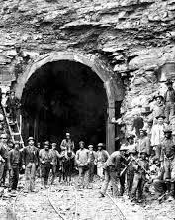

Historic & Cultural Importance of the Hawks Nest, WVA Tunnel Project
This industrial tragedy is one of the more horrifying workplace safety disasters in American history, one created by ethnological prejudice & the complete indifference of employers to workers dying.
There is a spellbinding allure to disaster, …Hypnotic & wordles, the disaster repulses even as it propels one’s attention toward it.
Hawk’s Nest is an extreme in a class of extremes — the disaster where truly nothing seemed to survive, not even in memory.
I can only cover the basic facts & points of conjecture of this intriguing story here, so please read my much more detailed account in my PS article, or the copy on my LinkedIn page. https://www.linkedin.com/in/howard-spencer-530aa2191/
Spencer, H.W. (2023, Feb.). The historic & cultural importance of the Hawks Nest Tunnel disaster. Professional Safety, 68(2), 42-47.
Notes:
The community of Gauley Bridge is named after a bridge over the Gauley River near the original town site. The name Hawk’s Nest is derived from the fish hawks that inhabited the cliffs on Gauley Mountain.
During the 1930s Depression, men were desperate for work of any kind. The unemployment rate in most WV counties was between 30 & 40%, well above the national average. Despite that statistic, most laborers were non-local immigrants from the Deep South. When word got out that there were jobs in West Virginia, hundreds of black agricultural migrant workers hopped trains and rode north to the coal mining fields. They soon learned that they faced a classic “Hodson's Choice” Take this job or risk starvation.
But the jobs were not mining coal. Instead, a company needed workers to drill a tunnel through Gauley Mountain, located between Ansted and Gauley Bridge in Fayette County, West Virginia.
Ethnology: a science that deals with the division of human beings into races and their origin, distribution, relations, and characteristics.

Slide 2

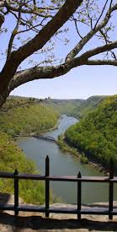
Why is this Incident Important?
We must understand that the mass killing at Hawk’s Nest was only possible because of white supremacy & racist beliefs. This often gets clouded over in historical accounts, but it is important to keep it at the center of our understanding. There are many safety lessons we can also learn from the failure to observe known precautions.
We’re still unable to find all of the names of the dead, many of whom were buried in mass, unmarked graves.
Catherine Venable Moore, a WV author
NOTICE
The facts disclosed in this presentation may be disturbing to highly empathetic individuals
Viewer Discretion is Advised
Notes:
Since the drilling of the tunnel was a construction project and not technically a mining operation, the workers were deprived of any protective provisions for underground mining. Collective trauma like this never really goes away; but the process of recovering is so much slower if we continue to deny its full truth.” “The historical record is disgracefully neglectful of the event, and only a handful of the workers’ names were ever made known. What is more, any understanding of Hawk’s Nest involves the discomfort of the acute race divide in West Virginia, seldom acknowledged or discussed.” Catherine Venable Moore, a West Virginia author

Slide 3
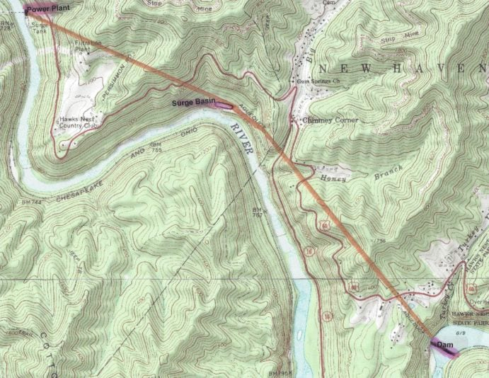
Route of the Tunnel
Fayette County gets precipitation,151 days per year. 46” of rain, & 38” of snow per year
W
1
1
FLOW
The tunnel is 16,240 feet in length
High silica portion 5,052’
Camp 2
2
Camp 1
CC
3
Direction of simultaneous digs
3
and drops in elevation a total of 163 feet.
The project consisted of Hawks Nest Dam and Intake plus a 3+ mile Tunnel, Hawks Nest Surge Basin, Hawks Nest Powerplant, 6 miles of Transmission Lines, & the 243-acre impoundment behind the dam.
Rivers natural flow
4
Camp3 & Commissary
Notes:
Gauley Bridge is a small town in Fayette County, (668.36 square miles) in the center of West Virginia. The New River flows northwesterly across the state of West Virginia and near the center of the state becomes the Kanawha River after its confluence with the Gauley River immediately downstream of the Hawks Nest Project.
Discuss highlight of the map
In 1929 the male population of Fayette County was 80% white.
The new river is reported to be the oldest river in the continental US.
A private corporation had bought parts of a major river system and effectively dewatered more than 5 miles of riverbed without encountering significant objection from either state or federal government.”

Slide 4
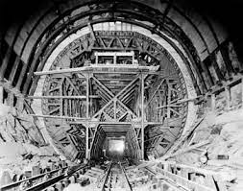
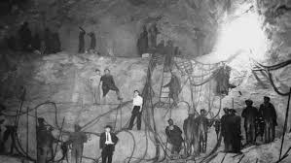
The Engineering Plan
Construction of the tunnel began on March 31st, 1930
The tunnel is 16,240 feet in length & drops in elevation 163 feet.
Workers moved forward from 250 to 300 ft per week through 99.44% pure silica, in dig #1.
The original plan was for the tunnel to be 32-36ft in diameter.
When high-grade silica was discovered UC&CC widened the tunnel to 46 feet in diameter, for approximately 1/3 of its length to mine more silica.
  300,000 tons of valuable silica ore were delivered to Boncar
Drilling used a benched process in all 4 shafts. Four crews using wet drills would bore horizontally into the open face.
Simultaneously 16 crews would dry drill vertically 12-20 feet into the bench.
The contractor would pay $250 for each day they exceeded the target & the company would pay the contractor $250 for every day they beat the target.
Notes:
Because the Hawk’s Nest Tunnel was licensed as a civil engineering project, even the most modest forms of safety were not applied
Workers drilled holes and then stacked dynamite to blast through sandstone. Approximately 2 million pounds of explosives were used in the tunnel work without a single explosive related fatality. Explosives were supervised by Dupont Company who manufactured the explosives.
The horizontal drills needed the water to remove the debris. Dry drilling was much faster than wet drilling. Four dry holes were jack-hammered in the time it took to wet drill one hole. One shift of workers would drill the holes and at the end they would clear out as the shot was ignited.
The New-Kanawha Power Co., set to build the tunnel, dissolved as soon as the tunnel was completed late in 1934.

Slide 5
Construction Process
Two engineers drowned on May 29, 1929, while taking soundings for the construction of the dam.
Construction of the tunnel began on March 31st, 1930, just 18 days after the contract award.
Because the Hawk’s Nest Tunnel was licensed as a civil engineering project, not a mine, even the most modest forms of mine safety were not required or applied.
The horizontal drills needed water to remove the debris. Dry drilling was much faster, 4 dry holes could be jack-hammered in the time it took to wet drill one hole.
One shift of workers would drill the holes & then stack dynamite to blast through the sandstone, at the end they would clear out as the shot was ignited.
  Approximately 2 million pounds of explosives were used in the tunnel without a single related fatality. Explosives were supervised by Dupont Company who manufactured them.
Black workers were assigned to carry steel to the drillers & haul the rock & debris, (mucking) from the tunnel, the dirtiest & deadliest work. 507,336 yards³ of material were removed.
The New-Kanawha Power Co., created to build the tunnel, dissolved as soon as the tunnel was completed late in 1934.
Notes:
To generate electricity for a plant downstream at Alloy, Union Carbide's Kanawha and New River Power Company subsidiary decided to divert the New River to improve its power generation ability.
Beginning in 1927, its contractor Rinehart & Dennis began construction of the 3-mile tunnel carrying the river under Gauley Mountain. A dam was constructed immediately below Hawks Nest to divert most of the New River flow into the tunnel. It then re-enters the river near Gauley Bridge leaving a section known as "the Dries" in between.

Slide 6
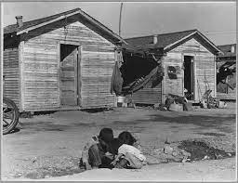
Housing at the Camps
The workers primarily lived in three camps constructed by the contractor, Reinhard & Dennis
  Camps were located adjacent to the major work areas.
The black workers were segregated in a portion of Camp #1
Camp #2 housed 150 workers while Camp #3 housed 350
  The commissary was also at Camp #3
Shacks were small wooden frame structures, generally 3 building units wide, 1 room deep, & 1 story high.
Shacks occupied by whites had electricity with a single bare bulb hanging from the ceiling and housed 4 men.
Black Workers’ shacks were the same 12’ by 14’ with 2 levels of bunks with 8 to as many as 15 men in a room.
There were no privies or wash facilities
Fayette County WV gets precipitation, 151 days per year
The shacks were burned down at the end of the project to drive out any remaining workers
Notes:
Camps were located adjacent to the major work areas.
The shacks were provided unfurnished. So occupants had to buy bed linen, coal, and a stove, from the Company Commissary. Fayette County West Virginia gets precipitation, on average, 151 days per year. It gets on average 46 inches of rain, and 38 inches of snow per year. On average, there are 158 sunny days. Daily high temps range from 75 - 80°F
The snowy period of the year lasts for 4.2 months, from November 23 to March 28,
A country club sits (once intended for the pleasure of the Union Carbide staff, now privately owned) on top of where Camp 1 for the Hawk’s Nest Tunnel workers once stood.

Slide 7
Payroll System
In the beginning workers were paid $.50 an hour which was lowered to $.40 and later to $.30. White workers were paid 5 cents an hour more for the same work & in cash.
Supervisors earned 15 cents per hour more than the average worker
Black workers were paid in “Script” for about $3, at the end of each 10-hour shift, which could only be “cashed” at the company’s Commissary for a 10% charge.
  If they waited until Friday to cash all of their script, there was no surcharge for cashing.
All workers paid $1 a week for shack rent and electricity plus 50 cents a week for the use of a company doctor and local hospital, which the company deducted from the worker’s pay or when they cashed the Black worker’s script.
Workers also paid $0.25 per week for coal whether they used it or not. They continued to pay for medical services which were rarely available.
For comparison workers who had a job in the adjacent coal mines earned about $1.80 a day but $0.80 was withheld for rent.
The tunnel proved to be an asset for UC&CC, repaying the $9M investment in 9 years.
Notes:
In the beginning workers were paid $.50 an hour which was lowered to $.40 and later to $.30. White workers were paid in cash.
Black workers were paid in “Script” for about $3, at the end of each 10-hour shift, which could only be “cashed” at the company’s Commissary for a 10% charge.

Slide 8
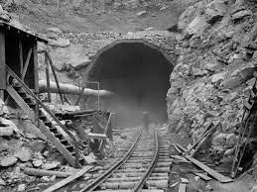
Health Exposures
R&D decided the most cost-effective way to handle the crisis was not to acknowledge the dangers, stop work & provide safer conditions, but to deny the reality of the situation, keep hiring a steady stream of new workers & complete the tunnel as quickly as possible.
At Hawks Nest, the combination of large work crews drilling & blasting underground for 12-hour shifts, six days a week lack of any dust suppression, CO exhaust from gas fueled “Dinky” engines, inadequate ventilation & no personal respiratory equipment were all contributory factors to the elevated levels of exposure.
Company doctors called the illness “Tunnelitis” & gave workers “little black devils”: tablets of baking soda coated with sugar.
FAN reported to supply 7,000 CFM
18” Air Duct
Approximately 3-5,000 feet long
Underground workers began dying two months after they first entered the tunnel.
Notes:
The officials in charge decided the most cost-effective way to handle the crisis was not to acknowledge the dangers, stop work and provide safer conditions, but to deny the reality of the situation, keep hiring a steady stream of new workers and complete the tunnel as quickly as possible.
At Hawks Nest, the combination of large work crews drilling and blasting underground in confined spaces, lack of dust suppression, exhaust from small gas fueled engines called “dinkey’s,” inadequate ventilation and no personal respiratory equipment were all significant contributory factors of elevated levels of exposure.
There were no end-of-shift shower facilities, so workers carried contamination back to their shacks or homes. No where in the record can any mention be found of privies or washing facilities be found. One can only imagine the personal hygiene issues created by the lack of sanitary facilities

Slide 9
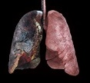
Primer on Silicosis
Silicosis is an interstitial lung disease caused by breathing in tiny bits of silica, a common mineral found in rock. It has had names such as Miner’s Phthisis, Grinder’s Asthma, and Potters’ Rot.
In 1700, Dr. Bernardino Ramazani, the “father of occupational medicine” identified evidence of silicosis. He did autopsies of the stone workers, noticing a “sand-like” substance in their lungs.
In the early 1900s, Dr. Alice Hamilton found evidence of silicosis in granite workers in Vermont. The dust that workers were inhaling caused their extreme difficulty of breath & eventual death.
By 1911, the connection between airborne silica & death by silicosis had been established well enough to cause South Africa, to force its gold mines to use water to suppress dust when drilling
There are three types: of Silicosis
  Acute: Symptoms happen a few weeks up to 2 years after exposure to a large amount of silica.
  Chronic: Exposure to silica dust for more than 10 years,. Symptoms may be mild at first & slowly worsen.
  Accelerated: exposure to silica dust for 3 to 10 years. Symptoms worsen quickly causing permanent lung scarring, called pulmonary fibrosis.
Because the disease affects the immune system, silicosis patients are vulnerable to developing tuberculosis, lung cancer, COPD and kidney disease.
There is no cure for silicosis, but treatment is available, but only palliative.
Notes:
Silicosis is a chronic disease, but progress quickly. As a serious occupational disease it significantly reduces the life span of exposed workers. Silicosis can lead to breathing problems, a serious lung condition called Progressive Massive Fibrosis (PMF), or lung cancer. There is no cure for silicosis and it can be fatal.
stage1 Disease is confined within the lung and the diaphragm. Stage 2 All of Stage I with the addition of intrathoracic lymph nodes. Stage 3 extension into the chest wall, heart or through the diaphragm
The survival times of silicosis stage I , II and III, from the year of diagnosis to death, were 21.5, 15.8 and 6.8 years, respectively.
The longer silicosis goes without treatment, the more likely it is to develop a complication. Because the disease affects the immune system, silicosis patients are vulnerable to developing tuberculosis, lung cancer, COPD and kidney disease.

Slide 10
Other Exposures
Not Quantified in the 1930’s
Noise:
The time-weighted average noise level for a pneumatic drill is a mean of 116.2 dBA and a peak of 130.4 dB in a test conducted by the University of California, Berkeley. Applied Ergonomics Volume 74, January 2019, Pages 31-36
Handle Vibration:
The weighted total handle vibration was 39.14 m/s² for the pneumatic drill (16X standard)
The size of this signal is proportional to the acceleration applied to it. The frequency-weighting network mimics the human sensitivity to vibration of different frequencies. The use of weighting networks gives a single number as a measure of vibration exposure and is expressed as the frequency-weighted vibration exposure in meters per second squared (m/s²) acceleration units.
Vibration Standard – (ISO) standard ISO 5349.
An acceptable level of vibration is 2.5m/s² for 8-hour use. Excessive vibration can lead to HAVS, VWD, and Raynaud’s Syndrome.
Notes:
The noise levels in the Hawks nest tunnel were never measured because there was no instrumentation at the time. However, we know that rock drills are noisy. A recent study from Berkley in 2019 is illustrative
We also recognize that jackhammers are vibratory tools, and we know that many workers reported numbness in their hands. Again, there was no instrumentation but citing the same research we learn that the typical vibration of jackhammers is approximately 16 times the standard. Vibration can cause changes in tendons, muscles, bones, and joints, and can affect the nervous system. Collectively, these effects are known as Hand-Arm Vibration Syndrome (HAVS)
Vibration white finger is a term used when secondary Raynaud's has been caused by vibration. This typically happens to people who regularly use certain types of vibrating tools, such as hammer drills. VWF is Von Willebrand disease (VWD) is the most common hereditary blood-clotting disorder in humans. An acquired form can sometimes result from other medical conditions

Slide 11
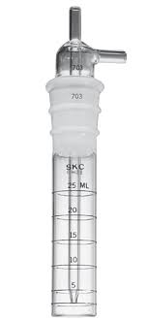
Exposure Controls or lack thereof
Drilling: The company ordered that workers use a dry drilling technique that would create more dust because this method was faster and cheaper
Dry drilling ceased while wet drilling continued, but only when inspectors were present.
Testing for Air Contaminants.
It is worthy to note that Reinhard and Dennis only conducted two tests for CO
in the 17- month duration of the tunnel dig. They conducted no dust counts.
A proven technology existed to measure dusts. The Impinger was developed in 1916
by the US Public Health Service and regularly employed by the US Bureau of Mines.
Ventilation
The Department of Mines pushed the company to install a ventilation duct. It was 24 inches in diameter made of canvas and had an 18” fan, that the company reported supplied 7000 CFM. It was reported and widely acknowledged that it was ineffective because of many holes caused by falling rocks.
Respiratory Protection
Union Carbide officials and engineers wore masks to protect themselves
Reinhardt & Dennis failed to provide masks for the tunnel workers themselves, even when they requested them.
Personal Hygiene
There were no end-of-shift shower facilities, so workers carried contamination back to their shacks.
Notes:
The circumstances cannot be considered accidental. Prior to groundbreaking, core samples made it clear that most of the tunnel would be drilled through high grade silica-bearing sandstone. Ultimately, a third of the tunnel was enlarged for the purpose of silica extraction.
The two physicians hired were “Dr. Mitchell” of Mount Hope, West Virginia, and “Dr. Simmons” of Alloy, who was associated with the Electro-Metallurgical Company. They received 25 cents per person examined.

Slide 12
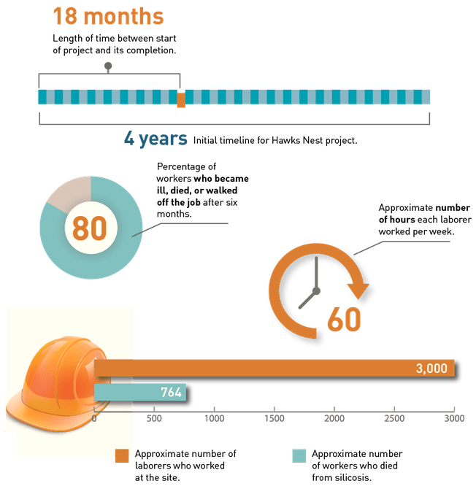
Some Amazing Numbers
Very high turnover rate
64%
1,213 employees worked at least 2 months underground
A NIOSH Review in 2002 raised the death estimate to 1000.
Notes:
Beginning in 1927, Union Carbide and Carbon’s contractor Rinehart & Dennis began construction of the 3⁺mile tunnel carrying the river under Gauley Mountain. The contract for the tunnel portion had built in incentives and penalties regarding meeting the 2-year target date. The contractor would pay $250 for each day they exceeded the target and likewise the company would pay the contractor $250 for every day they beat the target.
Because of the size of the work crews and the long hours the project was completed in less than half the scheduled time.
The average length of work was 15 weeks for a black worker and 16 weeks for a white worker
The real number of workers who actually died will never be known partly because Union Carbide wiped out the historical record and partly because most of the tunnel workers were dismissed at the end of 1931 and scattered throughout the South. Many of the men did not become sick until later, so their deaths never became a part of the official numbers. Of the approximately 1,213 employees who worked at least two months digging the Hawk’s Nest Tunnel, 764 (63%) died within seven years of silicosis. That was 4 times the prevailing rate of respiratory death for working-age men in Fayette County.

Slide 13
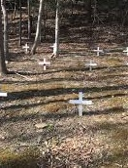
Burials
On average 10-14 individuals died a day
African Americans who died could not be buried in local "white" cemeteries. At first, the recently deceased were dumped in the riverbed & covered with tunnel rock.
Reinhard & Dennis surreptitiously, & at nearly 2X the going rate, hired undertaker, Hadley C. White & paid him $55 for each burial.
White dispensed with embalming. When he ran out of room in an old slave cemetery, he used the Martha White Farm in Summersville.
Each of the unmarked graves is said to contain more than one body in plain coffins.
In 1972, the farm was excavated to enlarge State Rt.19, & the bodies were reburied at Whippoorwill, with simple wood crosses.
Whippoorwill became a dumping ground for old appliances & highway crews disposing of roadkill.
Whippoorwill was abandoned for 40 years until Charlotte Yeager, a local newspaper publisher found it in 2010 & restored it, locating each grave with radar equipment.
Notes:
The County paid local undertakers $25 to bury paupers in the local slave cemetery.
Records show that the corpses of ten black men employed by Rinehart and Dennis were shipped to their homes in the South,” mainly in North Carolina and Tennessee.
The bodies in that makeshift cemetery were moved several miles away to unconsecrated ground in 1972, when the state of West Virginia decided to widen U.S. 19. The new burial site in Summersville became a dumping ground for old appliances and highway crews disposing of roadkill until local resident Charlotte Yeager and Charles Neilan made it their mission to find the graveyard, which they did with the help of West Virginia State University Professor Richard Hartman.
On Sept. 7, 2012, the names of the dead buried in the cemetery were read and the ground was consecrated in a service performed by three ministers.

Slide 14
Worker’s Compensation Laws
Wisconsin was the first state to pass a worker’s compensation law in 1911.
Unlike an injury that is caused by work, an occupational disease can be more difficult to prove. An occupational disease is identified when it is shown that it is more prevalent in a particular body of workers than in the general population.
Coverage for diseases varies from authority to authority. One system used is the “List System” which covers only a certain number of occupational diseases and has the advantage of listing diseases with a presumption that they are of occupational origin.
The WV WC law originally did not list silicosis as an occupational disease. It was upgraded in1935, (4 years after work ended) to include Silicosis, but it had a unique statute of limitations.
This article provides that if a worker has worked for 2 years in the same employment, if he presents his claim within 1 year after leaving his job, if he has given his life’s history in all detail to the employer, if he has never broken any safety rules, he may recover $500 perhaps $1,000, but no more though he should later be dying of Silicosis”
Between 1936 - 1940, only 79 WVA workers received compensation for Silicosis.
Notes:
Unlike an injury that is caused by work, an occupational disease can be more difficult to prove. An occupational disease is identified when it is shown that it is more prevalent in a particular body of workers than in the general population.
Coverage for diseases varies from authority to authority. One system used is the “List System” which covers only a certain number of occupational diseases and has the advantage of listing diseases with a presumption that they are of occupational origin.
READ QUOTE

Slide 15
Lawsuits and Settlements
There were 538 lawsuits filed against the 2 companies, (R&D & N-KPC) requesting $4 million in damages. The out-of-court settlement was $130,000. Lawyers received 50%.
The largest trial ended with a hung jury.
  Evidence of jury tampering, and $20,000 bonus compensation to the plaintiffs’ attorneys from Reinhard & Dennis superintendent Perkins may have influenced the outcome.
Out of all the lawsuits filed, only two highlighted Union Carbide’s involvement.
Judge J.W. Eary, hearing the consolidated cases determined that:
  a single Black man would receive $400 & a married Black man $600 while
  a single white man got $800, & a married white man received $1,000.
$100 in 1930 is equivalent in purchasing power to about $1,669.47 today
During the trial, there was considerable evidence that the contractor worked to bribe witnesses & tamper with juries. However, precision is difficult because the contractor later destroyed all the medical records, including any information about the afflicted workers.
The total amount of damages represented Just Over 1% of The $9M Project Cost.
Notes:
Union Carbide was able to remain detached in the eyes of both the public and the law from the horror at Hawk’s Nest,
This power to control the narrative would serve the company well during civil legal proceedings that would be held later in the Fayette County Courthouse. $100 in 1930 is equivalent in purchasing power to about $1,669.47 today,
Rinehart and Dennis went bankrupt several years after the settling of the hundreds of lawsuits

Slide 16
Newspaper Coverage
West Virginia’s newspapers took little notice of the dying workers and the construction project itself. In all of 1931, only three sizable stories on the largest construction project in the county’s history appeared in local newspapers.
When workers started getting sick, newspapers published blatantly racist articles, attributing the lung problems to poor habits of nutrition & an unusual susceptibility among African Americans to pneumonia.
Union Carbide, Rinehart & Dennis & local officials were worried revelations of suffering by industrial workers would arouse sympathy and outrage among the public.
The Fayette Tribune, tried to dig deeper into why so many workers were becoming ill & dying. However, the newspaper claimed it could not verify facts at the construction site. “Rumors & reports of various conditions known to exist at the tunnel & dam project are discussed generally by residents, but little firsthand information is obtainable because of the ‘gag order’ enforced by executives of the contracting company”.
Then government officials, newspapers, & others conspired to keep this story from the public knowing that soon the witnesses would all be dispersed or Dead!
Notes:
West Virginia’s newspapers took little notice of the dying workers and the construction project itself.
For many Americans outside the state, of WVA a January 25, 1936, Newsweek article was the first time they heard of the tunnel deaths taking place years before. While an industrial disaster and human tragedy, the Hawks Nest project was an engineering success.
The Hawks Nest Tunnel became an important part of the labor culture of the 1930s, generating a novel and several short stories, as well as songs and an important cycle of poems by the activist poet Muriel Rukeyser. National news stories were published for several weeks when the extent of the tragedy came to public light.

Slide 17
Congressional Hearings
On May 20, 1931,The Fayette Tribune broke the story about the sick and dying tunnel workers & inhumane & unsafe working conditions, but a gag order was issued by a Judge to Stop Publication.
On January 8, 1935, Albert Maltz, an American author and one of the infamous blacklisted Hollywood Ten, published a short fictional story titled “Man on the Road” about Hawks Nest, it was later widely reprinted.
The U.S. House of Representatives Committee on Labor convened a hearing on January 16, 1936, on the Hawks Nest Tunnel disaster. Representatives from the tunnel companies declined to attend.
The February 26, 1936, Blues song “Silicosis is Killin’ Me by Josh White was heard by President Roosevelt, who initiated the actions that became the Walsh-Healy Act.
An R&D Supervisor testified in an obvious pejorative statement, “I knew I was going to kill these N-Word, but I didn’t know it was going to be this soon.”
What follows is a quote taken from the summary statement of the findings of the Congressional Hearings,
  “That the whole driving of the tunnel was begun, continued, & completed with grave & inhumane disregard of all consideration for the health & future of the employees’ lives. That as a result many workmen became infected with Silicosis: that many have died & many more not dead are doomed to die from the ravages of the disease as a result of their employment & the negligence of the employing contractor”
Despite the clear proof of negligence, no criminal accountability has ever been initiated!
West Virginia historian Chuck Keeney said in an interview, on May 11, 2017 “Nobody gets punished for Hawk’s Nest. Nobody goes to jail. And nobody (outside of) WVA even knows about!
Notes:
The silicosis disaster at Hawk’s Nest Tunnel could easily have remained a local (Fayette County) story in West Virginia. However, on January 8, 1935, Albert Maltz an American author, published a short story titled “Man on the Road” in the small left-wing magazine called The New Masses.
Later, in 1936, a Senate subcommittee investigated the disaster.. An R&D supervisor put it starkly, when he said at the congressional hearings, “I knew I was going to kill these niggers, but I didn’t know it was going to be this soon.”
The subcommittee’s report lambasted conditions at Hawks Nest
At the time, President Roosevelt’s labor secretary, Frances Perkins, declared “war” on silicosis in response to the Hawk’s Nest disaster and other workers across the U.S. developing the disease.
But by 1940, the Hawk’s Nest disaster was no longer in the headlines and concern about silicosis had diminished.

Slide 18
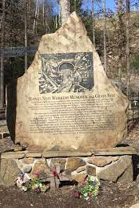
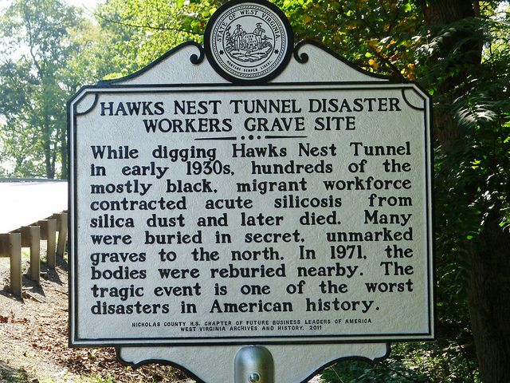
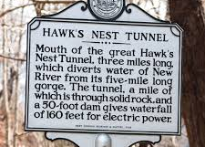
Memorials
The first marker was not erected until 2008 by West Virginia Archives & History. The Marker is near Ansted, West Virginia, in Fayette County with no mention of the deaths. In 2009 a private group installed the memorial stone at the relocated cemetery. In 2011, 70 years after the event a marker was installed that mentioned the deaths. Because there has been no atonement for the Hawk’s Nest Tunnel disaster, ninety years later, it still inflames & disrupts!
2011
2009
2008
9 decades on, West Virginia hasn’t recovered from Hawk’s Nest
Notes:
West Virginia officials have done a superb job covering up the truth about Hawk’s Nest. The disaster is not taught in U.S. history classes. Remembrances of the people who died are extremely rare.
In the late 1930s, West Virginia Gov. Homer Holt, a Democrat, refused to sanction a Federal Writer’s Guide to his state until the writers toned down their discussion of Hawk’s Nest. Holt believed the guide would discredit the state and was “propaganda from start to finish” After leaving office, he served as general counsel of Union Carbide.
Hawks Nest is still a Hot Button item, In the 1960s, a West Virginia university professor received more than a dozen death threats when he tried to interview some of the survivors, Sheldon Rampton and John Stauber wrote in their book, Trust Us, We’re Experts.
Because there has been no atonement for the Hawk’s Nest Tunnel disaster, ninety years later, it still inflames and disrupts

Slide 19
In Conclusion
We, as Americans, have always prided ourselves in our industriousness & innovation. However, there comes a time when society must decide what it is we value. The lack of advocacy for victims of the Hawk’s Nest Tunnel tragedy is an excellent illustration of how structural & social determinants of a society influence health outcomes.
President Roosevelt’s labor secretary, Frances Perkins, declared “war” on silicosis in 1936 in response to the Hawk’s Nest disaster.
The February 26, 1936, Blues song “Silicosis is Killin’ Me by Josh White was heard by President Roosevelt. Later in 1936, he used his position to help pass the Walsh-Healy Act that required companies doing business with the government to maintain safe & healthful working conditions. Walsh-Healy was the forerunner of OSHA. https://m.youtube.com/watch?v=_BeK6K_m4WA
In 1938 Muriel Rukeyser, wrote Book of the Dead, poems of her impressions after a visit to Hawks Nest.
Today, Silicosis has been designated as an occupational disease with compensation for workers. However, tunnel workers at Hawk’s Nest were not protected by the laws established 40 years later by OSHA and MSHA, the acceptable limit now for GI for silica dust exposure, as allotted by OSHA in 2017, is 50 micrometers/m³ for an eight-hour period which is significantly lower than the standard set in 1971 at the onset of OSHA of 250 mm/m³ for eight hours. Construction is 25 mm/m³.
We live in a six-degrees-of-separation world. The six-degree separation theory holds that upon a keen evaluation, all people and events are closely related. The way that blues music impacted EHS history is but one example. How are you related or affected by this Travesty? Can it happen again?
Notes:
West Virginia historian Chuck Keeney said in an interview. “Nobody gets punished for Hawk’s Nest. Nobody goes to jail. And nobody even knows about.
So, what does the future of West Virginia look like? That is yet to be determined, but the more we understand these divisive political issues the more we will be able to pick the people who will properly represent us in Charleston.
Chuck Keeney also said West Virginians have too long been marginalized by the mainstream media and politicians as hillbillies and rednecks. It is much easier for people to take advantage of a group of people they see as a caricature or less than human.
The officials in charge decided the most cost-effective way to handle the crisis was not to acknowledge the dangers, stop work and provide safer conditions, but to deny the reality of the situation, keep hiring a steady stream of new workers and complete the tunnel as quickly as possible.

Slide 20
Resources used in the preparation of this talk
The Hawks Nest Tunnel an Unabridged History, by Patricia Spangler, 2008 by Wythe-North Publishing
Martin Cherniack, The Hawk's Nest Incident: America's Worst Industrial Disaster [1986]
David Rosner & Gerald Markowitz, Deadly Dust: Silicosis and the On-Going Struggle to Protect Workers' Health [2006]
Hawks Nest Tunnel Disaster. https://en.wikipedia.org/wiki/Hawks_Nest_Tunnel_disaster#:
Environmental Health Insights a Brief Review of Silicosis in the US,” (May 2010).
Hawk’s Nest Tunnel A forgotten tragedy in safety’s history. C, Keith Stalnaker, Professional Safety October 2006.
Before Black Lung, The Hawks Nest Tunnel Disaster Killed Hundreds
https://www.npr.org/2019/01/20/685821214/before-black-lung-the-hawks-nest-tunnel
Hawk’s Nest Tunnel Disaster, Wv: Worst Industrial Disaster in U.S. History
http://corporatecrimewatch.blogspot.com/2010/03/hawks-nest-tunnel-disaster.html

Slide 21


Pinewood Tom (Joshua White)
Joshua Daniel White (February 11, 1914 – September 5, 1969) was an American singer, guitarist, songwriter, actor & civil rights activist. He also recorded under the names Pinewood Tom & Tippy Barton in the 1930s. White grew up in the South during the 1920s & 1930s.
https://m.youtube.com/watch?v=_BeK6K_m4WA

