Slide 1
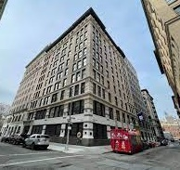

The Triangle Shirt Waist Fire
March 25th, 1911, was the 1st sunny day that year
The Asch building was designed by architect John Woolley, for Joseph J. Asch and constructed in 1900-01
On Saturday, March 25, 1911, was the deadliest disaster before 9/11 in the history of NYC, & one of the deadliest in U.S. history.
“ It is: The Fire that Changed America”.”
As a result of the fire, the American Society of Safety Professionals was founded in NY City on October 14, 1911
Notes:
No law required fire escapes, fire sprinklers, or outward opening doors. All of this was up to the discretionary power of the Building Superintendent.
The story of the fire is not the story of one accidental moment in time. It is a story of immigration and hard work to make it in a new country, as Italians and Jews and others traveled to America to find a better life. It is the story of poor working conditions and greedy bosses, as garment workers discovered the endless sacrifices required to make ends meet. It is the story of an unimaginable, but avoidable, disaster.
And it the story of the unquenchable pride and activism of fearless immigrants and women who stood up to business, got America on their side, and finally changed working conditions for our entire nation, initiating radical new laws we take for granted today.
Isaac Harris was born in Russia in 1865, and Max Blanck was born there three or four years later. They came to America in their 20s as part of the great wave of Jewish immigration. By the early 1890s both men had settled in New York City, and like many Jewish immigrants of the time, they entered the garment business.
The building was donated to the university in 1929 by Frederick Brown. It occupies 23-29 Washington Place in Greenwich Village, New York City. It was completed in 1901 and is an example of the neo-Renaissance architectural style. It features a stone base and brick upper walls with terra-cotta trim. Five limestone pilasters decorate the front façade and are topped with terra-cotta capitals. The Triangle Shirtwaist Factory fire in the Greenwich Village neighborhood of Manhattan, New York City, on Saturday, March 25, 1911, was the deadliest industrial disaster in the history of the city, and one of the deadliest in U.S. history. Workplace deaths weren’t uncommon then. It is estimated that more than 200 workers died every day on the job around 1911.
The building had experienced four recent fires and had been reported by the Fire Department to the Building Department as unsafe in account of the insufficiency of its exits.

Slide 2
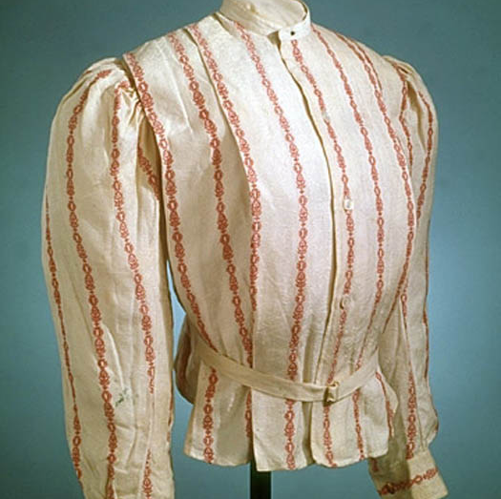
What was a shirtwaist
The shirtwaist or ladies' blouse was one of America’s first fashion trends to transcend the class divide.
“The waist-&-skirt combination both symbolized & enabled a wave of women’s liberation.”
The shirtwaist was appropriate for working in a factory or attending temperance or lady's auxiliary meeting, a versatility which was a hot commodity in a time when women’s clothing was layered and bulky.
It was a light cotton blouse made fashionable by artist Charles Dana Gibson’s famous “Gibson Girl.”
In 1906 Triangle produced 1,000 shirtwaists a day.
In Manhattan alone, there were 450 textile factories,
Shirts sold for $3 each
Notes:
At the turn of the 20th century, the most popular piece in a woman’s wardrobe was the shirtwaist. A gauzy blouse made of cotton or linen, it mimicked a man’s shirt, albeit one decorated with lace or embroidery, and often featured bell sleeves.
Harris and Blanck took advantage of new technology, installing mechanical sewing machines, which were five times faster than those run by a foot pedal. They priced their shirtwaists modestly, averaging about $3 each. The partners expanded, opening shirtwaist factories in New York, New Jersey, and Pennsylvania. Blanck partnered with his brothers and opened more around the country.
New York was a city of enormous wealth and wide disparities between rich and poor. New industries were booming — none more so than women’s and men’s clothing. The new age had created a demand for off-the-rack, mass-produced clothing that could be sold in department stores. No industry had more women than the garment industry, which in the first half of the 20th century came to produce almost 90 percent of the nation’s clothing.
The term "shirtwaist," derived from "waist," the nineteenth-century term for what we would now call a blouse (in itself so-called because it bloused over the waistband as it was tucked into the skirt), was commonplace by the 1890s.

Slide 3
Who were the Employees?
These young, working, immigrant women fled the pogroms of Eastern Europe only to struggle against economic, religious, political, and gender-based oppression in the United States.
The Triangle Shirtwaist Company was an anti-union shop and one of the sites of the famous 1909 Uprising for union recognition when more than 15,000 NYC shirtwaist makers walked out.
The Triangle Waist Company employed about 500 women and less than 100 men.
Sewing machine operators had to rent their sewing machines and buy the needles and thread.
At Triangle women had to leave the building to use the bathroom, so management began locking the steel exit doors to prevent the “interruption of work” & only the male foreman had the key.
The shirtwaist makers, worked seven days a week, from 7 a.m. to 8 p.m. with a half-hour lunch break. They were paid about $6 per week, equivalent in purchasing power to about $182.60 today
Many of the seamstresses, were from the Austro-Hungarian empire, Italy, & Russia.
  The Jewish workers were forced to violate the Shabbat (or "Sabbath") which is the centerpiece of Jewish life,
Most could barely speak English. Almost all were the main support of their families.
A male foreman monitored the largely female immigrant workforce during the day & inspected the women's bags as they left for the night. That is why the company scheduled the use of only one elevator at the end of the workday. But the company admitted it never had a serious theft problem.
Notes:
They had brought with them ambition, hunger for knowledge, and a healthy appetite for dissent, long denied to them in their homelands
Adding to the notoriety of the story was the fact that the dead were mostly women. It was not widely known that a huge proportion of immigrant women had entered the workforce, propelled by the need for a wage.
The Jewish workers were forced to violate their beliefs about working on the sabbath
The young workers had to submit to the indignity of a search when they left the shop. They had to line up and pass single file through the one door on the Greene Street side because the other was kept locked.
New York papers were filled with stories about communism, socialism, anarchism, and the new labor organizations, all of which challenged the idea that Gilded Age prosperity was shared by all. Nowhere were the voices of protest more vocal than in New York.

Slide 4
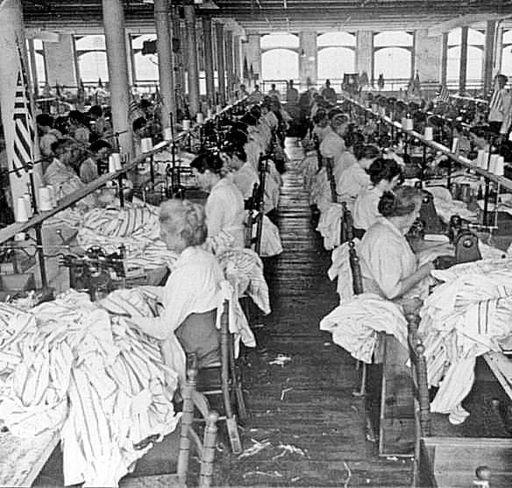
Political Environment
No political organization typified corruption & party bossism as greatly as the Tammany Hall Democrats who played a major role in controlling NYC, from the 1790s to the 1960s.
Blanck & Harris’ notorious anti-worker policies. Their employees were paid $7 to $12 a week, despite working 9 hours a day on weekdays plus 7 hours on Saturdays. 12 hr./day in the busy season. There were no child labor laws then.
When the International Ladies Garment Workers Union led a strike in 1909 demanding higher pay & shorter & more predictable hours, Blanck & Harris’ company was one of the few manufacturers who resisted, hiring police as thugs to imprison the striking women, & paying off politicians to look the other way.
The alleged cause of the fire was the disposal of an unextinguished match or cigarette butt in a scrap bin belonging to a cloth “cutter” Isidore Abramowitz, who tried to extinguish the flames but couldn’t. The bin contained 2 months of accumulated cuttings; Arson was never suspected in this case.
The fire broke out at 4:40 p.m. on the 8th floor. There was a flash of flames, leaping first among the girls in the SE corner of the 8th floor, & then suddenly over the entire room, spreading through the linens & cottons with which the girls were working
4
Notes:
No political organization typified this corruption and party bossism as greatly as the Tammany Hall Democrats of New York City in the second half of the 19th century. Tammany Hall Boss William Tweed built the Hall into a political force after the culmination of the Civil War, and effectively established the model of urban bossism. However most of the new immigrants had an allegiance to Tammy so it was loosing power. Tammany pushed the reforms to gain their support
The danger of fire in factories like the Triangle Shirtwaist was well-known, but high levels of corruption in both the garment industry and city government generally ensured that no useful precautions were taken to prevent fires.
Blanck and Harris already had a suspicious history of factory fires. The Triangle factory was twice scorched in 1902, while their Diamond Waist Company factory burned twice, in 1907 and in 1910. It seems that Blanck and Harris deliberately torched their workplaces before business hours in order to collect on the large fire-insurance policies they purchased
There was no clear city agency responsibility to ensure the safety of workers and factories,” Greenwald says. “No one was responsible for building safety. There were no clear regulations for fire safety and no modern fire equipment.”
Workers could only leave through a single door, where they and their handbags were searched for stolen goods. It was reported that three of the four elevators were taken out of commission due to security concerns, or blocked by the fire..
The fire began in a scrap bin belonging to a cloth “cutter” Isidore Abramowitz, who tried to extinguish the flames, but couldn’t,.

Slide 5
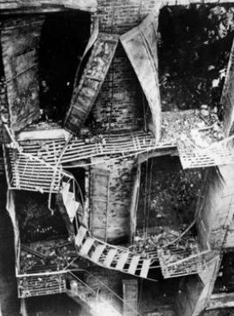
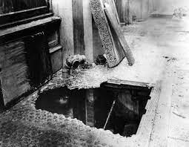
History
Max Blanck & Isaac Harris started the Triangle Waist Company in 1900
Triangle factory, was on the top 3 floors of the 10-story Asch Building, on the corner of Greene Street & Washington Place, in Manhattan.
  Real estate speculator Frederick Brown bought the building & donated it to the university in 1929 when it was renamed the Brown Building.
It was a modern factory, occupying about 27,000 Ft² in a brightly lit 10-year-old building, it had no sprinklers or audible alarm system
The waist company had 600 employees 500 of whom were girls. The fire had flashed through their workroom just as they were expecting the signal to leave the building. In 10 minutes, all would have been out.
There were 4 elevators with access to the factory floors, but only 1 was fully operational in the evening & the workers had to file down a, narrow corridor to reach it.
There were 2 inside stairways down to the street, each 3’-6“ wide, but one was locked from the outside to prevent stealing & the other only opened inward. The building had only one fire escape, which collapsed killing two dozen during the rescue effort. Had they made it all the way down, they would have found that it ended treacherously a full floor above a basement skylight. The air shaft had no exit to the street
The cutters at the Triangle Shirtwaist Factory ignored the no smoking on the job because their skills were so highly valued.
Shutters
Sections of ladder which ended two stories above the ground, twisted & collapsed under the weight of workers trying to escape the fire
Skylight
Notes:
The other concerns in the building had dismissed their workers at 3 o'clock, and only the shirtwaist makers were continuing their work. Saturday was pay day.
The Triangle Waist Company factory was located on the eighth, ninth, and tenth floors of the Asch Building. About five hundred people worked there. Most of them were young immigrant women and girls with roots in Southern and Eastern Europe. Many were Jewish. Most left traditional Jewish lifestyles and were forced to work on Shabbos. It was the great compromise of many Jewish immigrants, and it changed forever the landscape of religious Jewish identity. They worked long hours sewing women’s blouses, or “shirtwaists.” The danger of fire in factories like the Triangle Shirtwaist was well-known, but high levels of corruption in both the garment industry and city government generally ensured that no useful precautions were taken to prevent fires.
Triangle had experienced fires that were quickly extinguished with water from pre-filled buckets that hung on the walls. Neither the owners, nor the landlord, invested in extra firefighting systems like sprinklers. While the contents of the factory were highly combustible, the building itself was considered fireproof (and survived the fire without structural damage). Triangle dealt with fire hazards to their equipment and inventory by buying insurance.
Because it was only to be 135 feet tall, it was allowed to have wood floors, wood window frames, and trim, instead of the metal trim, metal window frames, and stone or concrete floors that would have been required in a 150 feet tall building.
The fire escape was just mounted in the facing brick, not to the building structural steel, it collapsed.
Fire Commissioner Waldo had reported this place to the Building Department within the past three months as a building unsafe for use as a factory, since there were insufficient means of egress by stairways, and there were not sufficient fire escape facilities.

Slide 6
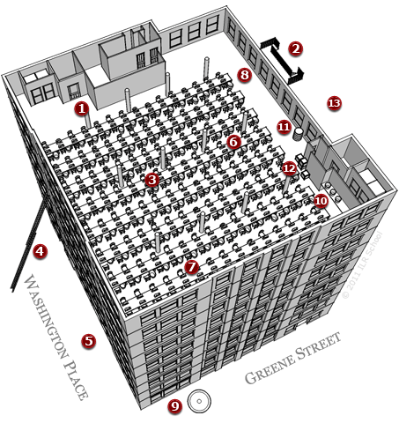
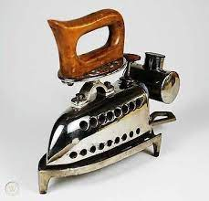
Layout of the 9th Floor
Rear elevators
Harris designed the layout of the sewing floor, placing the tables in a way that would minimize conversation among the workers to increase productivity
100’
Front
Elevators
FIRE HAZARDS
1. Locked door to the stair well
2. Rusty fire escape that collapsed, anchored only to face bricks
3. Cluttered workspaces
4. Short ladders only reached 6th floor
5. Not enough water pressure
6. Long wooden tables became obstacles
7. Wicker baskets full of scraps
8. Oily floors spread the fire quickly
9. Fire nets failed to catch jumpers
10.No sprinkler system, only 27 pails of water
11. Flammable barrel of oil for machines
12. Boxes crowding the exit
13. Lack of a required third staircase
75’long tables bolted to the floor
6’ pile of bodies against locked door
, Many tissue patterns hung from wires
240 Sewing machines
- use of alcohol irons was reported-
On Greene Street, running along the eastern face of the building more people leaped to the pavement than on Washington Place to the south.
Notes:
In 1900, Harris and Blanck founded the Triangle Waist Company and opened their first shop on Wooster Street. In 1902, they moved their company to the ninth floor of the brand-new Asch building on the corner of Washington Square in Greenwich Village.
This building was designed to be 10 floors Instead of 11. One more floor and the wooden windows would have had to be metal, the wooden floor would have had to be concrete.
In 1906, the successful company expanded to the eighth floor. By 1908, sales at the Triangle Factory hit the $1 million mark. Harris and Blanck purchased the 10th floor of the Asch building for their administrative offices. Producing more than 1,000 shirtwaists a day, the Triangle Factory had become the largest manufacturer of blouses in New York,
The rooms on each floor were overcrowded because there was no limit at the time as to how many people could occupy one floor. The floor plan of the Asch Building's 9th floor, on the corner of Greene Street and Washington Place, shows the layout of eight, long tables in relation to the cloak room, windows, fire escape, elevators, and stairs. Although innovations like fire stairs and sprinklers were available, the Asch Building did not have them. Nor did most other factories. A fire drill had never been conducted there.
Customarily, the only way out for workers at quitting time was through an opening on the Green Street side, where all pocketbooks were inspected to prevent stealing.

Slide 7
Employee Response
Workers unraveled a hose from a stairwell fixture, but the hose had rotted, & the water valve had rusted shut. The building had no sprinklers, nor had the factory held fire drills. The fire began to race across the 100-foot-long loft. Workers on the 8th floor rushed to escape down the stairs & in the elevator, which bypassed them.
The panicked workers rushed to escape, but one of the fire doors was locked to keep them from leaving the building with stolen goods, taking breaks, & excluding union organizers’ entry.
  The foreman who held the stairway door key had already escaped by another route
The 2 elevators could only fit 12 people at a time. Operator, Joe Dido made 20 trips up & down, the women on the 9th floor were trapped. The elevators were full on the 8th floor.
The one inward-opening door made a pile-up of those trying to escape & crushed the workers closest to the doors against them, preventing anyone inside from opening the doors. This crush also made it impossible for firefighters to smash them open from the outside.
Dozens more workers, inside the building, jumped into the elevator shaft, trying to escape to safety by grabbing the cable. Some survived, many did not!
  The elevator was so weighed down by the crush of 19 bodies that it could no longer rise.
Workers who pressed onto the narrow fire escape in a rear air shaft found their way blocked by swinging metal shutters. It was so narrow that it would have taken hours for all the workers to use it. It collapsed!
Notes:
A bookkeeper on the 8th floor was able to warn employees on the 10th floor via telephone, but there was no audible alarm and no way to contact staff on the 9th floor
Workers on the ninth- floor lost precious minutes as a telephone operator fled rather than alert them to the fire, which they couldn’t yet see.
The rest of those caught on the floor was only discernible as a mass of charred bones when the firemen, at last, worked their way up the staircase. There was a six-foot-high pile of bodies jammed up against a door to the back stairway
Fifteen feet above the Asch building roof, Professor Frank Sommer was teaching his class at the NY University Law School when he saw dozens of hysterical Shirtwaist workers stumbling around on the roof below. Sommer and his students found ladders left by painters & placed them to allow the escaping employees to climb to the school roof. Over 100 women & 20 men escaped this way. Another hundred reached a building north of the burning one, whose roof was only five feet higher and could be reached without a ladder.
One of the elevator operators -- which one was not made clear in the various versions of the affair offered -- deserted his elevator and ran away, crying "Fire" as he ran. Max Steinberg, a New York University law student, saw him running through Washington Place, and at the same time saw a girl leap from an eighth-story window. He pulled a fire alarm box in Washington Square East & then ran to the building, where he entered the deserted elevator and ran it for four more trips before the heating of the cables put it out of commission.
On Greene Street, running along the eastern face of the building more people leaped to the pavement than on Washington Place to the south. The police stopper escapees from leaving the building for fear of being struck by jumpers.

Slide 8
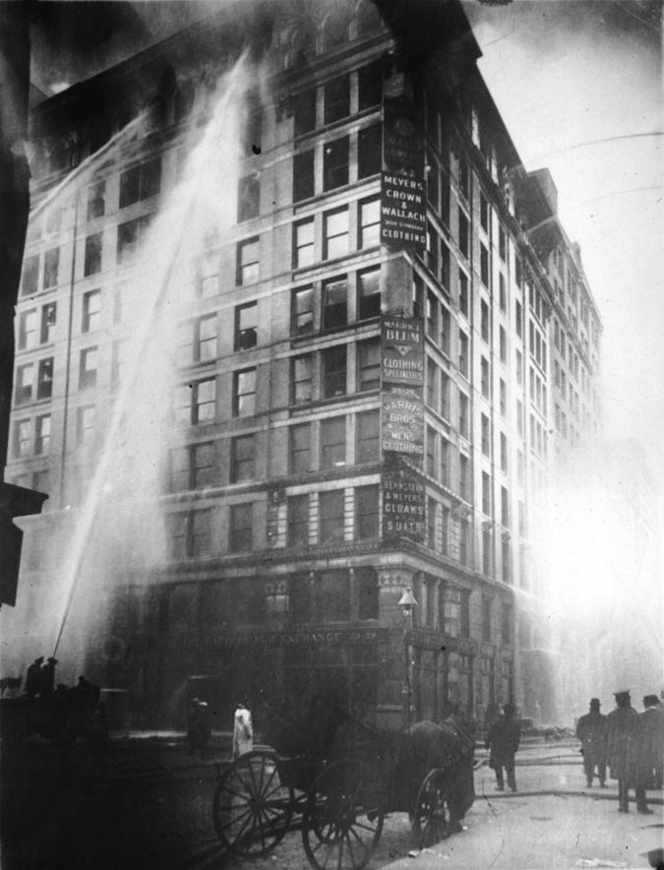
Fire Department Response
Four alarms were rung in fifteen minutes. The first 5 girls who jumped did so before the first engine could respond.
Horse drawn Pump Engine Company 20 & Ladder Company 20 arrived quickly but were hindered bringing their apparatus into position because of the bodies which strewed the pavement & sidewalks.
The firefighter's ladders reached only 7 floors high, & the fire was on the 8th floor. In one case, a life net was unfurled to catch jumpers, but 3 girls jumped at the same time, ripping the net. The nets turned out to be ineffectual.
The available fire nets were designed to safely catch one person but tore on the combined weight of multiple jumpers.
One girl jumped into a horse blanket held by firemen & policemen. The blanket ripped like cheesecloth, & her body was mangled almost beyond recognition.
Another dropped into a tarpaulin held by three men. Her weight tore it from their grasp, and she struck the street, breaking almost every bone in her body.
The building containing the Triangle Shirtwaist Factory was one of 7,000 that had been recommended for additional fire escapes following a Fire Department investigation just weeks earlier.
56 fiction & non-fiction books have been written about the Triangle Shirtwaist Factory fire
Notes:
In addition to the fire apparatus and firefighters Twenty-five police wagons from all the downtown precincts and 150 men came into the fire zone. They made one line on Washington Square East, forcing the people to the west side of the street, another line at Broadway, and cross-street lines at Waverly Place and on Fourth Street.
Trapped employees faced a classic “Morton's fork Choice” stay and be burned or jump and be crushed on the pavement.
The available fire nets were designed to safely catch one person but tore on the combined weight of multiple jumpers.
One girl jumped into a horse blanket held by firemen and policemen. The blanket ripped like cheesecloth, and her body was mangled almost beyond recognition.
Another dropped into a tarpaulin held by three men. Her weight tore it from their grasp, and she struck the street, breaking almost every bone in her body.
The fire department had to also fight a fire in the basement as some of the burning jumpers broke through the glass sidewalk panels setting rabbits’ fur stored there on fire
The Triangle Fire tragically illustrated that fire inspections and precautions were woefully inadequate at the time.

Slide 9
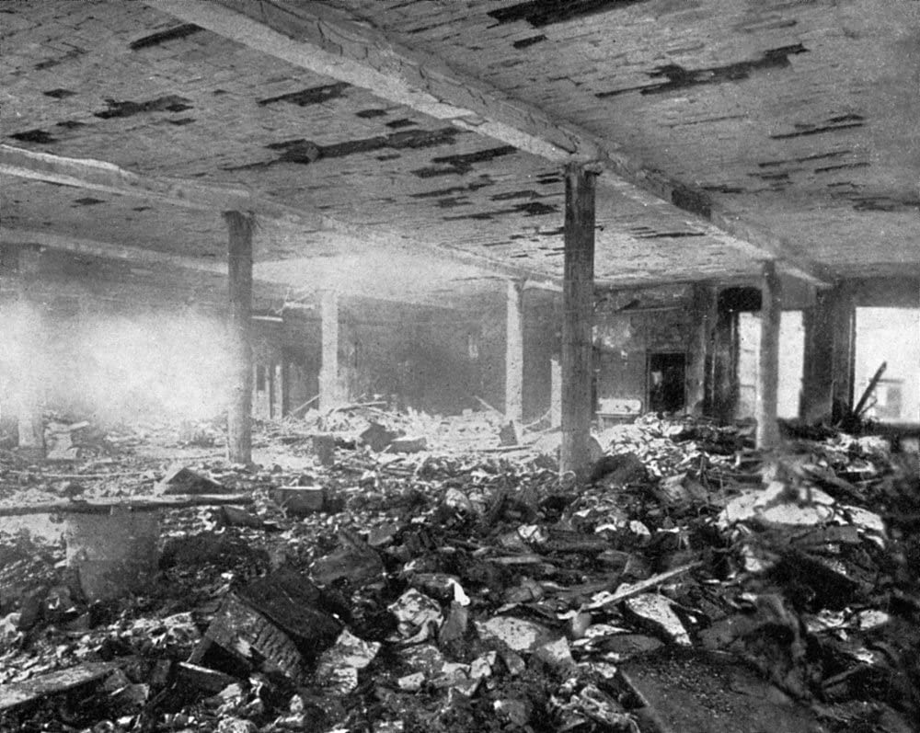
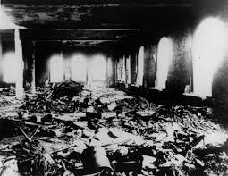
Tragic Results
Within 18 minutes, it was all over; 123 women/girls & 23 men were dead.
workers had burned to death or been suffocated by smoke,
36 pried the elevator doors open and jumped into the empty shaft,
58 died from jumping to the sidewalks. (Hit the ground at 58 MPH)
  As an eyewitness to the horrific ordeal William G. Shepherd, explained “I learned a new sound–a more horrible sound than description can picture. It was the thud of a speeding, living body on a stone sidewalk.
  Thud—dead, thud—dead, thud—dead, thud—dead. 58 thud—dead.
2 more died later from their injuries,
50 burned bodies were taken from the ninth floor alone.
146 were killed by the fire. (24% of the workforce)
  102 of the victims of the fire were reported to be Jewish
Out of the 200 workers on the 9th floor, 146 perished,
54 burned beyond recognition
Police & firefighters spent 4 discouraging hours lowering shrouded bodies from the factory after the Triangle fire.
Notes:
Within three minutes, the Greene Street stairway became unusable in both directions. Terrified employees crowded onto the single exterior fire escape – which city officials had allowed Asch to erect instead of the required third staircase[ – a flimsy and poorly anchored iron structure that may have been broken before the fire. It soon twisted & collapsed from the heat and overload, spilling about 20 victims nearly 100 feet to their deaths on the concrete pavement below and landed as mangled, bloody pulp. 9 stories are approximately 97 feet tall. Historical reports suggest no patients are able to survive a fall greater than 50 ft. (90 feet of free fall, you are traveling over 50 mph)
Occasionally a girl who had hesitated too long was licked by pursuing flames and, screaming with clothing and hair ablaze, plunged like a living torch to the street
Out of the 200 workers on the floor, 146 perished. The fire resulted in the fourth highest loss of life from an industrial accident in United States History.
Some women were so poor their families could not afford their burial, and the Hebrew Free Burial Association provided free interments in their Staten Island cemetery
A grand jury failed to indict them on manslaughter charges. To settle lawsuits against them, they eventually paid $75 in compensation to each victim’s family—a fraction of the $400 per death that they were paid by their insurer.

Slide 10
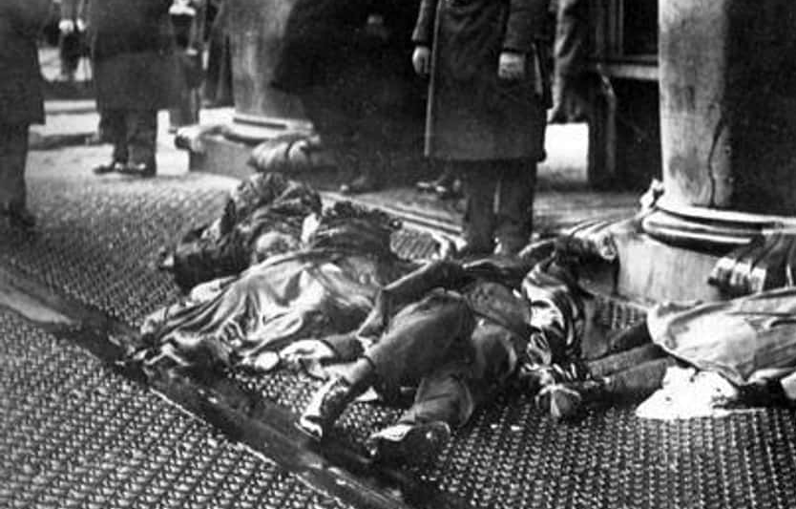
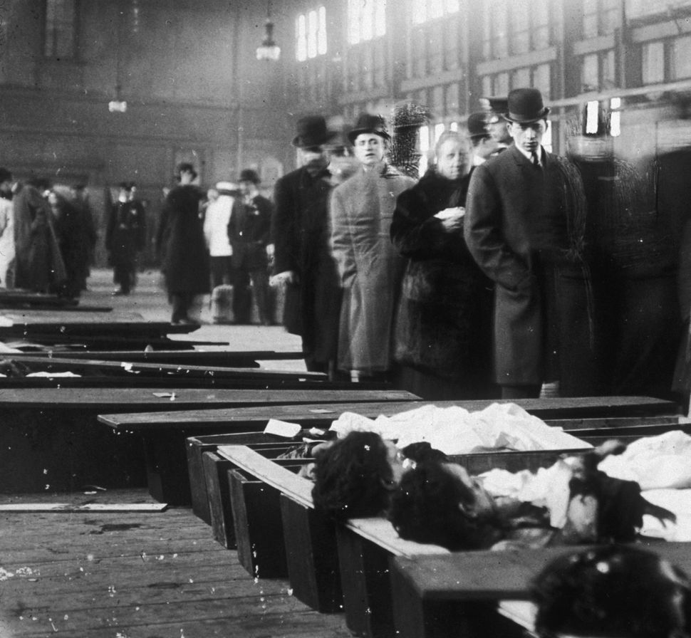
Identifying the Victims
Skylight
A heap of corpses lay on the sidewalk for more than an hour.
Bodies of the victims were taken to Charities Pier located at 26th street & the East River, adjacent to the morgue for identification by friends & relatives
But in the Morgue, they received the charred remnants with no more emotion than they ever display over anything. Fifty-six of these were burned beyond all but a human semblance
Family looked around with an air of frightened bewilderment at the ghastly array of dead, & then, one by one, looking down at the nearest box at their feet, where the mangled bodies lay, with heads propped up on boards
Victims were interred in 16 different cemeteries. 22 victims of the fire were buried for free by the Hebrew Free Burial Association now called The Workers Circle
It took several days for family members to identify the victims,. Six of the victims, all interred under a monument in a New York City cemetery, were not identified until 2011!
  https://trianglefire.ilr.cornell.edu/victimsWitnesses/unidentifiedVictims.html
More than 350,000 people participated in the funeral procession for the Triangle victims.
"I saw the Slocum disaster, (6/15/1904), but it was nothing to this." "Is it a man or a woman?" asked the reporter. "It's human, that's all you can tell," answered the policeman.
The victims included at least one 11-year-old, two 14-year-olds, three 15-year-olds, sixteen 16- year-olds, & fourteen 17-year-olds.
Learn the names of the victims
Cornell University - ILR School - The Triangle Factory Fire
Notes:
Coroner O'Hanlon, said he had cared for the dead from the Slocum disaster on the recreation pier, and it would be better, as the Morgue also on 26th street would prove hopeless in the task. He said he still had some of the tags used in the Slocum disaster, and he proposed that each body be tagged exactly where it lay, and that records be made by number. He was told by Coroner Holtzhauser to proceed, & did so with the assistance of 100 policemen.
The emotional toll was so high that there needed to be constant shift changes as the men dealing with the dead couldn't bear it for more than an hour. The dead were brought to a makeshift morgue at the Charities Pier. Misery Lane was the site of the Municipal Lodging House, built in 1909 to house homeless, derelict men When the wagons arrived, they were met by a team of men from the Municipal Lodging House, who were assigned to open the boxes and arrange them in 2 long rows Grieving family went o the pier to try to identify people by jewelry, shoes, or the way their hair was braided.
Many faces were beyond recognition, and the work of identifying people progressed partly by process of elimination and family reports of who was missing. The task of identifying the dead lasted four cold, rainy days. Pickpockets and the morbidly fascinated lined up along with family members. Within a week, all but seven bodies had been ID’d. Six victims were buried without names and remained unidentified until Michael Hirsch, a historian, completed four years of researching 32 different newspaper articles and other sources for missing persons and was able to identify each of them by name
A few minutes after the first load of fire victims was received at the Bellevue Hospital Morgue the streets were filled with a clamoring throng, which struggled with the reserves stationed about the building in an effort to gain entrance to view the bodies of the dead in the hope of identifying loved ones. At 1 A.M. eight bodies had been identified by relatives and set aside in sealed boxes.

Slide 11
Who was Saved?
The 10Th floor of the factory housed the offices of executives, the switchboard, 40 garment pressers, inspectors & the packing & shipping room. After a warning call from a worker on the eighth floor, most were able to escape over the roof to the adjacent NY University building with the aid of faculty members & students. Of the 70 people on that floor, all were saved but two. Clotilde Terranova, died when she jumped from the tenth floor.
Some employees on the 9th floor escaped the fire by going up the Greene Street stairway to the roof. Approximately a 100 reached a building north of the burning one, whose roof was only 5 feet higher & could be reached without a ladder. Flames prevented workers from descending the Greene Street stairway.
Found Alive After the Fire. The first living victim, Hyman Meshel of 322 E. 15th Street, was taken from the ruins 4 hours after the fire. He was found paralyzed with fear & whimpering like a wounded animal in the basement, immersed in water to his neck, & with his head just below the elevator.
All that those who escaped seemed to remember, was that there was a flash of flames, leaping first among the girls in the southeast corner of the 8th floor & then suddenly over the entire room, spreading through the linens & cotton with which the girls were working. The girls on the 9th floor caught sight of the flames through the windows, up the stairway, & up the elevator shaft.
Based on an estimated 600 occupants It is believed that 456 people escaped but 200 of those survived with critical burns & broken limbs.
Learn the names of the survivors. https://trianglefire.ilr.cornell.edu/victimsWitnesses/survivors.html
Notes:
Rose Freedman, an Austrian immigrant, was two days shy of her 18th birthday when she went to work sewing buttons at the factory The day of the fire she helped escort a trove of workers to the roof, where they stepped over to the top of a neighboring building. "All those who followed her were saved,“
Two elevator operators made valiant, repeated trips to the factory floors, saving at least 150 people.
Women, historically discouraged from active public roles, were front and center, showing that by the early 20th century there had been a sea change in attitudes toward them. Only seven years later, the U.S. Congress passed the nation’s first suffrage law, allowing women equal political participation in the nation.

Slide 12
Workers Compensation
In 1900 no state in the Union had a workers’ compensation law. By 1915 every highly industrialized state had passed an act for some form of compensation.
Before the 1911 Wisconsin Law, the only way an employee injured at work could receive any compensation was to sue his or her employer for negligence; an expensive & lengthy process.
The day before the tragic & preventable catastrophe at Triangle, the NY State Court of Appeals struck down a new “workmen’s compensation” law as unconstitutional, as it interfered with the “due process” rights of employers to have their liability adjudicated in court.
New York amended its constitution, a new workers’ compensation law was adopted in 1914, and the United States Supreme Court upheld it in 1917.
By taking out insurance policies to guard against dangers to their employees, employers had to acknowledge that they could be held accountable for injury/death of people on their payroll.
Before WC, the insurance industry in New York had rigged regulations in such a way that brokers profited from higher risk, so arson was one of the city’s growth businesses.
Notes:
Before the 1911 Law, the only way an employee injured at work could receive any compensation was to sue his or her employer for negligence; an expensive and lengthy process. Indeed, employers often avoided blame for accidents that injured, maimed, or killed employees by using legal loopholes.
Prior to these laws, an employer was liable for damages resulting from industrial accidents only when an employee could prove that the accident was a result of the employer's negligence. However proving employer negligence was very difficult because, at that time, employers had three defenses: (1) contributory negligence if a worker's own negligence contributed to his injury, (2) fellow-servant doctrine if an accident was caused by the negligence of a fellow employee, and (3) assumption of risk if an employee knew or should have known of the inherent risks involved..
Public outrage over the fire also pushed the Workers’ Compensation Act forward. New York’s original workers’ compensation laws, passed in 1910, were actually two statutes. One was voluntary, and the other was compulsory for eight “dangerous” occupations. A court quickly ruled the compulsory law violated both the state and federal constitutions
With “The Great Trade Off,” workers sacrificed their right to sue their employers for damages in order to obtain a no-fault method of prompt and definable benefits to be paid and provided after a work accident. Employers were guaranteed a monetary limit for payments at a fixed rate and could rely on predictable costs and reduced labor strife.

Slide 13
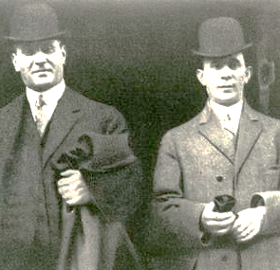
Action in the Courts
On April 11, Harris & Blanck were indicted on 7 counts of manslaughter in the 1st & 2nd degree, under section 80 of the Labor Code, which mandated that doors should not be locked during working hours.
The trial of Harris and Blanck began on December 4, 1911, in the courtroom of Judge Thomas Crain.
Harris & Blanck were defended by a giant of the New York legal establishment, 41-year-old Max D. Steuer. Heading up the prosecution team was Assistant DA Charles S. Bostwick.
More than 100 witnesses testified at the 3-week criminal trial.
Max Blanck
Isaac Harris
After deliberating for just under 2 hours, the jury returned a verdict of not guilty. After the verdict, one juror, Victor Steinman declared, "I believed that the door was locked at the time of the fire, but we couldn't find them guilty unless we believed they knew the door was locked."
In 1913 Max Blanck faced legal action again after he locked a factory exit door during working hours at his new factory.
For this he paid a $20 fine
Three years after the fire, on March 11, 1914, 23 individual civil suits against the Triangle Company were settled. The average recovery was $75 per life lost to each of the families of victims who had sued. A fraction of the $400 per death that Max & Isaac were paid by their insurer.
Notes:
On April 11, a grand jury indicted Harris and Blanck on seven counts, charging them with manslaughter in the second degree under section 80 of the Labor Code, which mandated that doors should not be locked during working hours.
Following Harris and Blanck's acquittal, the two partners worked to rebuild their company. From a small factory on the corner of 16th Street and Fifth Avenue, Blanck acted as president and Harris as secretary. All of their revenue went into paying off their celebrity lawyer, and they were sued in early 1912 over their inability to pay a $206 water bill.
In March of 1913, the two men reached a settlement with the victims' families in which the factory owners paid out a week's worth of wages for each worker
Despite these struggles, the two men ultimately collected a large chunk of insurance money -- $60,000 more than the fire had cost them in damages. Harris & Blanck had made a profit from the fire of $400 per victim.
In 1913 Max Blanck faced legal action again after he locked a factory exit door during working hours. For this he paid a $20 fine They were found liable of wrongful death during a subsequent civil suit in 1913 in which plaintiffs were awarded $75 each.
In 1914, the two owners paid a final fine when they were caught sewing fake Consumer's League labels into their garments, labels certifying the items had been manufactured under good workplace conditions.
The company never fully recovered from the fire and the controversy surrounding it, and in 1918, it closed its doors. Harris was injured as he led workers to safety on the roof of an adjacent building. Both men lost relatives in the blaze.

Slide 14
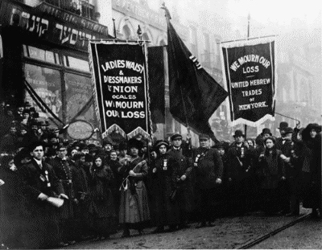
Growth of the Union Movement
The International Ladies Garment Workers Union (ILGWU) was founded in 1900 by eleven Jewish men who represented seven local East Coast unions with heavy Jewish immigrant populations.
Overworked & underpaid, garment workers struck, for 13 weeks, Triangle in the fall of 1909.
Harris and Blanck hired goons from Max Schlansky’s notorious “private detective” agency to attack picketing workers.
More than 70 of the smaller factories agreed to the union’s demands within the first 48 hours.
When the strike ended in February 1910, Triangle workers went back to their jobs without a union agreement, according to the AFL-CIO history.
Women leaders like the ILGWU's Rose Schneiderman & Pauline Newman advocated for both union organizing & legislative reforms & worked tirelessly with the National Women's Trade Union League, NWTUL to push for legislative reform.
Local 25, which prior to the strike represented only a few hundred members, now had more than 20,000.
It is also important to recognize that the Triangle victims were at the nexus of the shifting role of women in early 20th-century America
The Triangle Waist Company ceased operations in 1918.
140,000 mourners met on April 5, 1911, in Washington Square Park and marched up Fifth Avenue in a funeral parade in memory of the unidentified victims of the Triangle fire
250,000 onlookers lined the route.
Notes:
A sweatshop or sweat factory is a crowded workplace with very poor, socially unacceptable or illegal working conditions
As a result of the Triangle fire, the International Ladies’ Garment Workers Union (ILGWU), the union to which some of the Triangle workers belonged, stepped up its organizing efforts and fought to improve working conditions for garment workers. The role that strong unions could have in helping prevent such tragedies became clear. Workers organized in powerful unions would be more conscious of their rights and better able to obtain safe working conditions. The Union’s Executive Committee distributed weekly pensions, supervised and cared for the young workers and children placed in institutions of various kinds, and secured work and proper living arrangements for the workers after they recuperated from their injuries.
The fire led to legislation that required improved safety conditions for workers in sweatshops and contributed to the expansion of the International Ladies' Garment Workers' Union which has transformed into the Union of Needle trades, Industrial and Textile Employees. The shirtwaist makers’ story was so compelling because it brought attention to the events leading up to the fire. After the fire, their story inspired hundreds of activists across the state and the nation to push for fundamental reforms.
The precedent set by those lost in the Triangle Shirtwaist Factory fire allows public employees and industrial workers to ensure their rights in the workplace. T he tragedy still dwells in the collective memory of the nation and of the international labor movement. The victims of the tragedy are still celebrated as martyrs at the hands of industrial greed.

Slide 15
Regulatory Reform
1911 was a time of no social safety net for the lower classes & low wages, long hours, unsanitary conditions in factories, & crowded conditions in immigrant urban districts. This situation was believed to be the source of militant strikes, radical working-class politics, poor public health, low educational levels, & corruption in politics & government. The course of Francis Perkins’ life had changed when she witnessed the Triangle Shirtwaist factory fire. She was one of hundreds of people on the square that day.
Under pressure from the reformers, the city government acted. In October 1911, the New York City Board of Aldermen passed an act creating the Bureau of Fire Prevention, aimed at ending confusion over the responsibilities of various city departments and agencies for inspections, codes creation, and enforcement. In the next few years, the new board made changes to the Municipal Building Code, which provided a measure of protection by requiring the existence of safety devices such as fireproof materials & stairwells, fire alarms, extinguishers, & hoses. They also prohibited smoking in factories by 1916.
Thirty-six of the laws it drafted were enacted by the New York State legislature. These laws would serve as a model for other states. Twenty years later, the New Deal expanded the terrain of social democracy; but by the late 1930’s, opponents … dismantled many of its signature programs.
In 1968, after an explosion at Consol No. 9 coal mine trapped & killed 78 miners, the coal miners in WV went on strike, This action led to the passage of the Federal Coal Mine Safety & Health Act of 1969, followed the next year by enactment of the Occupational Safety & Health Act of 1970.
Notes:
The members of the committee convinced Governor John Dix of the merits of their point of view, and he suggested they consult with Assemblyman Alfred Smith and Senate Majority Leader Robert F. Wagner, two Tammany Hall Democrats. The two politicians submitted a resolution to the legislature to appropriate funds for an investigative commission, and on June 30 1911 the resolution passed, approving the appropriation for establishing the Factory Investigative Commission (FIC).
With the support of both Progressive reformers like Robert F. Wagner and Tammany Hall politicians like Al Smith, they passed thirty-eight new laws.
As we all know, among the people who witnessed the fire was Frances Perkins, who later became the U.S. Secretary of Labor. observed, “the New Deal was born that day, the day the Triangle burned.
The Triangle Shirtwaist tragedy forever cemented the notion that that the state has responsibility for the welfare of all its members.

Slide 16
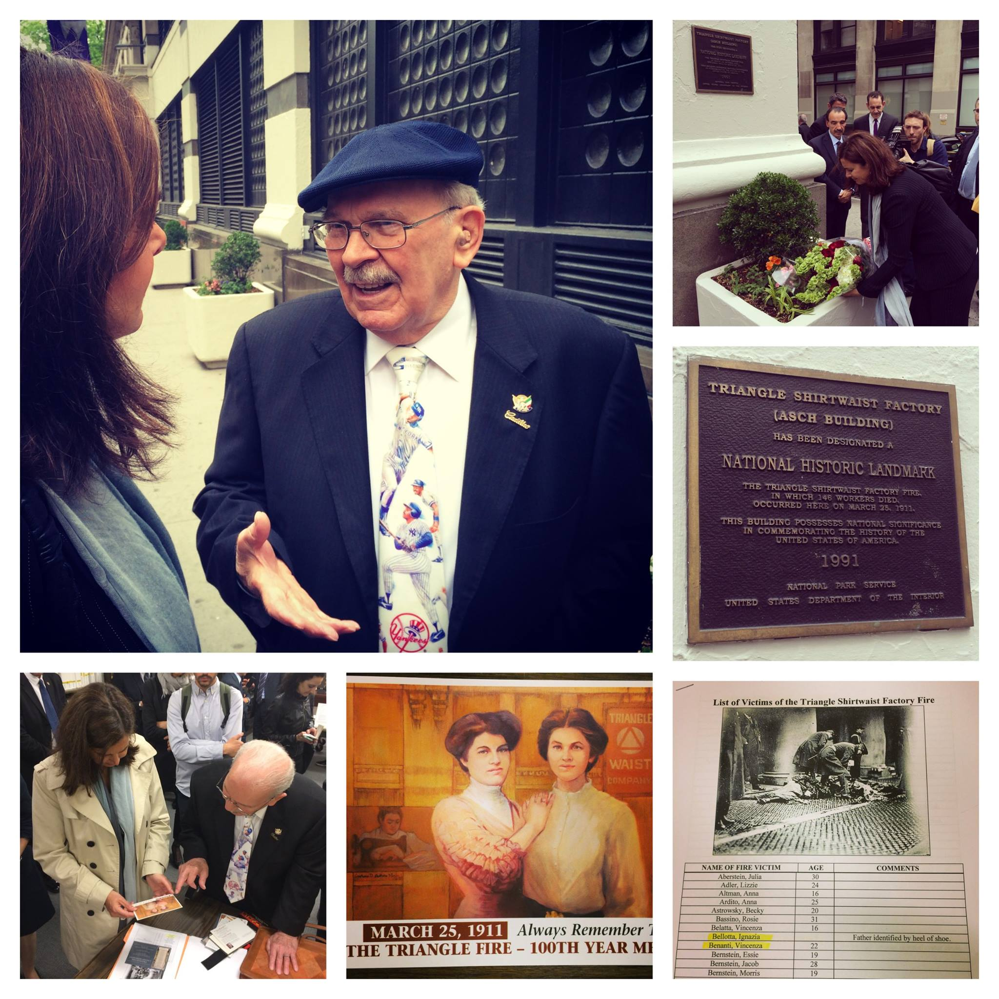
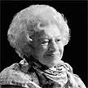
Aftermath & Legacy
the NY State Legislature created a Factory Investigating Commission, which sent inspectors into the tenements, factories & workshops of the time. Shocked by their reports, reforming everything from fire regulations to working hours for women & children.
The event crystallized support for efforts to organize workers in the garment district & for the International Ladies’ Garment Workers’ Union.
  Doors to public buildings & places of business must open outward so that masses can rush out in an emergency. (Homes may have doors that open inward, to allow the homeowner to blockade it to keep would-be intruders out.)
  All buildings must have at least two exits to the outside. Public buildings may require more, depending on their size & layout.
  Exits (& the paths to exits) must be marked with emergency lighting.
  Emergency exits must not be locked or blocked. In cases where, for security, the doors must be locked to keep intruders out, the lock is one-way, i. e., people can open emergency exits from within, even if they are locked (or even lacking doorknobs!) from without.
  Buildings have sprinkler systems and fire extinguishers.
  Fire alarms and fire drills.
  Fire lanes in front of buildings so emergency vehicles can park close to the sites.
The fire's last survivor, Rose Freedman, who was 17 at the time of the disaster, died in 2001 at age 107.
Notes:
The struggle for safety and health in the U.S. workplace has achieved progress. But it will not be finally won as long as our economic system gives employers an incentive to put profit before people, that is, to risk killing, maiming, and sickening workers in the interest of maximum corporate profit.
The Triangle Waist Company was to cease operations in 1918
The Kheel Center for Labor-Management Documentation and Archives at Cornell University, in cooperation with the Union of Needletrades, Industrial and Textile Employees (UNITE), have created a Web site on the Triangle Shirtwaist Company fire at http://www.ilr.cornell.edu/trianglefire.

Slide 17
What Remains to be Done
Despite these significant advances, a fire at Imperial Foods chicken processing plant in Hamlet, N.C., on September 3, 1991, killed 25 workers and injured 54, as they were trapped behind locked fire doors
In 2010, young garment workers in Ashulia, Bangladesh, jumped to their deaths from the 10th & 11th floors when a fire overtook the Ha-Meem factory
Windows on the World, the restaurant at the top of the World Trade Center on 9/11/2001, 73 workers of the 100 people died as they attempted to exit the restaurant to the rooftop via a locked door.
Some 15 workers still lose their lives every day on the job from injuries – & many more from long-latent illnesses. Worse, many, if not most, of these deaths are from preventable causes.
A recent study ranked the U.S. 29th out of the 38 members of the Organization for Economic Co-operation & Development (OECD) countries in worker safety & health protections.
We must be sensitive to factors of culture & language that demand new approaches to meaningful safety training for newly arrived workers.
We still have inadequate regulations to protect workers from silica, & MSD’s that continue to disable the lives of hundreds of workers each year.
Widespread labor law violations in low-wage industries ... are as common today as they were in 1911
Cancers don’t leap from burning windows – they smolder silently
Notes:
The safety of citizenry, firefighters, and property should not be negotiable or sacrificed on the altar of budgetary considerations. If we have learned anything, if we are to honor the struggles of men and women in the labor movement, and to maintain improvements in working and living conditions, we cannot allow our elected leaders to put lives and property at risk.
Fire precautions and inspections were almost nonexistent at the time, so escape routes and secondary means of egress could be blocked or locked. Shortly after Triangle, building and fire codes such as the Fire Prevention Act of 1911 were enacted to ensure that a tragedy of this magnitude would never happen again. Latino immigrant workers face substantially higher risks than the population as a whole of injury and death on the job.
Such historical disasters are unlikely to re‐occur if three simple lessons are heeded:
first, it is unfortunate that it has required major trauma or carnage to awaken the public to the realities of existing dangers;
second, mere compliance with existing statutes is often insufficient for protecting workers; and
third, organizations which fail to self‐monitor will often be subjected to external control and regulation.

Slide 18
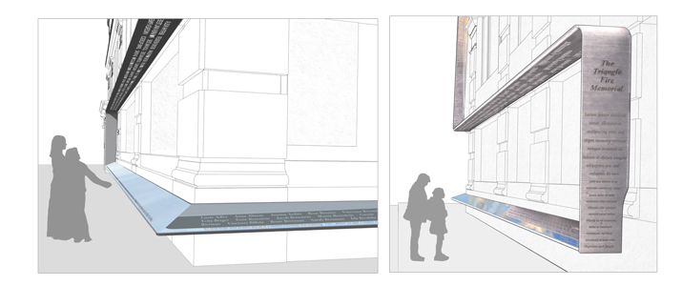
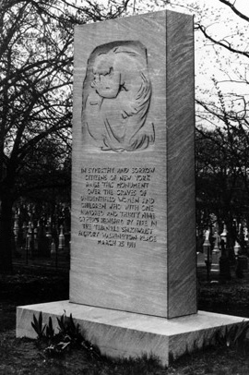
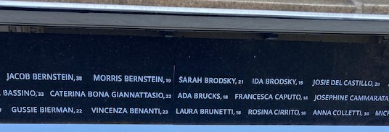
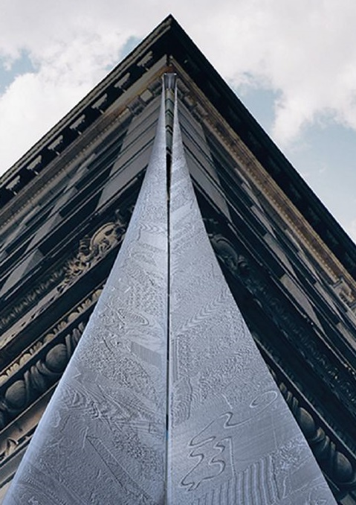
Triangle Fire Memorial
Starting with the 50th anniversary of the fire & each year since the New York City Fire Department & the ILGWU have marked the anniversary of the Triangle fire with a memorial ceremony in front of the building.
The Remember the Triangle Fire Coalition held a dedication of the memorial at the site on October 11, 2023.
Actual picture of names taken from memorial
Grave of the unidentified
In 1911
Evoking the appearance of mourning ribbons which were draped on buildings at times of public grief, the main body of the memorial is a textured stainless-steel ribbon, which descends from the corner of the 9th floor of the Brown Building, the site of the fire. At the top of the ground floor, the ribbon splits to flank the building's facades. The names of the 146 victims are cut into the ribbon 12 feet above the sidewalk & reflected by a darkened reflective panel on the street level. As visitors' transverse the length of the memorial, the names of the victims overhead will appear in the reflective panel, written in the sky.
Testimonies of survivors & eyewitnesses to the fire will be etched as a single line of text along the lower edge of the reflective panel, inviting the visitor to look down into the reflection & discover the names of the victims. For more information about the fire see: http://www.ilr.cornell.edu/trianglefire
Construction of the memorial is nearly complete, only the ribbon from the 9th floor is needed.
This important project will serve as a permanent reminder of the crucial need for workplace safety & the fundamental obligation that all workers be treated with respect & human dignity.
Notes:
Frederick Brown later bought the building and subsequently donated it to the NYU in 1929, The Asch Building (later called the Brown Building) became a national landmark in 1991. The long overdue Triangle fire permanent memorial is coming into focus! In honor of the victims, and in the name of social and economic justice, the Triangle Factory fire public memorial will be built. And, together, all of us will make it happen.
The design of the memorial consists of a stainless-steel ribbon that cascades vertically down the corner of the Brown Building (23-29 Washington Place) from the window-sill of the 9th floor, marking the location where most of the victims of the Triangle fire died or jumped to their death. The steel ribbon is etched with patterns and textures from a 300-foot-long cloth ribbon, formed from individual pieces of fabric, donated and sewed together by hundreds of volunteers. At the cornice above the first floor, the steel ribbon splits into horizontal bands that run perpendicularly along the east and south facades of the building, floating twelve feet above the sidewalk. The names of all 146 workers who died will be laser-cut through these panels, allowing light to pass through. At street level, an angled panel made of stone glass at hip height will reflect the names overhead. Testimonies from survivors and witnesses will be inscribed in this reflective panel juxtaposing the names and

