Slide 1

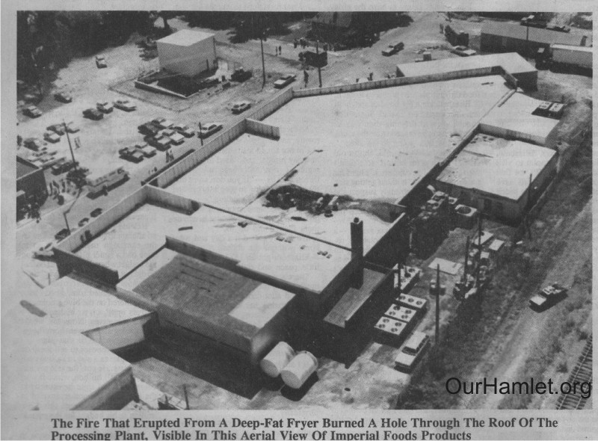
Strategic Amnesia
The Imperial Foods Fire
Eighty years after the Triangle Shirtwaist Fire, industrial disasters were supposed to have been a thing of the past
The fire occurred at a time when America was dominated by the idea of cheap food, cheap government, & cheap lives over quality ingredients, investment in human capital, & strong oversight & regulation.
Historian Bryant Simon.
The Hamlet fire & its aftermath reveal the social costs of antiunionism, lax regulations, & ongoing racial discrimination.
Hamlet, North Carolina
September 3, 1991
8:15 am
Presented to the ASSP NE-PDC on 11/5/2024
Notes:
At Imperial and in the wider food production industry—like deregulation (either by law or lack of enforcement), a growing demand for cheap labor, a culture of silence and intimidation among workers and management, and changes to the meat industry itself, with its shift in the 1980s to highly processed, mass-produced chicken products made at the plant, were integral to the conflagration.
On September 3, 1991, the Imperial Food Products plant in Hamlet, North Carolina burst into flames. Twenty-five people died, trapped behind the locked doors of the red-brick factory. Most of the victims were women; many were women of color, and most were single moms. Another sixty people were injured, and the blast left more than fifty children orphaned. Local officials called the fire an accident, but the women and men who worked at Imperial had been made vulnerable by the factory’s owners as well as public policy. Their gruesome deaths came, in no small part, as the result of pushes to slash oversight budgets, wipe regulations from the books, and become lax in the enforcement of health and safety laws, especially those that might have protected people left precarious by declining rates of unionization and pushed to the economic and political margins of society.
Imperial Food was fined $808,150, while the insurance companies involved agreed to pay $16 million to the injured and to the families of the deceased. The Hamlet fire and its aftermath reveal the social costs of anti-unionism, lax regulations, and ongoing racial discrimination.

Slide 2
History of the Company
Emmett Roe, founded Imperial Foods in Mossie, PA in the 1970’s.
Investigation found the Pennsylvania facility experienced twice the national rate of workplace injuries in food processing. The violations included poorly marked or blocked emergency exits. Frustrated with the safety inspectors & a largely unionized workforce in Moosie, Roe closed the decommissioned Pennsylvania facility in 1989.
He had purchased the largely-decommissioned Mello-Buttercup Ice Cream plant, located along Bridges Street in Hamlet, North Carolina, in September 1980. By 1990 the company was one of the largest private employers in Hamlet.
Wages were low: $5.50/hour. Labor relations were deplorable. Workers had to pay for their protective gear (smocks & caps).
The Hamlet plant experienced several small fires in 1980, 1983, & 1987, but none resulted in a safety inspection.
A worker told a USDA inspector he had concerns about the facility's safety, but the inspector said that such issues were outside his purview.
Of the 120 workers scheduled for the first shift, 90 reported for work, and the other 30 were told not to come in due to ongoing repairs near the fryer.
Notes:
Emmett J. Roe founded Imperial Food Products Incorporated (commonly called Imperial) in Moosic, Pennsylvania near Scranton in the 1970s after acquiring a food processing plant from his former employer, Empire Frozen Foods. Besides his Hamlet factory, Rowe bought the Haverpride Foods plant in Tarrant, Ala., in 1988. He closed it in 1990 without giving the employees 60 days notice, as required by federal law. More than $250,000 in severance pay was ordered to be paid to 115 workers by a federal judge. Rowe never paid a penny.
The corporation supplied grocery stores and distributors with chicken products. Roe purchased the largely-decommissioned Mello-Buttercup Ice Cream plant, located along Bridges Street in Hamlet, North Carolina,
Over the years the Hamlet plant was the subject of many safety concerns. In 1980, 1983, and 1987 there were several small fires in the plant, yet none resulted in safety inspections. In fact, the portions of the facility operated by Imperial had never undergone a workplace safety inspection despite OSHA inspectors visiting the site several times to examine spaces leased to Mello-Butter, the plant’s former owner.
Labor relations were deplorable. Workers had to pay for their own protective gear (smocks and caps). Bathroom breaks were restricted to lunchtimes or to the two ten-minute additional mid-shift pauses, unless absolutely essential.

Slide 3
Demographics of Hamlet, NC
Hamlet was economically depressed & local officials, valuing the employment Imperial Foods gave to residents, chose to treat it with "benign neglect“.
Hamlet, located less than ten miles from the South Carolina border, was once a vibrant, growing town. At the turn of the 20th century, the Seaboard Railway Company brought maintenance & shipping jobs to Hamlet & carried in visitors who frequented the shops along the main street.
But, during the consolidation of train companies from the late 1960s to the 1980s, the town lost its railroad jobs, & many of Hamlet’s citizens were left to take work wherever they could find it — even at factories that were skirting the laws.
The Roe’s recruited a workforce dominated by impoverished & undereducated people, including many single mothers & high school dropouts. (People who would not complain of Quit)
The plant produced a variety of custom chicken products including pre-cut frozen chicken breasts, but they mostly made battered deep-fried chicken tenders which were sold to restaurants in the American South.
The plant did not have a sign on the red brick building & most local townspeople did not know a chicken processing plant was operating in their town.
Notes:
The L.A. Corning family came to Hamlet in January of 1920 from Elmira, New York. Mr. Corning had owned a drugstore in Elmira and had experimented with making ice cream. Returning to Hamlet, he built his new ice cream plant and Buttercup Ice Cream was born. his family continued the business for another fifteen years. With mounting competition, the family sold out to Coastal Dairy Products in 1969, and the name was changed to Mello Buttercup. Coastal continued operations in Hamlet for the next nine years, closing the Hamlet plant in 1977
Hamlet, North Carolina also takes great pride in showcasing the life of hometown jazz legend John Coltrane
Hamlet, located less than ten miles from the South Carolina border, was once a vibrant, growing town. At the turn of the 20th century, the Seaboard Railway company brought maintenance and shipping jobs to Hamlet and carried in visitors who frequented the shops along the main street. But during the consolidation of train companies from the late 1960s to the 1980s, the town lost its railroad jobs. But by the 1970s, it had become a postindustrial backwater, a magnet for businesses searching for cheap labor with little or almost no official oversight.
The workers couldn’t count on their local government to help them either. Desperate to increase employment in the struggling town, Hamlet’s leadership looked the other way as the processing plant flouted guidelines and rules to a shocking degree.

Slide 4
Regulatory Discrepancies
NC Law requires businesses to obtain a License to Operate.
Roe never applied for a business license & did not register the plant with the labor department.
Roe also did not register the plant with city or Richmond County taxation authorities & never paid any local property tax.
Inspectors from the United States Department of Agriculture (USDA) visited the plant daily to examine the quality of the chicken, check for insects & vermin, & ensure that the facility's workers & processes were hygienic.
When states formed their own occupational safety & health offices, most were set up to favor businesses over workers. North Carolina’s state-run OSHA never inspected the Imperial plant, in all its eleven years of existence even, though the company’s Pennsylvania branch had twice been cited for serious safety violations.
By 1991, there was only one federal OSHA inspector for every 4,666 worksites nationwide.
Americans, in the 1980s began to believe that “more business, less regulation & fewer unions…could decrease prices, create more jobs & cure the country’s economic ills.
Those who made decisions about Imperial’s Safety protocols — the city, state & federal officials — were removed from the experiences of the workers impacted by them.
Notes:
North Carolina law required new industrial businesses to apply for a license to operate, and any business with 11 or more employees to register with the North Carolina Department of Labor and the United States Occupational Safety and Health Administration (OSHA)
Former Imperial workers who made clear that although they knew the factory was unsafe, they felt powerless to confront management lest they lose their paycheck. And organizing for better workplace safety and pay was a non-starter,
Throughout the years, small fires broke out in the factory, horrible smells seeped into the neighborhood and globs of fat entered Hamlet’s water supply—all with minimal interference from city authorities.

Slide 5
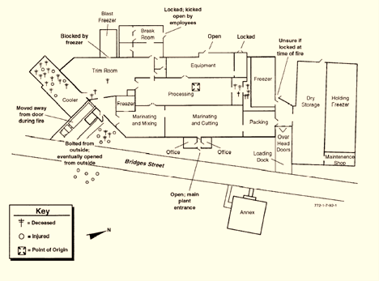
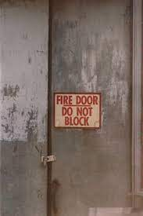
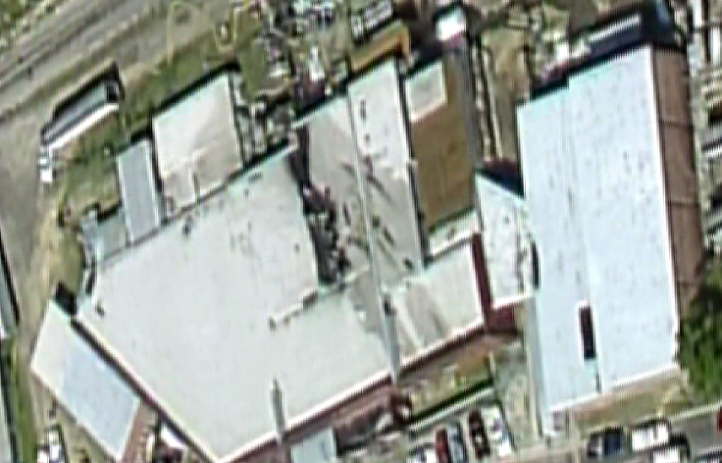
Layout of the Facility
A one-story windowless building of bricks and metalwork, the plant's basic structure dates to the early 20th century.
Of the plant's nine exterior doors, seven were locked or obstructed 2 from the outside, including a padlocked door marked "Fire Exit Do Not Block".
There was no fire alarm system, or evacuation plan or working sprinkler system
Fire started here
Location of bodies
loading dock door blocked by a dumpster that was moved by municipal workers
Supervisor, Mangus, swore that he had supplied the Hamlet FD with a key, & believed that it was not a safety problem.
The majority of those who escaped were working in the front of the building & were able to leave through the unlocked main entrance.
Total area 30,000 Ft²
Notes:
After the purchase, the 21,300-square-foot facility was vastly renovated and expanded to 37,000 square feet before initiating operations at the site. The lack of inspection by OSHA and fire inspectors left many hazards remain undetected, exposing the workers and facility to risk.
The interior was a “maze of large rooms separated by moveable walls”, and both workers and the product moved around the interior from process to process, going from front to rear. An extensive fire was considered unlikely because of a lack of flammable materials throughout the complex, other than packing materials in the rear. There were open spaces between rooms in place of doors to allow for easy access by forklift trucks.
Doors were reportedly sealed off from the outside and inside as a means of stopping the theft of food
Maintenance supervisor, Kim Mangus, later swore in a notarized statement that he had supplied the Hamlet Fire Department with a key, and therefore believed that it was not a safety problem.
Hamlet municipal workers chained the dumpster to a tractor and pulled it away from the building to create an opening for workers to escape

Slide 6
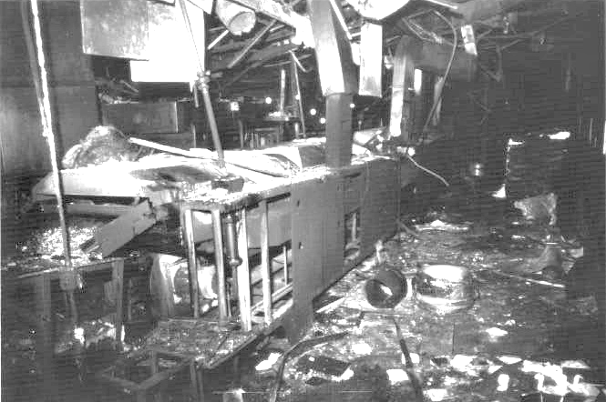
How the Fire Began
Over the Labor Day weekend, the plant's maintenance crew reviewed the hydraulic system of a conveyor belt which moved chicken tenders into a 29-foot-long, 300-gallon Stein fryer in the processing room. They shortened a hydraulic hose with a hacksaw & reused an old fitting!
The Stein fryer's manual advised the deactivation of heat sources before handling hydraulic fluid. They decided against deactivation since it could take 2 hours for the fryer’s furnace to heat up to 375 °F.
When the improvised connector was being brought up to its 1500-psi operating pressure, it separated from the line at 800+ psi & began wildly spraying hydraulic fluid. When the fryer ignited, flames fed off grease & oils on the factory floor. A section of the roof collapsed above the vat. It was 8:15 AM.
One of the previous fires disabled the fire sprinkler system installed by Mello-Buttercup; it was never repaired. The cooking vat had a hood-mounted CO₂ extinguisher unit above it, which for some time prevented the vat contents from igniting. The plant however was engulfed in less than 2 minutes
Large quantities of smoke were produced by a combination of burning soybean oil & chicken, together with melting roof insulation. Several gas pipelines in the ceiling caught fire & exploded, adding more CO.
Brad Roe (Emmett's son & operations manager) drove to the local Hamlet fire station arriving at 8:22 AM. for help since the telephone line had burned. Hamlet was not on the emergency 911 system.
Notes:
Workers had already experienced three fires that year, but the plant never shut down long enough to properly repair the equipment.
Ahead of the needed repair, the plant’s head mechanic, John Gagnon, had asked Brad Roe for funds to purchase new lines and connectors to fix the leaky line. This request was denied
The maintenance crew decided to shorten the line with a hacksaw and reconnect it to the machine box with an improvised connector The line was rated to 3,000 pounds per square inch , while normal operating pressure never fluctuated higher than 1,500 psi. The Stein fryer's manual advised deactivation of its heat sources before handling flammable liquids around it, such as hydraulic fluid. The cooker's temperature was controlled by thermostat and was maintained at a constant 375 °F, which was variable by design to 15 °F either way. The repairmen decided against deactivation, since it could take up to two hours for the fryer's furnace to heat back up to 375 °F, which would delay the plant's workflow and, they feared, likely anger Brad Roe. The hydraulic line pumped between 50 and 55 gallons of Chevron 32 into the fire before an electrical failure shut off the hydraulic system.
The fire began due to pressurization of fluid leaking from a hydraulic line. The leak, in combination with heat, caused immediate vapor and flames. This ignition transpired into heavy smoke making it a serious hazard very quickly. When workers attempted to escape, they realized that the designated fire escapes were blocked, and the doors were locked. It was common for the doors to the facility to be locked during working hours, but this often made the workers uncomfortable.

Slide 7

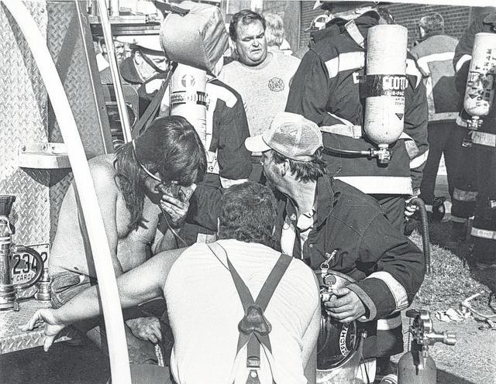
Response to the fire
The first 2 firefighters on the scene administered oxygen to the escaped plant workers
Captain White responded to the incident, at 8:27 AM. Upon his
arrival, he realized that the fire was serious & sent a mutual aid
call to East Rockingham Fire Department, (9 Minutes away).
By then 20 workers were lying on the ground outside the facility; 3
were dead. The fire spread rapidly, causing panic so that some
workers suffered trauma injuries during their rush to escape.
Once the first responders realized the extent of the emergency, they extended the mutual aid call to the North Side Fire Department,
(16 minutes away) and Cordova FD, (15 minutes away).
Assistance was never requested from the Dobbins Heights Volunteer Fire Department. It is based in the largely African American community of Dobbins Heights, 5 minutes away.
Search & rescue operations began at about 8:45 AM
Air ambulances from Winston-Salem, (104 miles) and Chapel Hill, (91 miles)
Durham,(103 miles) & Charlotte (79 miles) collected patients from the
hospital in Hamlet & delivered them to burn units in their cities of origin.
Over 100 medical & emergency service personnel ultimately responded.
Firefighters were able to bring the fire under control within two hours,
using AFF Foam.
Witnesses said that only two oxygen cylinders were available to help the victims of smoke inhalation.
7
Notes:
Brad Roe attempted to call the fire department (Hamlet had no generalized 9-1-1 emergency dial system) but the telephone lines were inoperable. He then drove his car a few blocks over to the Hamlet Fire Department, arriving at 8:22 a.m. By 8:24 about 20 workers were lying on the ground outside the facility; three were dead.
Once the first responders realized the extent of the emergency, they extended the mutual aid call to the East Rockingham and North Side Fire Departments. Hamlet Fire Chief David Fuller took charge of the emergency response. Fuller and the Hamlet Fire Department also asked for assistance from the Cordova Fire Department (located 8.5 miles away, ostensibly because of their experience with complex fires. Additionally, Fuller appealed for assistance from Richmond County Emergency Medical Services units and rescue groups in Ellerbe and Hoffman.
The Hamlet Fire Department did not have a floor plan of the plant, and the fire suppression team was forced to fall back when the heat and smoke in the processing room proved too intense. Search and rescue operations began at about 8:45 and ended after 12:20 p.m.
Historical footnote: Known officially as aqueous film-forming foam (AFFF), firefighting foam creates a blanket that cuts off the fuel from the oxygen it needs to burn. To help smother the fire, chemicals called perfluoroalkyl and polyfluoroalkyl substances (PFAS) were, and in some circumstances, still are used.
The highly durable nature of PFAS chemicals in AFFF means they do not break down over time. Because of this, PFAS may remain in the body for years, building up gradually. This can eventually cause numerous health issues like various types of cancer as well as other conditions like ulcerative colitis and thyroid disease.

Slide 8
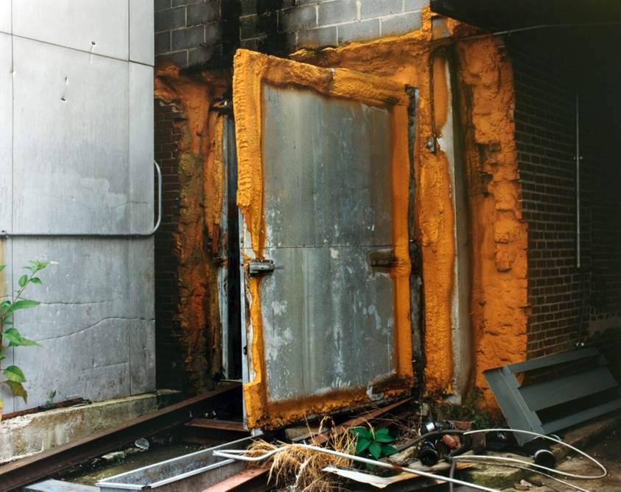
Results of the Fire
Of the 90 employees working at the time, 25 died & an additional 54 were injured, 11 escaped!
  A white delivery driver died while restocking vending machines, he was recognized on the scene by his son, a firefighter.
Of the 25 who died, 12 were African-American & 18 were women, & many were single mothers.
Autopsies indicated nearly all the fatalities were caused by smoke inhalation,
rather than direct flame injury.
Some desperate employees went into the -28⁰F, freezer, because the door did not
seal, 12 bodies were found inside, but 5 people inside the freezer survived!
The second largest fatality area was to the north of the processing area where 7 died. 3 perished in the trim room, from which the exit door to the outside, via the break room, was locked. (next slide)
Desperate to find exits, only to find locked doors, the victims collapsed into piles of bodies as the CO overtook them. The plant was a death trap with 2 of the 7 exits locked from the outside!
All 65 Survivors suffered long-term adverse health effects, or aftereffects such as burns, blindness, respiratory disease from smoke inhalation, neurological damage & Post-Traumatic Stress Disorder.
The North Carolina General Assembly eventually passed 14 new worker safety laws.
freezer
Notes:
The fire effectively split the facility in two, with workers in the marinating and packing rooms being able to flee through the unlocked front door and those in the processing and trim rooms being forced to retreat towards the loading dock, dumpster, break room, and equipment room. Reports indicate that only two oxygen tanks were on site to help smoke-inhalation victims.
Investigators said there would have been few or no fatalities if the plant had a sprinkler system, an evacuation plan, and marked unblocked doors. At least two of the plant’s seven exit doors had been locked. All 25 deaths were caused by smoke inhalation.

Slide 9
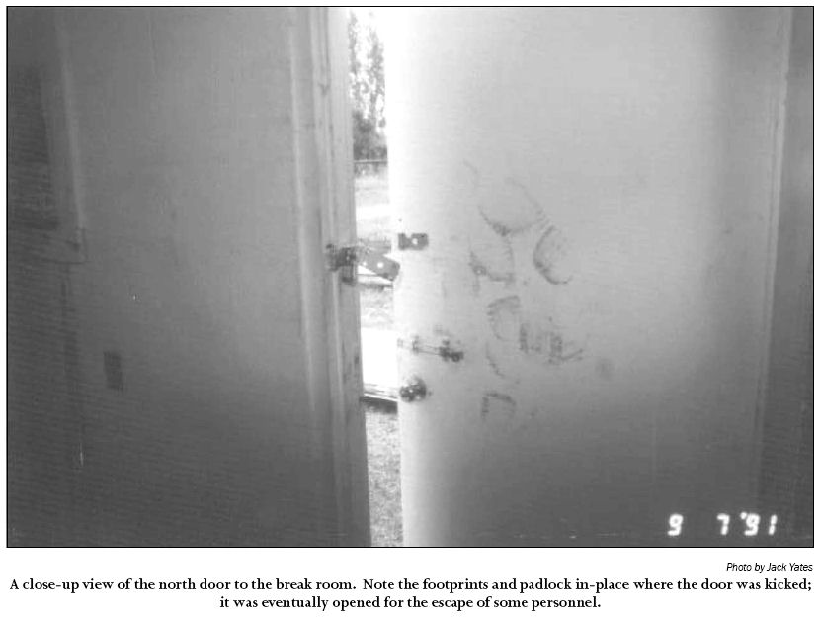
Many OSHA violations were uncovered after the fire.
Only a handful of Imperial employees, mostly maintenance workers, were aware that the doors were locked.
The basic OSHA exit & fire safety violations that contributed to the deaths & injuries were:
Locked doors,
No marking of exits or non-exits,
Excessive travel distances to exits,
No fire alarms,
Obstructed doors,
No emergency action plan or fire prevention plan, and
No operating automatic fire suppression system.
The fire prompted Federal OSHA to review 22 state-run enforcement programs & launch a national campaign to alert employers about the necessity of fire safeguards, including alarms, sprinklers, unlocked exits –
Imperial maintenance worker Bobby Quick eventually managed to kick open the north exterior door in the breakroom, rupturing discs
in his spine in the process, this allowed 10 workers to flee.
analogous to those from Triangle
Notes:
An investigation was immediately launched by state authorities, joined one month later by federal investigators.
The NC State Bureau of Investigation, (SBI) ultimately assigned 14 agents to the case, who put in 1,800 hours of work and compiled a 2,500-page report on the fire. Clark Staten of the Emergency Response and Research Institute in Chicago said in response to the blaze: "If the initial reports can be believed, this is an intolerable set of circumstances that should result in criminal charges being placed against those responsible for having the fire doors locked. Our experience with fires and fire deaths shows that we must ensure an adequate number of open exits from any occupied building.
On October 23 OSHA unilaterally altered the terms of the regime, dispatching 14 of its inspectors to North Carolina to act independently of the state program, an action it had never taken before.

Slide 10
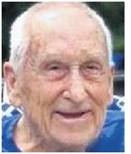
Criminal Proceedings & Litigation
Prosecutor Lowder was to pursue homicide charges against the plant's operators, but There
was no criminal trial.
  Lowder was dismissive of the deceased workers, calling them "a bunch of low-down black folks”.
On September 14, 1992, Emmett J. Roe pled guilty to 25 counts of manslaughter; no charges were pursued against his son.
  Each count had a maximum sentence of 10 years in prison.
The NC DoL imposed a fine of $808,150 (Equal to $ 1,816,183.20 in 2024) on Imperial Food Products for 83 OSHA violations, (52 willful) the highest such penalty in the state's history.
  Imperial ultimately declared bankruptcy thus the fine was never paid.
Emmett J. Roe, was convicted of non-negligent manslaughter. He was sentenced to 19 years & 11 months but was paroled after four years. He died in 2018 in Georgia in obscurity.
By December 1992, a settlement was reached, awarding $16.1M to the victims; payouts of $175,000 to $1M were awarded for individual wrongful death claims; settlements ranging from $2,500 to over $1 million were awarded in 77 injury cases, (65 employees & 12 first responders).
Insurance damages of $24M were awarded but, Hamlet workers received $35,000 to $70,000 each.
Some survivors sued the NC DoL, alleging that their negligence entitled victims to compensation. The NC Supreme Court ruled the department's failure to inspect the Imperial plant was neglectful, it was "not negligence”.
Notes:
Back Story: District prosecutor Carroll Lowder was to pursue homicide charges against the plant's operators. Lowder convened a grand jury to consider charges against the Roes, Hair, and Mangus, (maintenance supervisor). The jury voted against charging Mangus, but on March 10, 1992, it indicted the Roes and Hair, (plant manager) on 25 counts each for involuntary manslaughter.] They surrendered to authorities three days later
Lowder was allegedly dismissive of the deceased plant workers, emphasizing cases of theft from the plant and calling them "a bunch of low-down black folks
Others sued the North Carolina Department of Labor, alleging that negligence by the state entitled victims to compensation according to the North Carolina Tort Claims Act. The North Carolina Supreme Court ultimately ruled in a 5–2 vote that, though the department's failure to inspect the Imperial plant was neglectful,
{not giving enough care and attention to something or someone} it was "not the kind of negligence for which damages can be collected“
On October 23 OSHA unilaterally altered the terms of the regime, dispatching 14 of its inspectors to North Carolina to act independently of the state program, an action it had never taken before.
Disability benefits for survivors were pitiful. The payments were just two-thirds of their average pay, which was around $5 per hour.
Within two years of the accident insurance companies and the North Carolina business lobby together introduced legislation limiting the compensation available to injured workers and relatives of killed workers.

Slide 11
Lessons Learned
Life safety codes must be enforced, with compliance with safety regulations. These should include adequate exits, fire detection & suppression equipment, emergency plans & training.
Cooking areas must be separated from other areas. Walls & ceilings should have appropriate time-rated fire resistance.
Exits from wet operation areas should have emergency lighting above the exit door & at floor level to maximize visibility in heavy smoke conditions.
Maintenance on high-pressure (hydraulic) systems must be carried out only by specifically trained personnel.
High-pressure hydraulic systems must be fitted with valves that would automatically close in potentially catastrophic situations. The valves should also be designed to activate the CO₂ fire suppression system.
Negative air flow systems should be modified to accomplish smoke evacuation. Existing systems were designed to purge toxic vapors of ammonia, but the installation of heat sensors could enable the systems to pull smoke away.
Emergency plan rehearsals should be put into use at all facilities. A proper schedule of drills needs to be established.
Notes:
Life safety codes must be enforced. Proper enforcement of existing regulations must occur in future.
Cooking areas must be separately partitioned from other employee work areas. Cooking operations in food processing plants carry a high risk of fire, and so must be separated from the rest of the building, and from as many workers as possible.
Building exits in wet-type operations should have double emergency lighting, one positioned above the door and one low to the floor. Because the work areas were cooled to comply with food preservation laws, humidity was high, so-called "wet conditions". These conditions cause particularly heavy smoke, obscuring much high-level emergency lighting.
High-pressure equipment maintenance and repairs must be limited to factory-trained personnel and specifications. Maintenance personnel working on high-pressure machinery, such as the maintenance employee who conducted the faulty modification to the hydraulic hose in the plant, must be trained by personnel from the factory that supplied the equipment.
High-pressure equipment in probable incident areas should have built-in catastrophic shutdown valves. This would reduce the probability of accidents in high-risk areas by shutting down machinery should a fault occur.
Negative air flow systems in these facilities could enhance safety by being modified to also accomplish smoke evacuation. Many similar plants have this equipment, which is designed to quickly purge the air of toxic fumes in the event of accidental release of ammonia. The report recommends modifying the equipment to also pull heavy smoke away from lower areas.
State and federal inspectors from various departments should be cross-trained. Had the food inspector reported the problems he saw, the disaster may have been prevented despite the lack of other safety inspections.

Slide 12
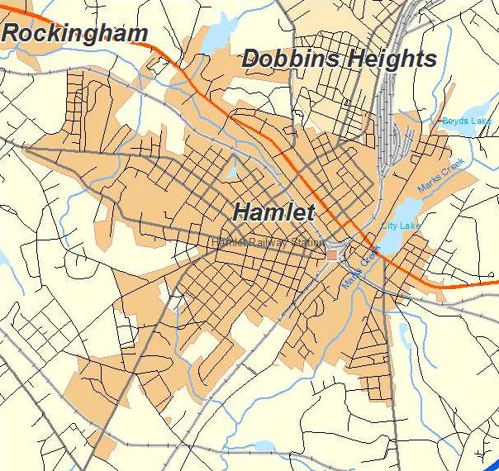
Effects on the city of Hamlet
Direct response to the fire cost the city of Hamlet
  $ 30,000 in policing expenses,
  $10,000 in lost firefighting equipment, and
  $ 8,000 in administrative costs.
The Imperial plant was permanently closed, with the loss of 215 jobs.
  By September 1992 it was estimated only 20 of the 54 survivors found new jobs.
A total of 49 children were orphaned.
The city of Hamlet declared itself bankrupt, so the court-imposed fine was never paid.
Over 15 government agencies & nonprofit groups coordinated the establishment of a Victim's Assistance Center to provide emergency aid & unemployment benefits to surviving workers & to victims' families.
Psychologists discovered high rates of anxiety & behaviors associated with post-traumatic stress disorder (PTSD) among survivors & victims' families.
Hamlet spent a total of $13 million from federal & state grants, both on cleaning up the site & on related efforts aimed at economic revitalization.
Race, class & gender played the core role in the tragedy.
Notes:
34 years after, what happened in this community to our fellow Carolinians remains an ongoing story. By 2000, some survivors had died from complications of their injuries. Others became addicted to drugs (including painkillers) and alcohol, and some became involved in intense domestic disputes over money
One group of plaintiffs sued Hamlet's municipal government, claiming that the fire department had failed to inspect the plant and that delays on the day of the disaster had contributed to the death toll.

Slide 13
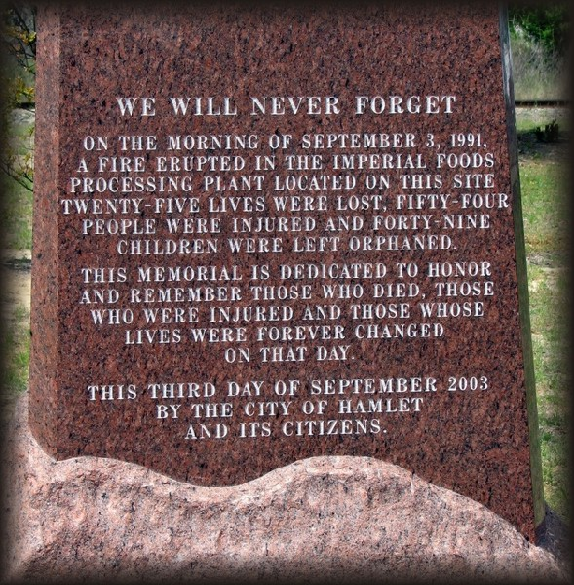

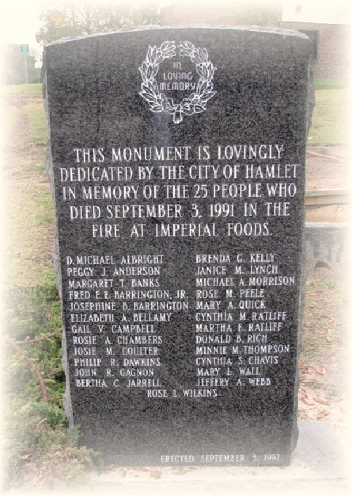
Memorials and Aftermath
Annette Zimmerman was the first of the two survivors to speak September 3, 2021, at the service, reading a poem she wrote for the occasion:
“ … Thirty years of tears.
Thirty years of pain.
Thirty years of anguish,
but none of it in vain.
The world took notice that day, our voices have been heard.
The injustices of this tragedy impacted workplace policies, word for word.
Who goes to work to die?
Not him, not her, certainly not I …”
Workers
Two separate monuments were erected
In 1994, USDA signed an agreement that inspectors would be trained to report “serious workplace hazards”. Inspectors were to report to USDA, who would report them to the OSHA.
But in the 30 years since the agreement was signed, no evidence was found that USDA has ever forwarded a written complaint involving worker safety anywhere in the nation to OSHA
30 years later, NC has 25 % of its 117 workplace safety inspector jobs vacant.
City
Notes:
Three decades have passed and memories have faded. While the deaths led to a reassessment of the state’s emaciated safety program and the hiring of dozens of new workplace inspectors, the reform momentum prompted by the fire is long gone. An Assembly review of 30 years of workplace safety data in North Carolina shows that several key indicators are moving in the wrong direction, making this a fraught time for the state’s workers.
In the last decade in North Carolina, inspections of non-construction worksites have been down by more than half. Twenty-five percent of the state’s 114 workplace inspector jobs are vacant, state Labor Commissioner Josh Dobson told The Assembly, well above the state government vacancy rate of 14.5 percent.
The number of workplace fatalities in the state has steadily increased during the last six years, rising to its highest level in almost two decades, according to the U.S. Bureau of Labor Statistics. At one federal agency, the lessons of Hamlet never took root.
While a state safety inspector had never visited the Imperial building, U.S. Department of Agriculture (USDA) food-safety inspectors were there every day to check on the quality of the chicken—and even approved locking a door to keep flies out.
USDA, which said it had no responsibility for workplace safety, relented under pressure. In early 1994, it signed an agreement saying its inspectors would be trained to report “serious workplace hazards affecting plant employees.” USDA inspectors were to report the hazards to their bosses, who would report them to the U.S. Occupational Safety and Health Administration (OSHA).
But that never happened. In the 27 years since the agreement was signed, The Assembly has found no evidence that USDA has ever forwarded a written complaint involving worker safety anywhere in the nation to OSHA.

Slide 14

Legacy
In 1992 a ceremony was held at Hamlet's City Lake marking the first anniversary of the fire.
Historian, Bryant Simon wrote that unlike the 1911 disaster, the Hamlet fire "didn't fundamentally change the conversation in the state or the nation.”
A memorial park, is located at the site of the former plant, which was torn down in 2001. The park consists of 25 steppingstones to represent each person killed.
This fire faded quickly from memory, unlike the enduring infamy of the Triangle fire.
The Hamlet fire remains a historic footnote, because to question & change the status quo would make life more expensive & less comfortable for the general public!
The cycle of tragedy, media & public outrage, cosmetic change, & a return to business as usual has played out so many times.
The tempting, cheap price tag doesn’t reflect the genuine, devastating human & environmental cost, of the fast-food industry, where workplace injuries are commonplace.
Wayne Goodwin insurance commissioner & fire marshal stated “The data suggest the lessons were briefly learned & now they are being unlearned or being allowed to fade into memory,”
Notes:
Unlike the Triangle tragedy that discredited the dog-eat-dog thinking of the Gilded Age and helped to usher in the Progressive Era of reform and regulation, the Hamlet fire didn’t change the larger conversation. It didn’t alter, at least not fundamentally, the set of ideas that allowed the fire to happen.
The underlying cause was an extremely intimidating climate that depended on a large labor pool in a community with high unemployment rates, overwhelmingly anti-worker policymaking, racist and classist disdain for Black and working-poor white workers, and a lack of jobs that paid above minimum wage.
Two separate monuments were erected due to a dispute. Many of the workers and their families wanted Jesse Jackson to speak in the city's memorial effort. Mayor Abbie Covington did not want Jackson involved and was backed up by many other local authority figures. One group of the survivors held their service which included Jackson. Both services unveiled near-identical monuments, which are situated just 50 yards (46 m) from each other.
It would be encouraging to conclude that the outcome of this terrible event was an improvement in the conditions for workers in factories like Hamlet; however, the major fire at a chicken processing plant in Jilin, China, as recently as 2013, shows that there is still work to be done. In this fire, 120 people perished behind closed, locked doors.
Never forget the workers in Hamlet who died because of greed. The Hamlet fire and its aftermath reveal the social costs of anti-unionism, lax regulations, and ongoing racial discrimination.

Slide 15
References
https://en Wikipedia.org/wiki/ Hamlet chicken processing plant fire.
Institution of Chemical Engineers, Loss Prevention Bulletin 260, April 2018.
The Hamlet Fire; A Tragic Story of Cheap Food, Cheap Government and Cheap Lives; Bryant Simon, The New Press, 2017; ISBN 978-1-62097-238-0
Chicken Processing Plant Fires, Hamlet, North Carolina, and North Little Rock, Arkansas, US Fire Administration/ Technical Report Series, USFA-TR-057/June/September 1991.
https://www.smithsonianmag.com/history/deadly-1991-hamlet-fire-exposed-high-cost-cheap-180964816/
https://www.osha.gov/etools/poultry-processing/plant-wide-hazards/fire-safety
You can read a 1,500-word article I wrote about this fire on my LinkedIn page.
https://www.linkedin.com/in/howard-spencer-530aa2191/posts

